Slide 1
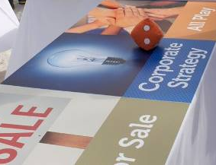
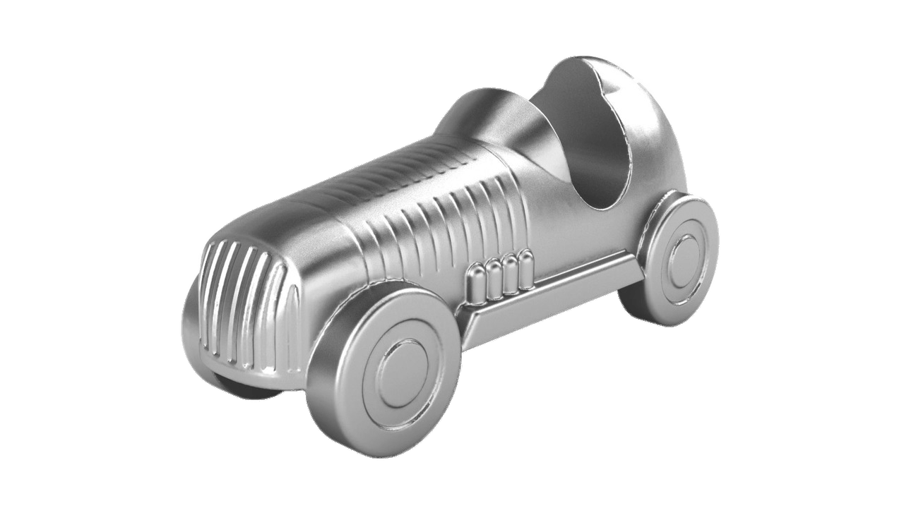
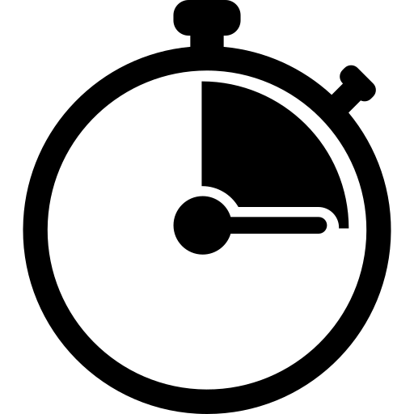



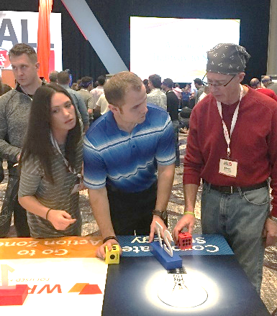
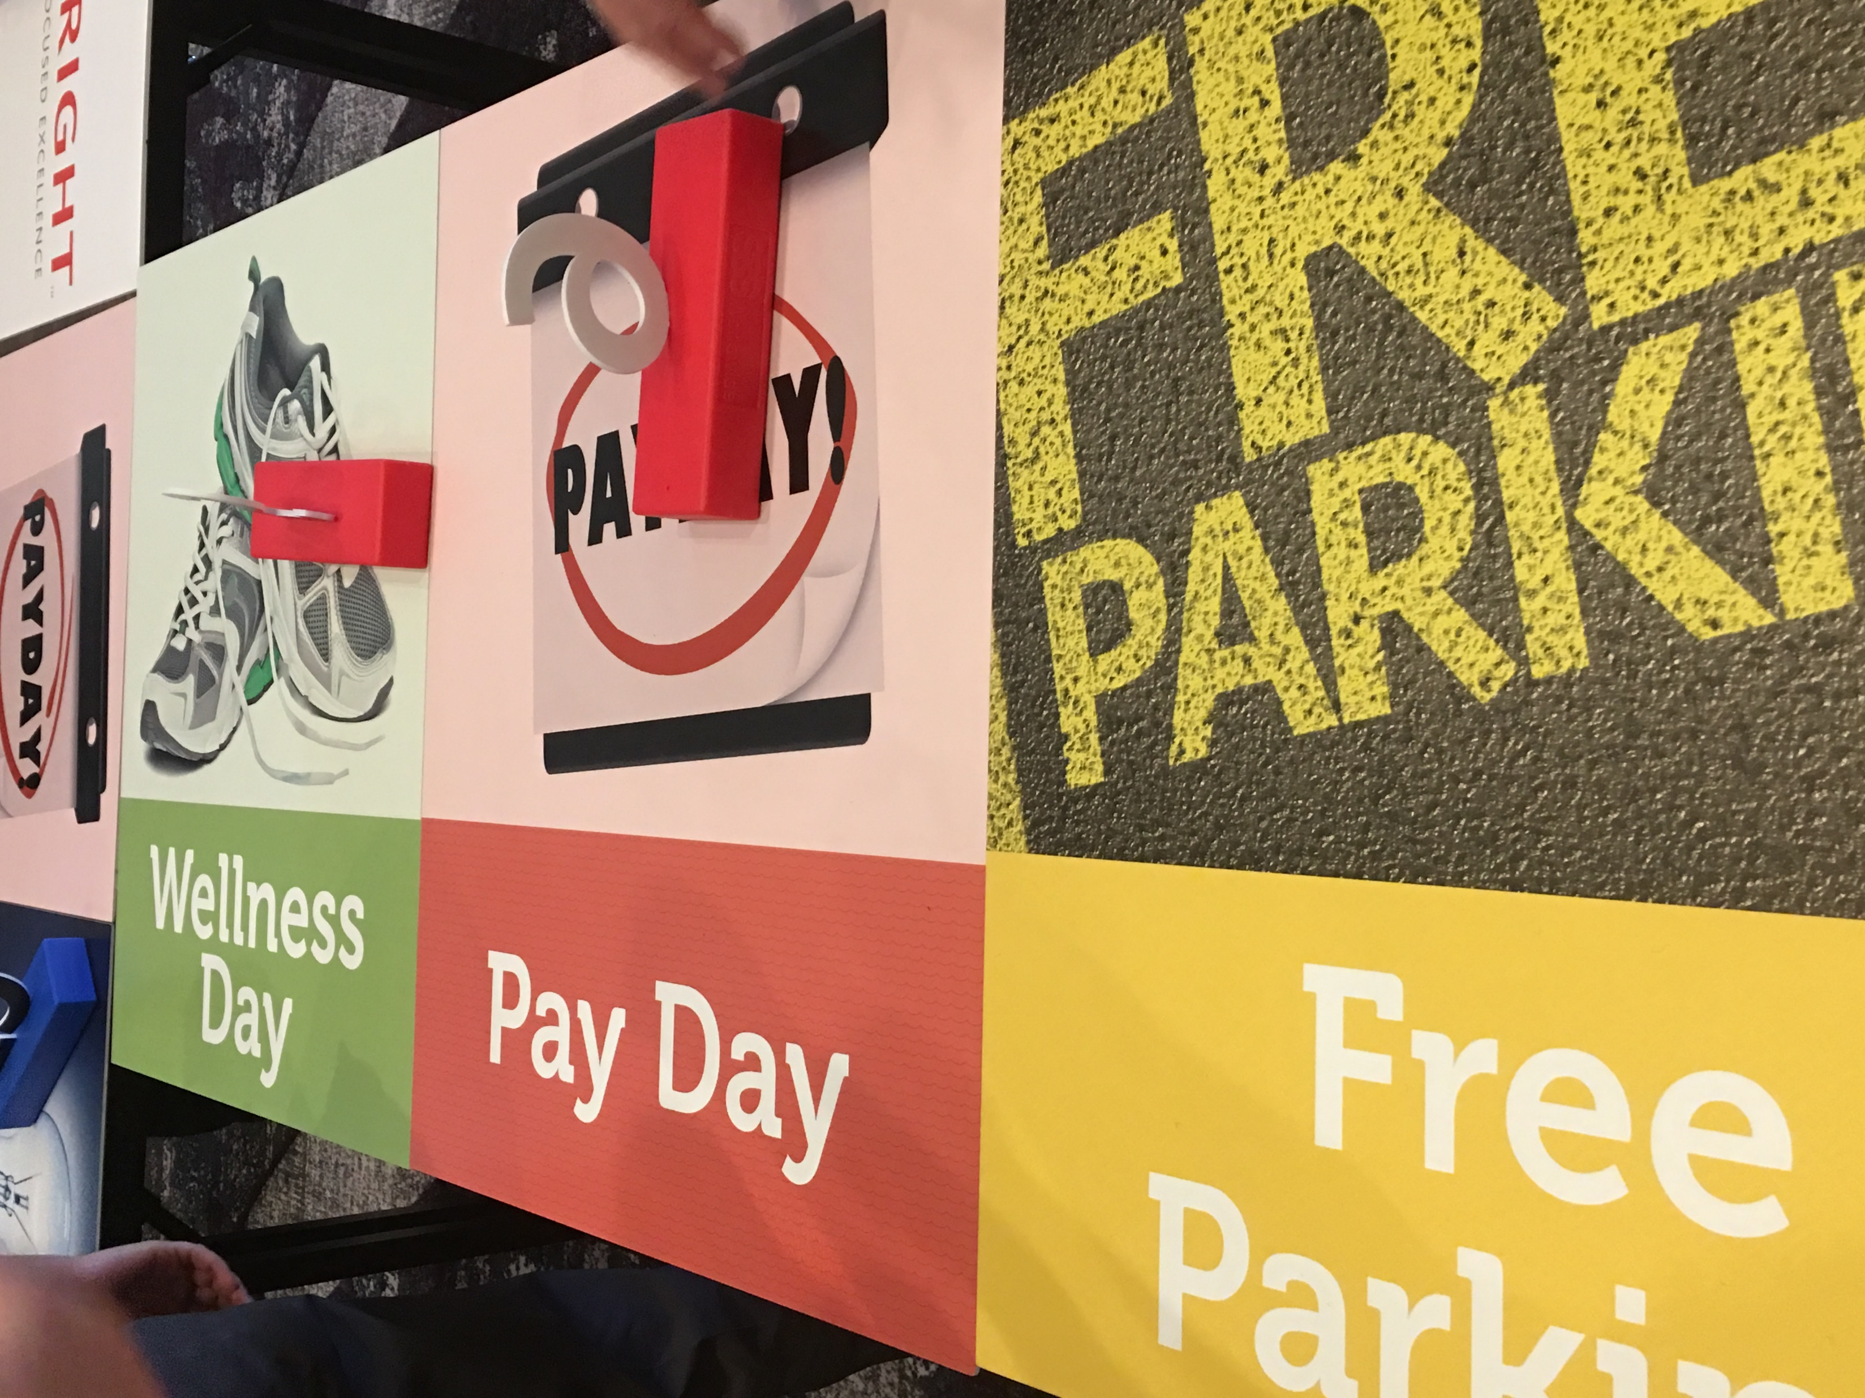
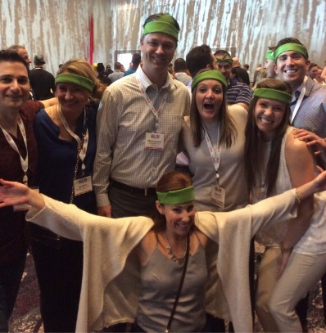

CORPORATE Game of LIFE
Risk It Big…or Play It Safe?
90min
120 min
Players 25 to
Unlimited
Indoor
Outdoor
Live
“You will learn about life when you play The Game of Life” went the original television advertising jingle for Milton Bradley’s Game of Life. The Corporate Game of Life charts new territory by making this version LIFE SIZED and giving it a spin that will deliver your business message in a way your attendees won’t soon forget.
COMPLETELY customized around your content, training and messaging, the game is designed to engage your guests in the material. Built to immerse them in the learning, they experience different perspectives and insights, focusing on how to apply the knowledge as opposed just recall it.
For fun, teams maneuver around the board in their hand-built car. It takes good decision making, problem solving, sacrifices and teamwork to make it through – each stage allowing for an experience that will teach them something about your content. The intentionally designed challenges embed your learning. Through the games it is internalized, remembered and used long after the meeting is over. Your guests will say THANKS for putting an end to dull, dry, boring learning programs!
Intro
90 Minutes
Game Play
Debrief
Awards

