Slide 1
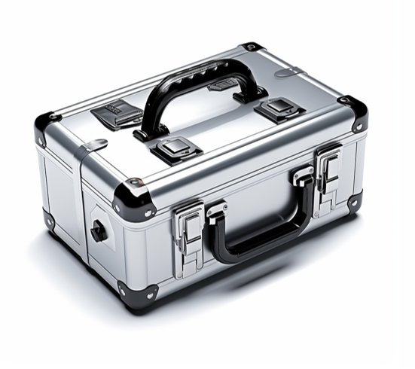
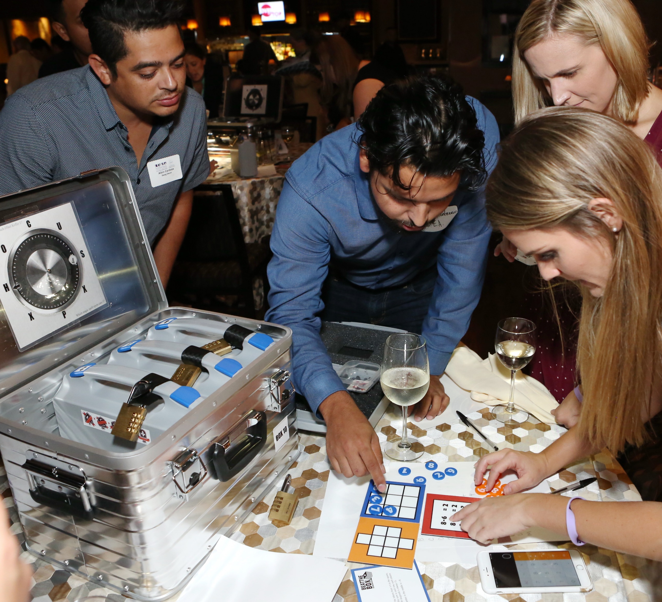
The
Box
"Crack the Codes; Unite as Victors!"
75min
120 min
Players 15 -500
Live
Indoor
Outdoor
Immerse yourself in an adrenaline-pumping collaborative adventure with our thrilling game of teamwork and brain-bending challenges, "Beat the Box." As a mysterious voice beckons, teams must race against the clock, unlocking cases, cracking codes, and solving puzzles in a high-pressure environment. Armed with only locked aluminum boxes, they embark on a quest unraveling a series of cryptograms and mysteries to reach the final puzzle.
Success reveals the ultimate code, stopping the countdown and securing victory. "Beat the Box" offers an exhilarating, brain-stimulating, and unforgettable experience that fosters teamwork, problem-solving, and strategic thinking skills. This immersive game promotes collaboration, resourcefulness, and the importance of leveraging diverse skills for success. Unlock the excitement of "Beat the Box" .
Intro
90 Minutes
Activity
Debrief

