Slide 1







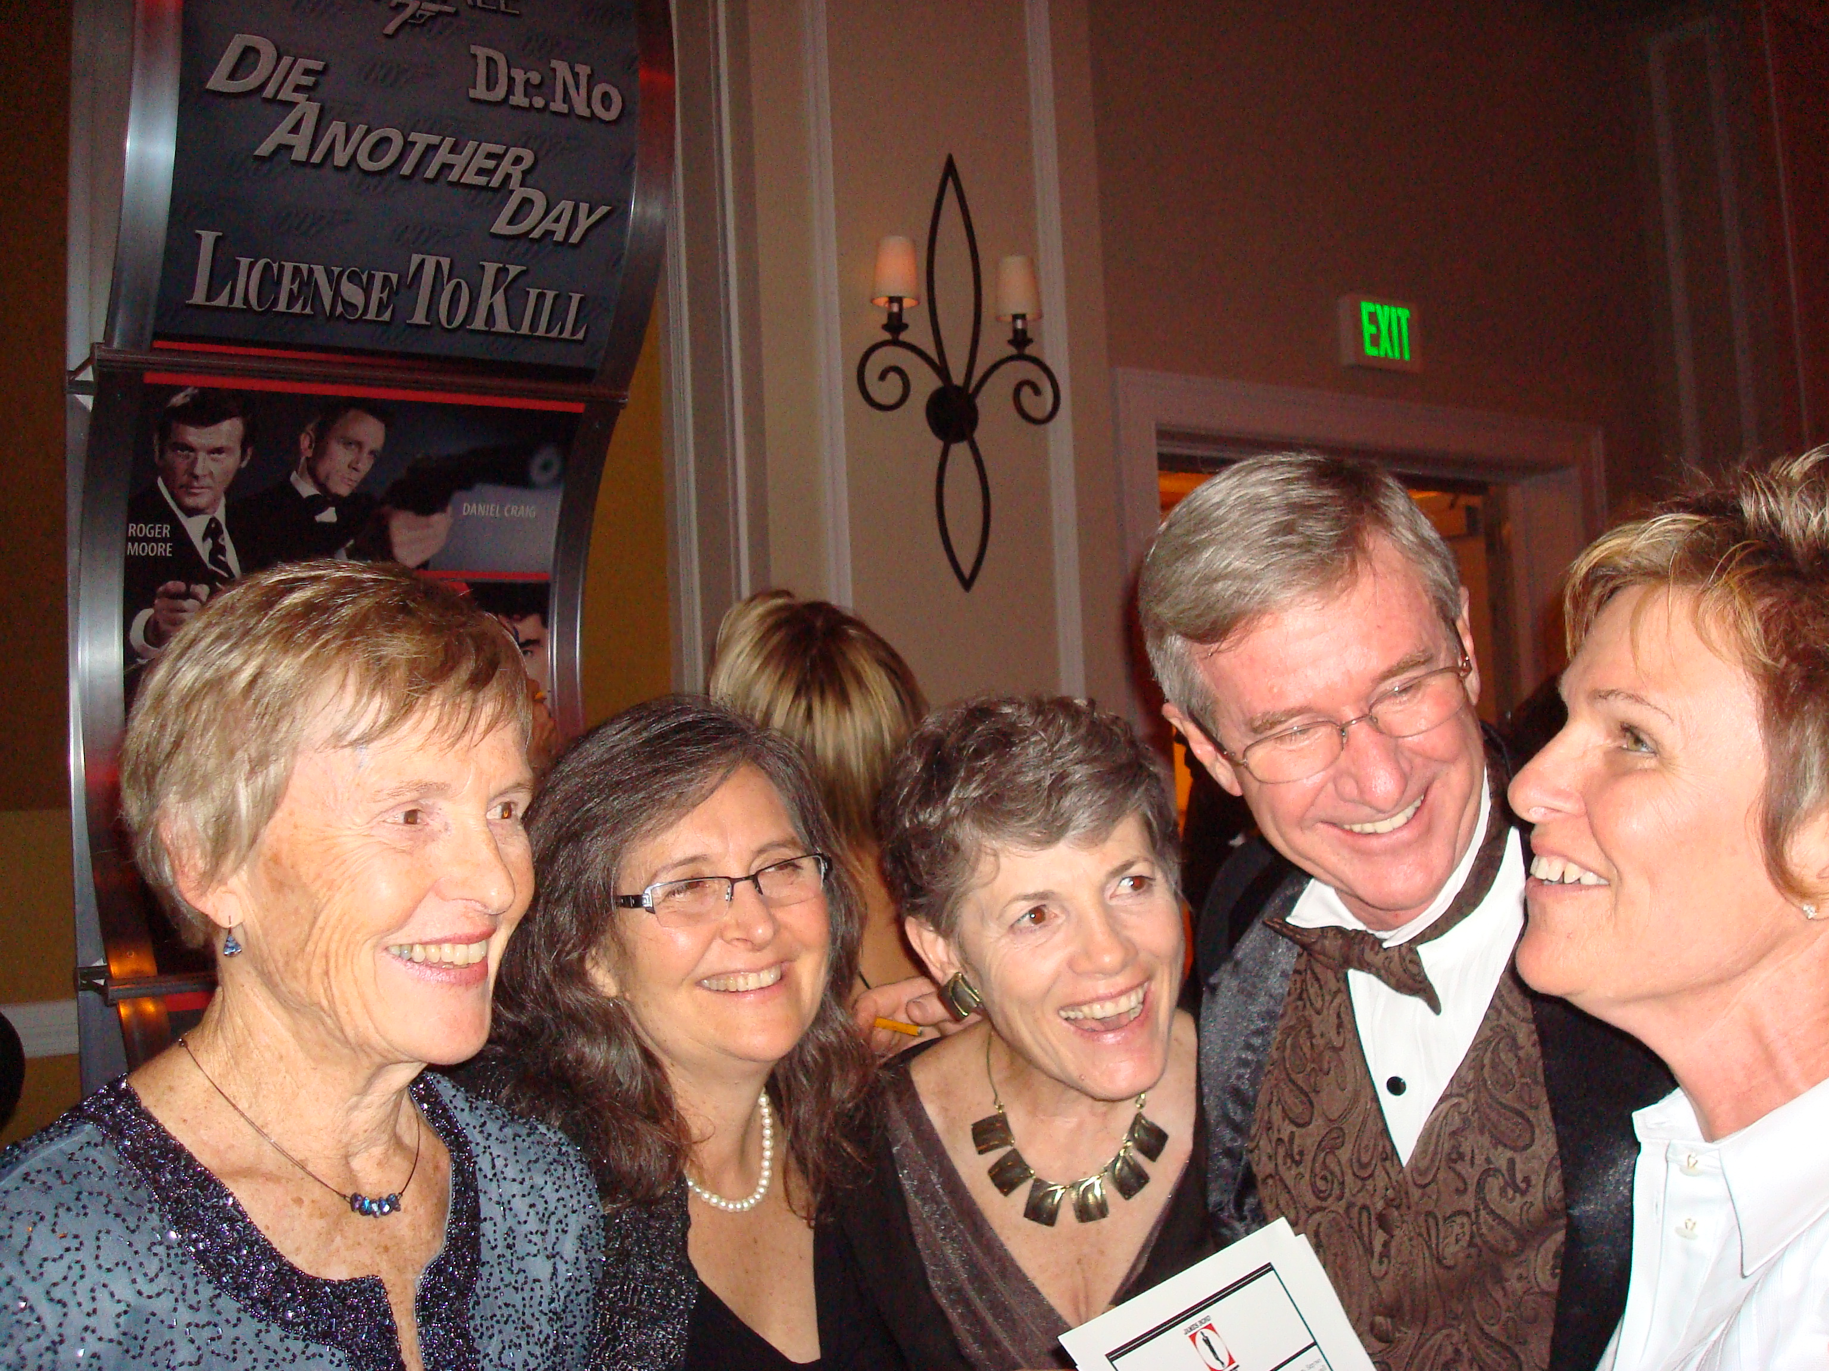
Mystery
Mystery
Mingle
The rumors are true!
60 to
90 min
Players 20 –
Unlimited
Live
Indoor
Outdoor
As one of the celebrated, you’ve been invited to an incredible event. But just before you arrive, your hostess is murdered - and the killer may be planning to end the life of another. Whatever the motive -- greed, jealousy, or just plain nastiness -- the killer must be identified and stopped before it's too late!
Using detective cards and suspect lists, your job is to uncover not only the murderer, but potential murder weapons and the location. Guests are privy to hidden clues, which they can choose to share or keep close to their chest. Their task: mingle with their fellow attendees to solve the clues and figure out the crime master! Could it be Dr. Bluecoat, or maybe Mr. Money? Or one of the devilish ladies who aren’t who they pretend to be?
Mingle, meet the suspects, question everyone – you must clear yourself of all wrong-doing!
Intro
60 Minutes
Activity
Awards

