Slide 1
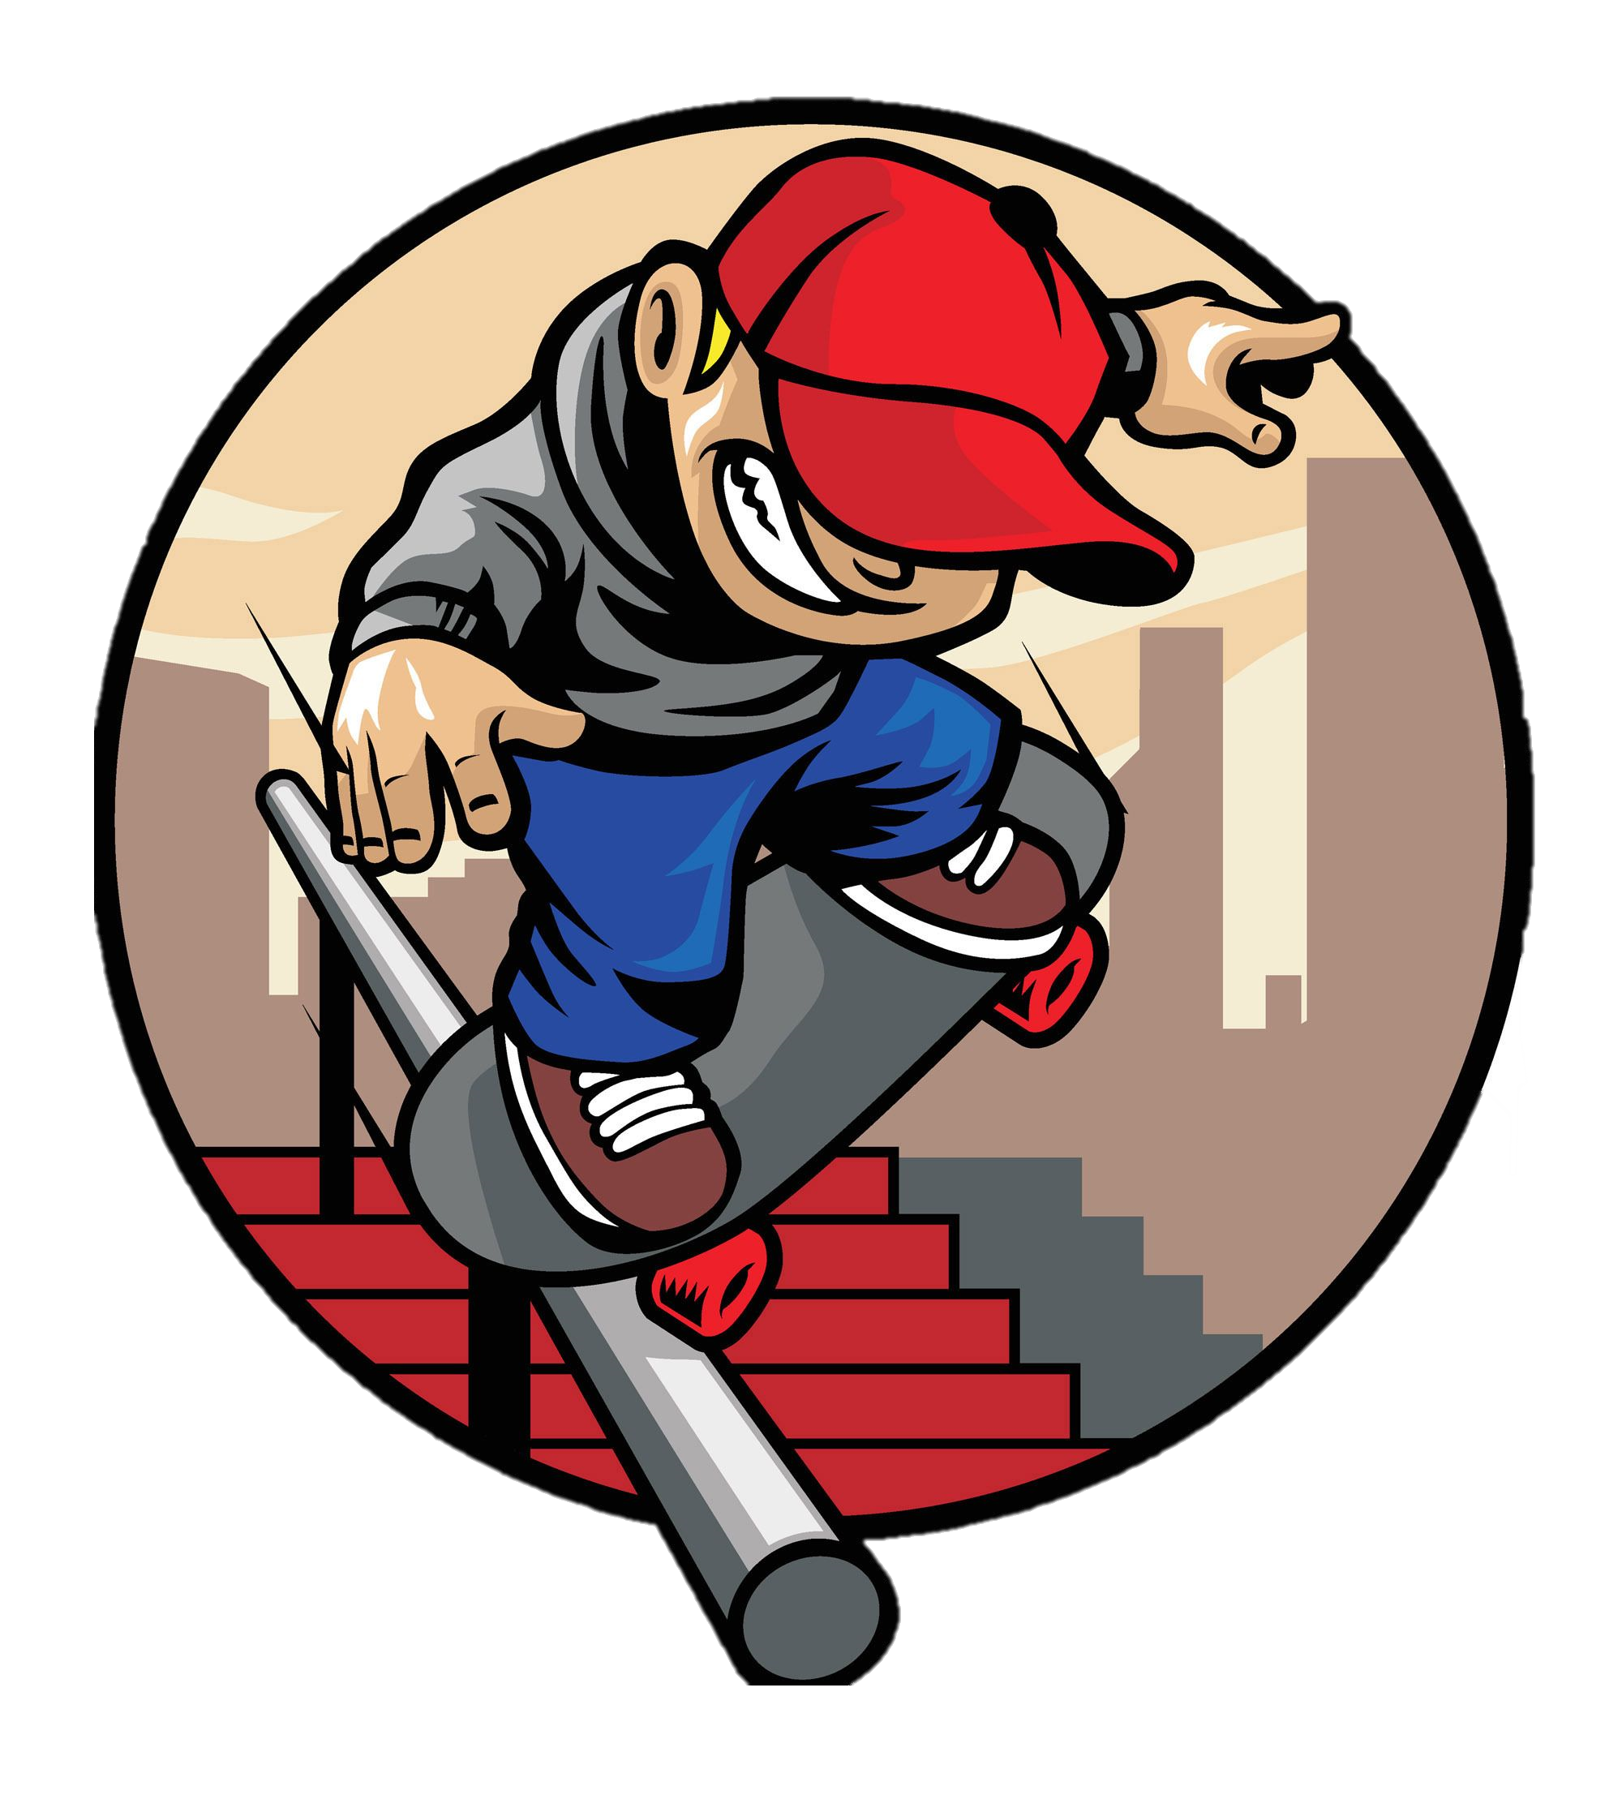




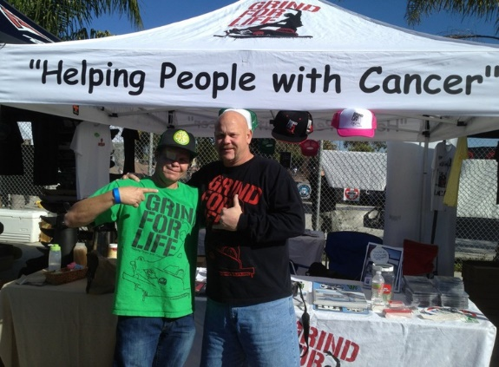
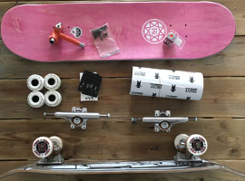
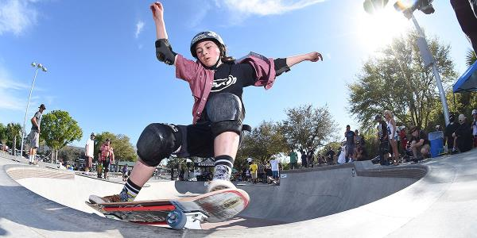
Hop-A-
BOARD
Where Dreams Take Flight on Four Wheels!
60 to
90 min
Players 10 –
Unlimited
Live
Indoor
Outdoor
The Skateboarding Community is unique – it truly sees no gender, race, age or sex and is one of the most inclusive sporting groups around. They believe that the freedom, cultural diversity and friendships developed from skateboarding are invaluable. Putting skateboards under kids feet allows them to roll towards positive opportunities and a happier, healthier life.
A video of kids skateboarding and having fun grinding (a skateboarding move that involves the skateboard trucks sliding along an edge or surface) on the full pipes, verts, coping, decks and ramps kicks off the design of cool and artsy skateboards. Then you’ll meet our charity rep from Grind for Life, a boarding organization that not only donates skateboards to kids but hosts skateboard competitions to raise money for people with cancer that are in desperate need of having travel to their treatments covered!
Intro
Icebreaker
Demo / Video
75 Minutes
Building
Charity Speaks
Group Picture/
Goodbyes

