Slide 1
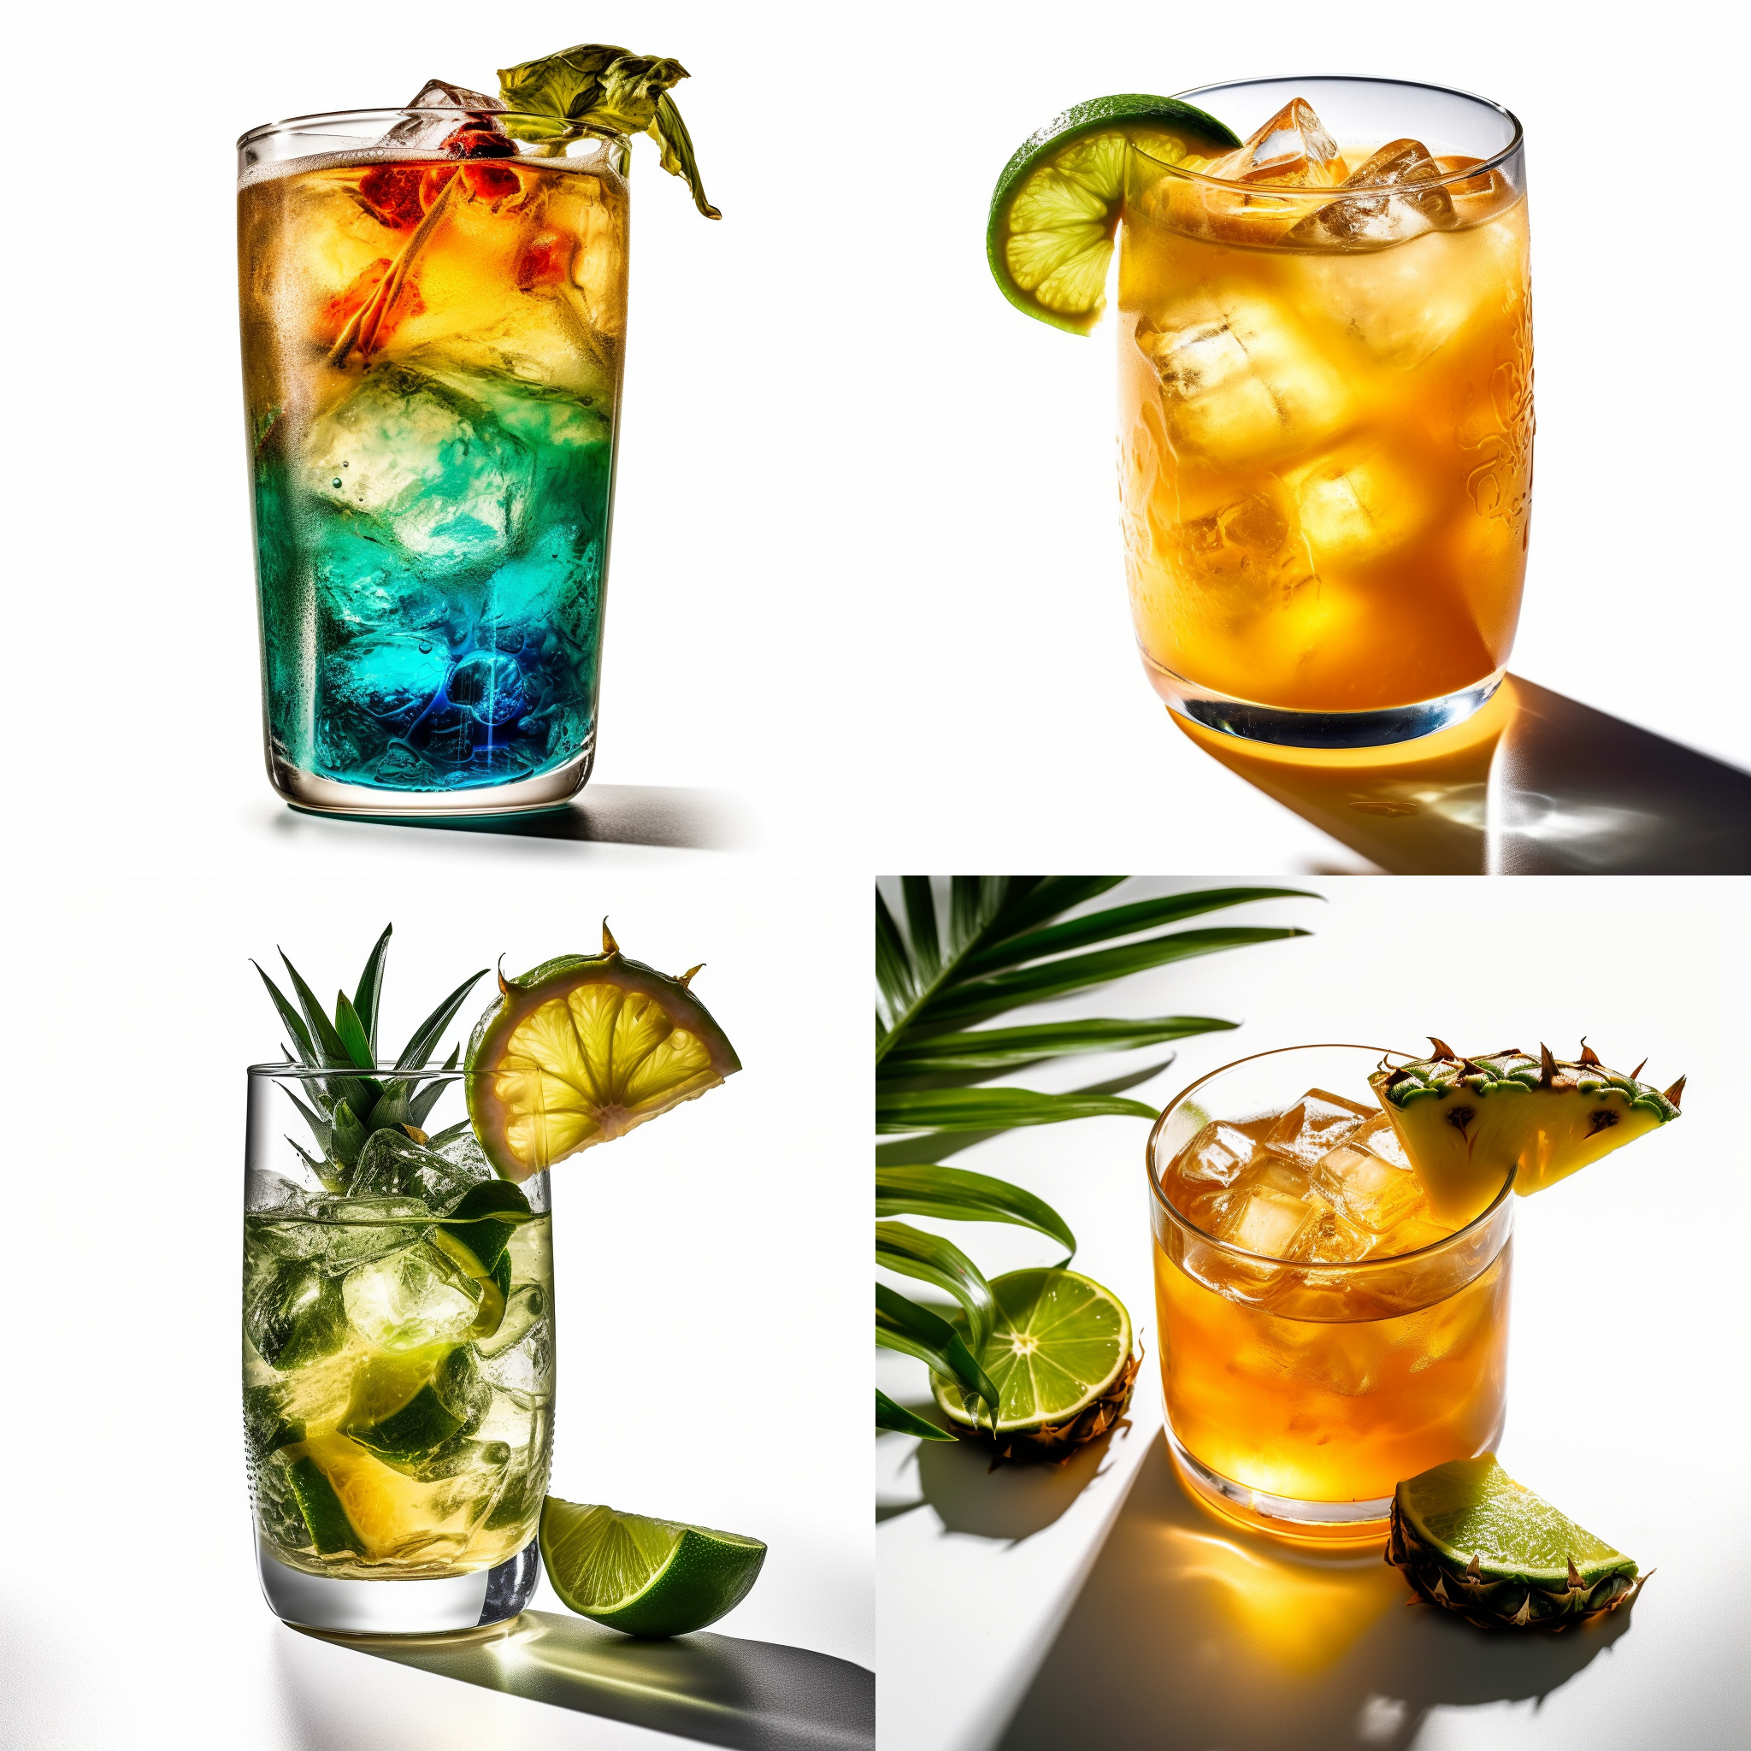
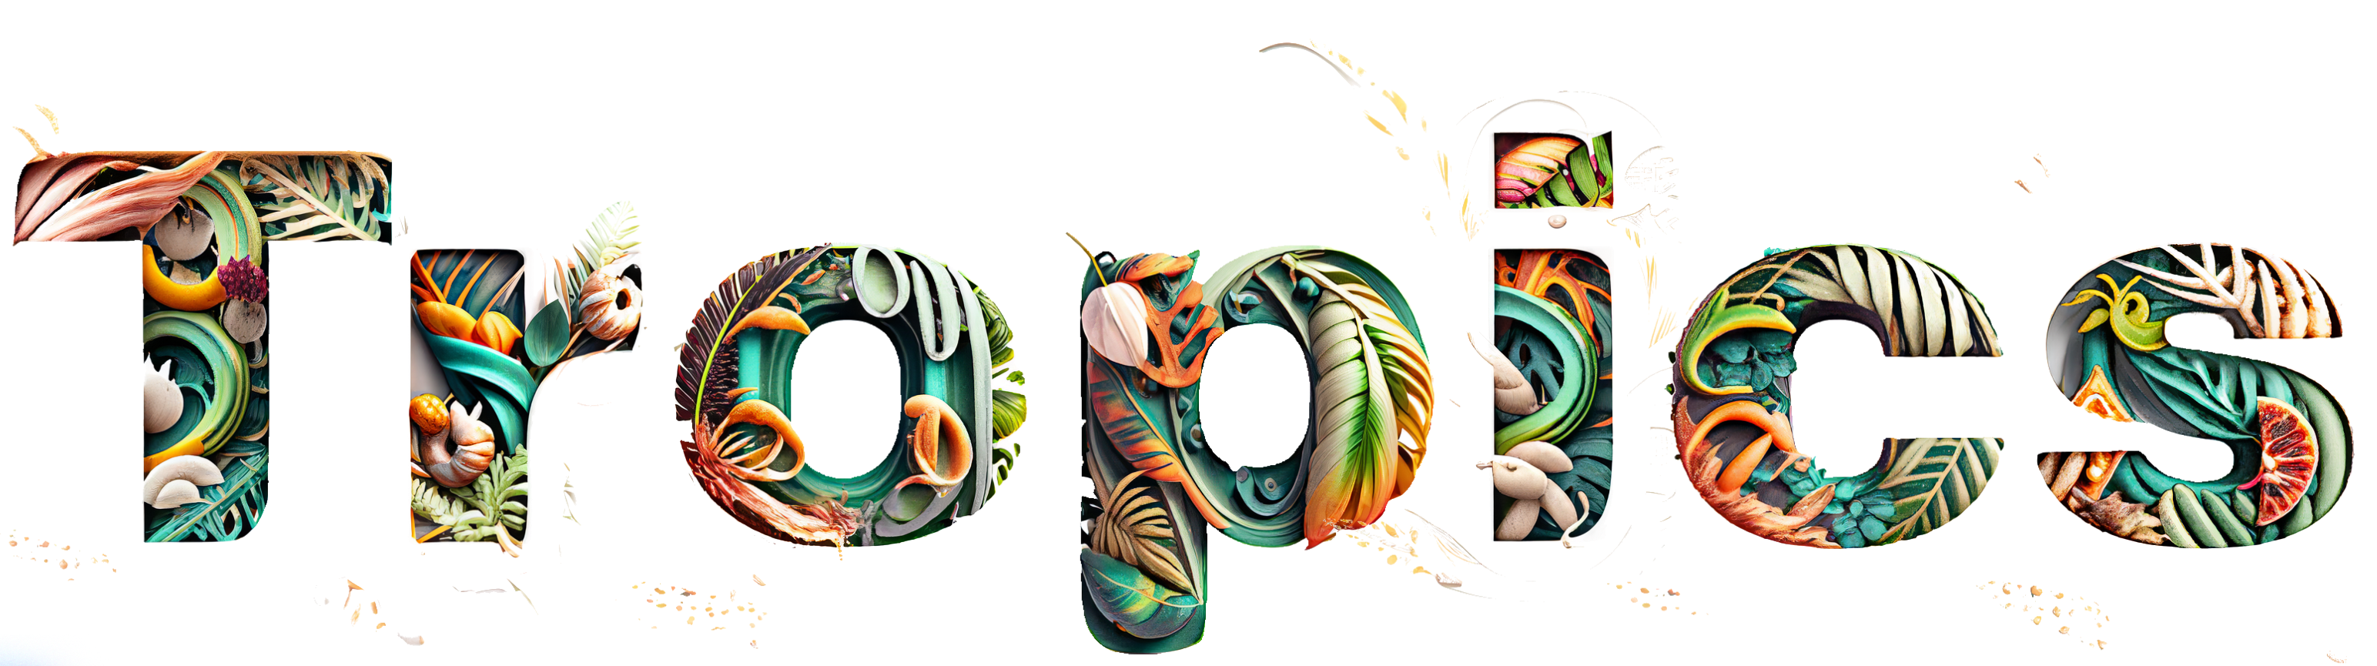




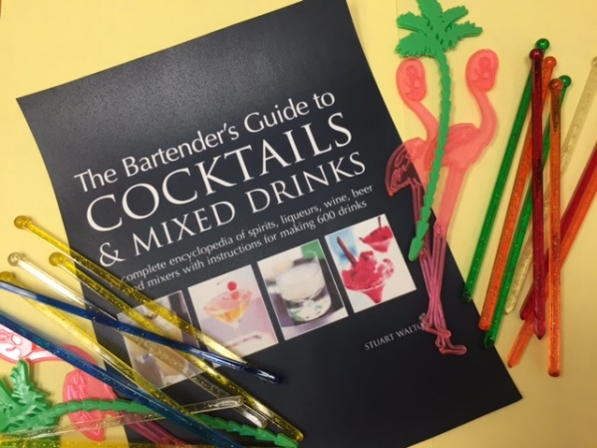
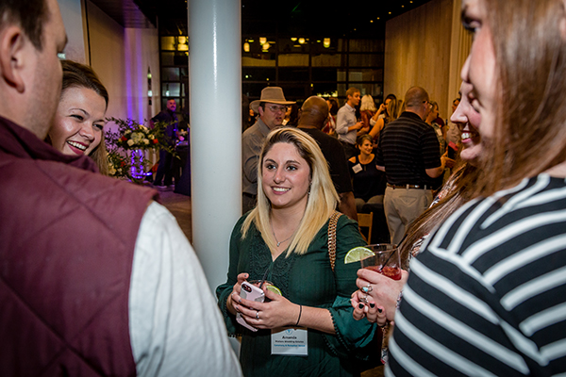
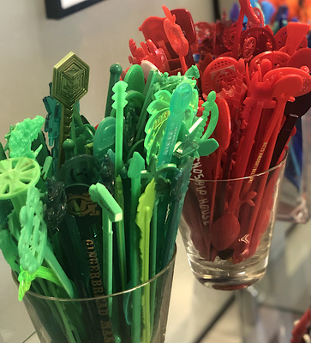
TASTE
Of the
Stir Up New Conversations!
60 to
120 min
Players 20 –
Unlimited
Live
Indoor
Outdoor
The lazy spirit of the tropics makes everyone think of a tall, cool taste-tempting tropical drink. Ever wanted to be a bartender concocting “Mud Slinger,” a “Grasshopper,” a “Salty Dog,” or a “Bushwacker?” Well, this fun mixer gives you the chance to try it out for a while as you and your colleagues come together through the “Scotch Mist” for a “Night Cap” before the “Tequila Sunrise.”
Guests all take on an alternate identity - as one ingredient of a drink. Mingling around the party are maraschino cherries, gin, creme de cocoa, ice cubes and other necessities of bartending. The object is for them to meet up to find one or more ingredients that combine with them to “make” some type of drink. Meet the most people, earn the most stir sticks and go home a winner! (Note: No actual drinking is included in this event.)
Welcome
60 Minutes
Activity
Awards

