Slide 1
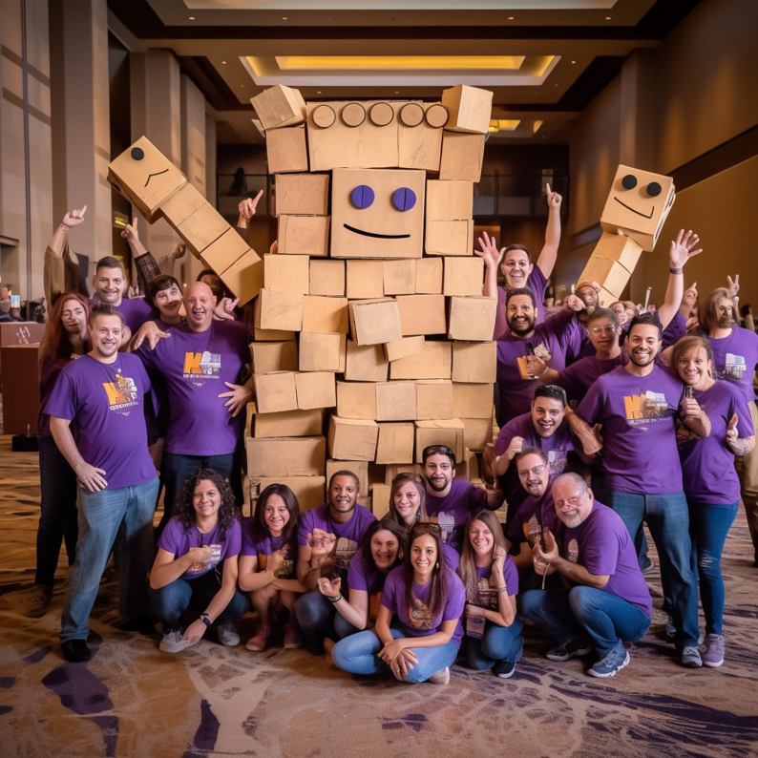
In the
ROOM
Where Fun Meets Fear!
60 to
120 min
Players 10 –
Unlimited
Live
Indoor
Outdoor
Join us for a thrilling event where fun and fear converge, unlocking your team's potential! Collaborate in teams to construct cardboard monsters representing workplace issues, each with a unique superpower as the solution. Identify problems, craft stories, and design innovative monsters to creatively address these challenges.
Through teamwork and creativity, participants will tackle workplace issues head-on. Using cardboard as the primary material encourages resourcefulness and out-of-the-box thinking. Teams visually represent challenges by bringing their monsters to life.
Monsters possess distinct superpowers, symbolizing creative solutions. Teams brainstorm and select relevant superpowers, fostering imaginative problem-solving. Craft compelling stories around monsters, adding depth and highlighting the transformative power of superpowers.
Monster in the Room offers an immersive experience, fostering collaboration, creativity, and fearlessness. See what monsters YOUR team lets out of the closet!
Intro
Icebreaker
Strategy Stage
90 Minutes
Building
Present Builds/Judging
Awards

