Slide 1
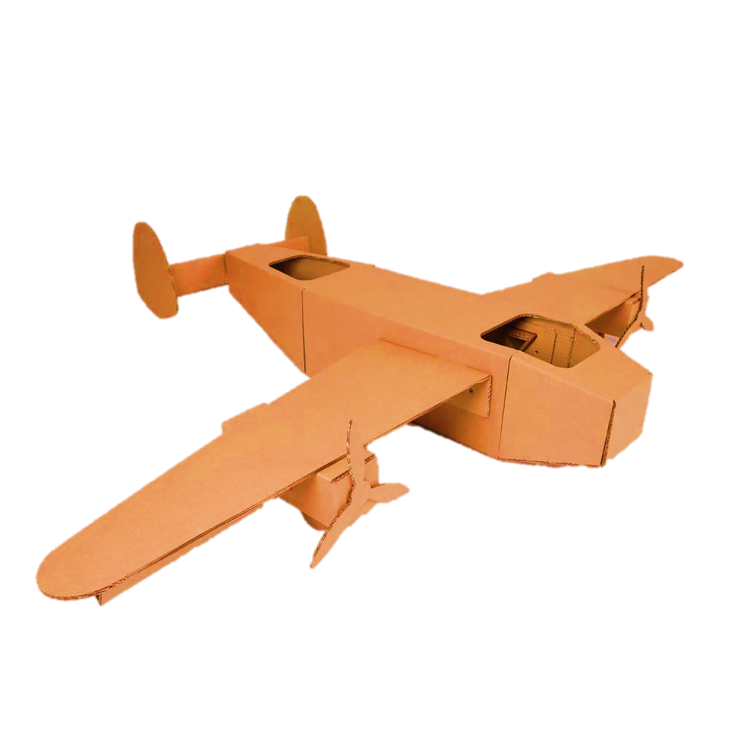
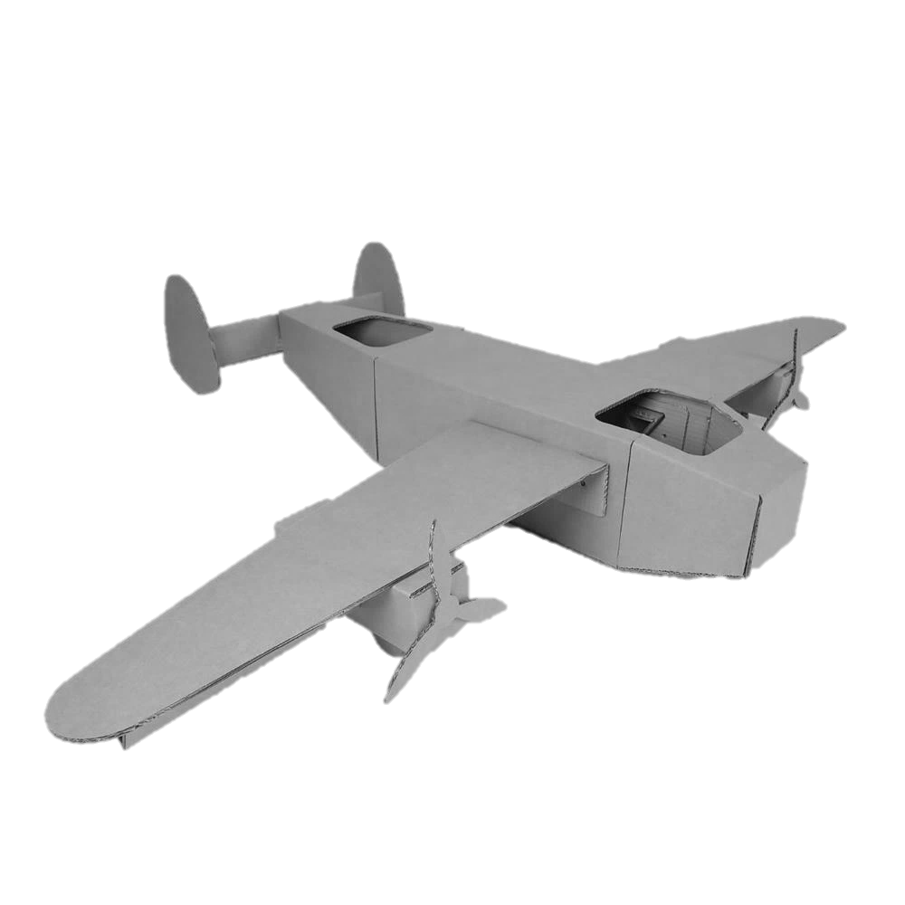
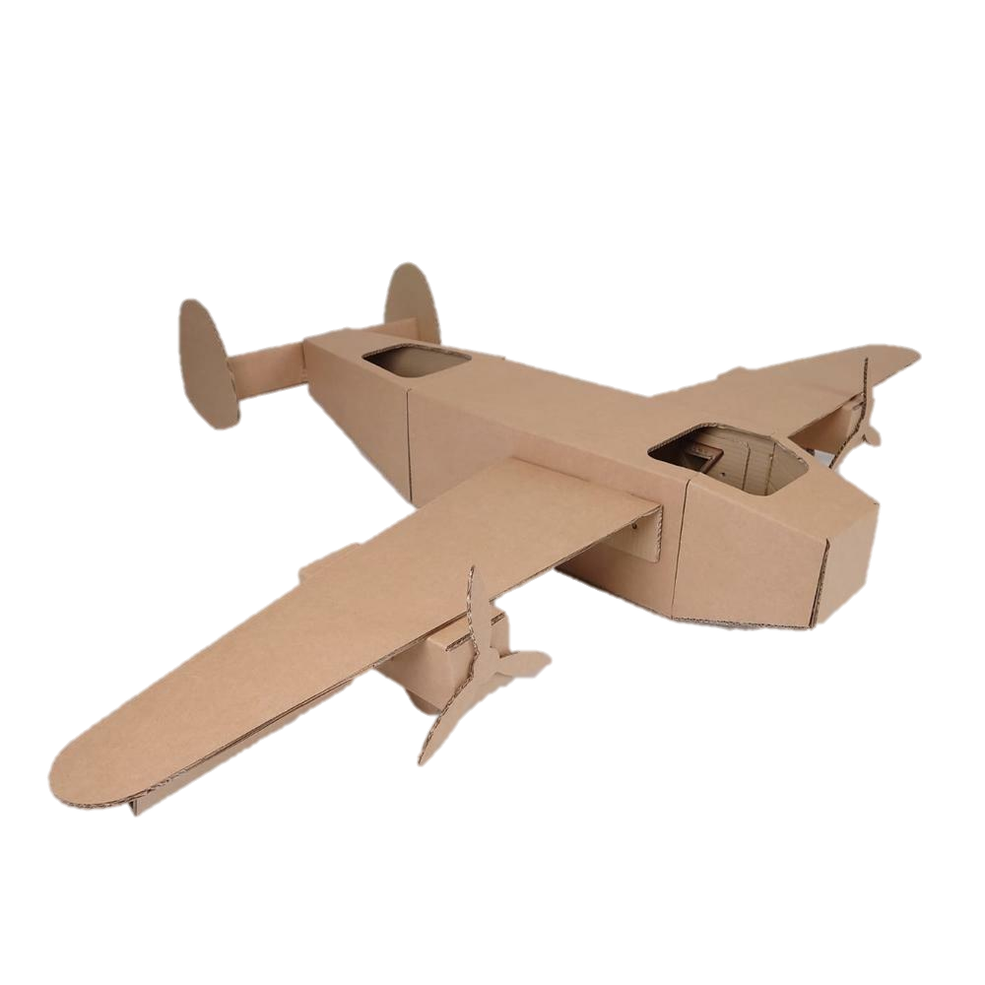
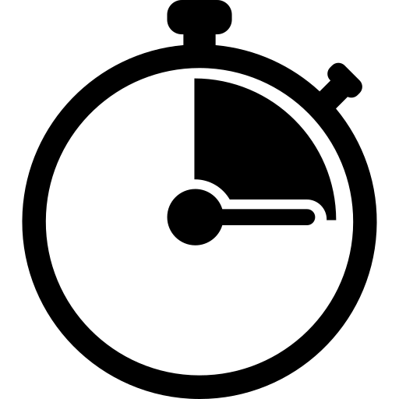


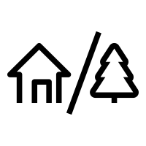
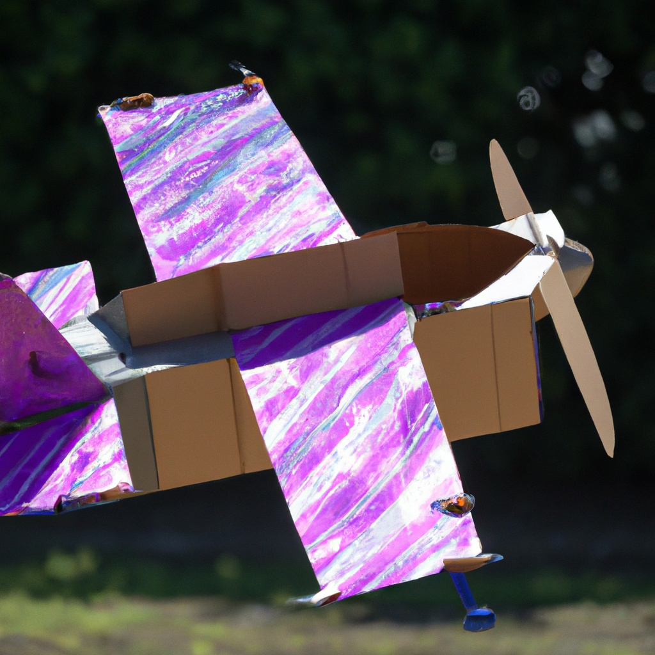
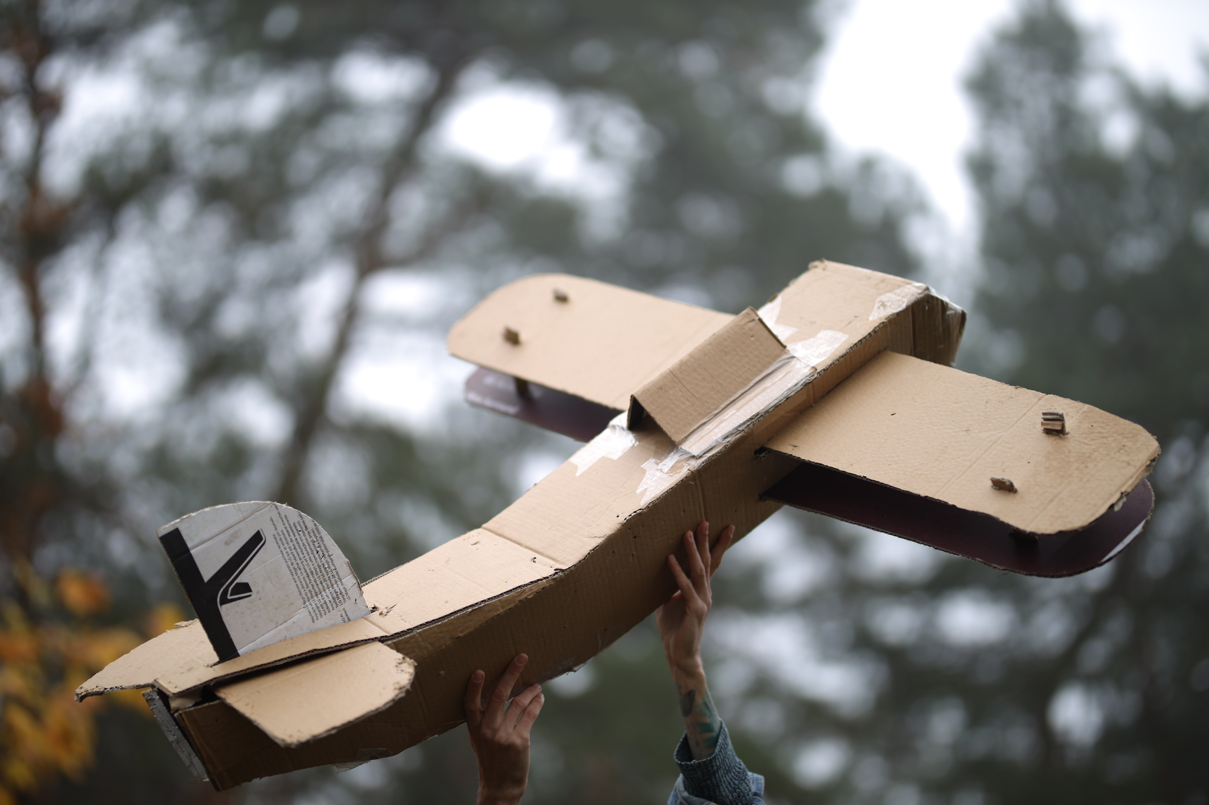
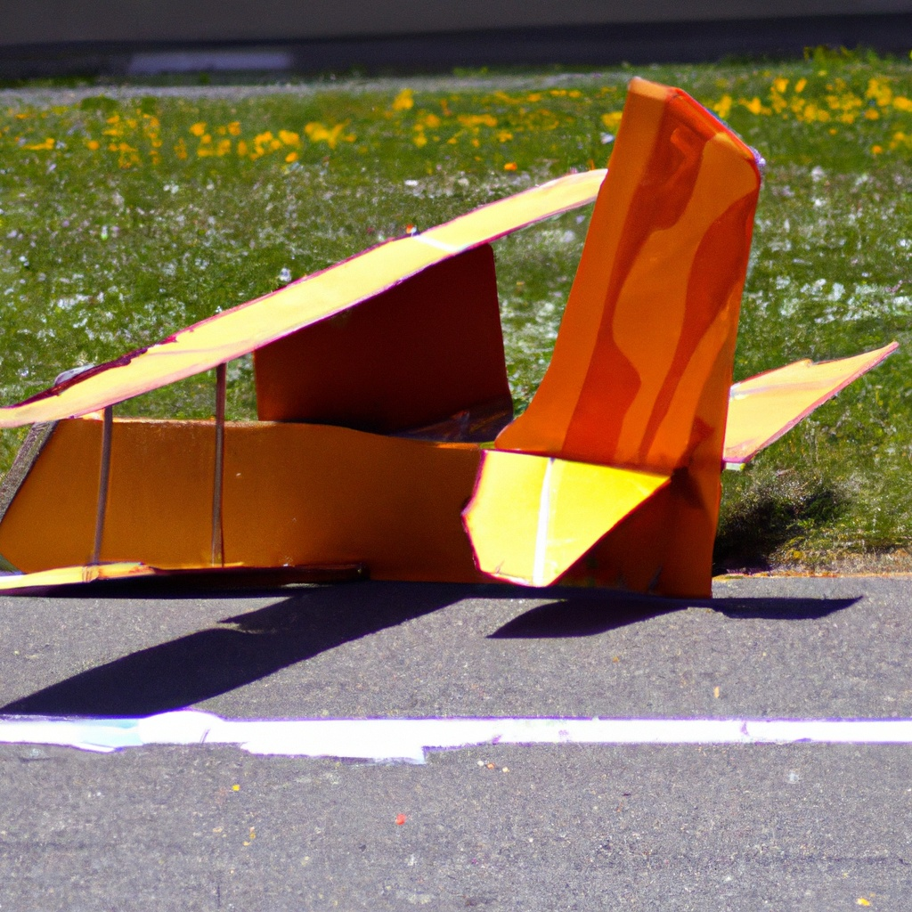
FLUGMASCHINES
Take Flight! Achieve The Impossible!
90min -
120 min
Players 10 –
Unlimited
Live
Indoor/
Outdoor
Prepare for an exhilarating airborne adventure! This (insurance approved) take-off of the RedBull Flugtag immerses you in a captivating atmosphere of nail-biting competition. Filled with airplane-themed music and realistic sound effects, the competition makes for an entertaining spectacle.
Flugmaschines is an event where teams create homemade, extra large flying machines to be set soaring from a launcher off a platform. They attempt to fly or glide for the longest distance before landing (or crashing) on the flight pad. Expect a thrilling range of outcomes, as some planes may achieve impressive distances while others meet a more rapid fate. Teams will be evaluated based on multiple criteria, including the distance traveled, the style of their aircraft, the creativity of their crew and the accuracy of their pilot's landing.
This event promises to put your creativity and engineering skills to the test, while simultaneously providing an abundance of laughter and amusement. Get ready for an unforgettable experience that will engage your ingenuity and leave you in stitches!
Intro
90 Minutes
Building
Competition
Awards

