Slide 1
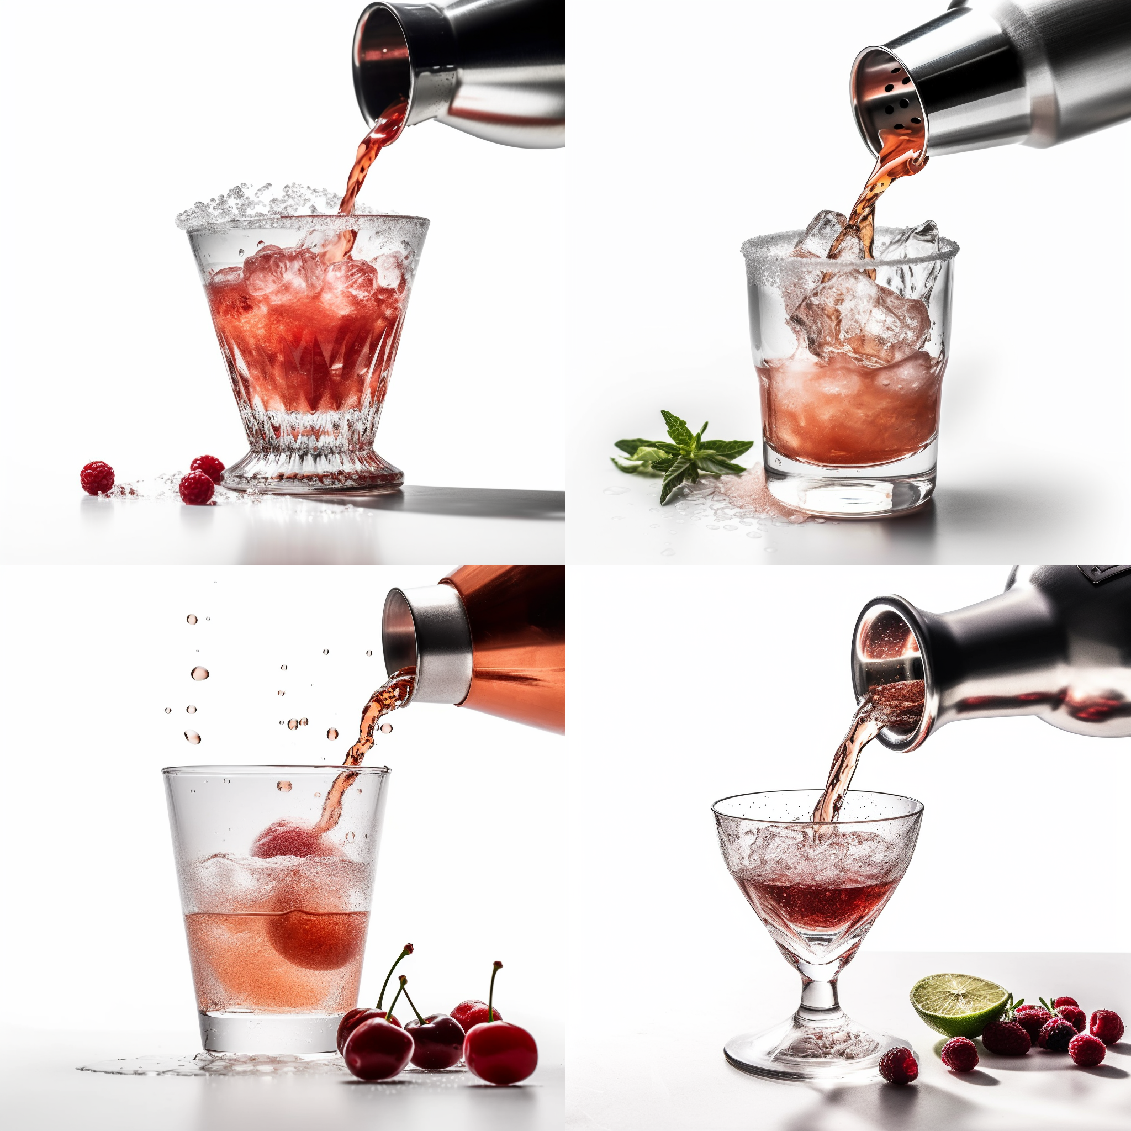
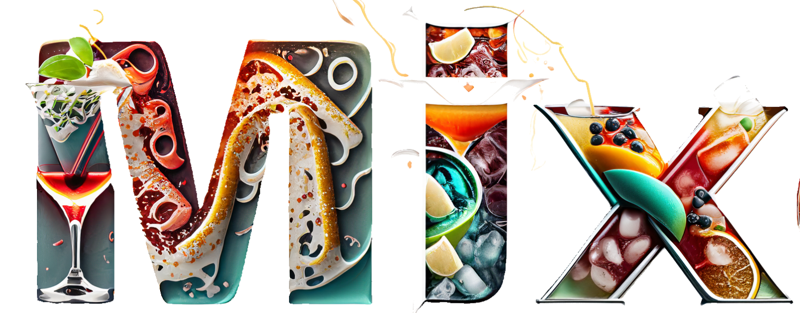
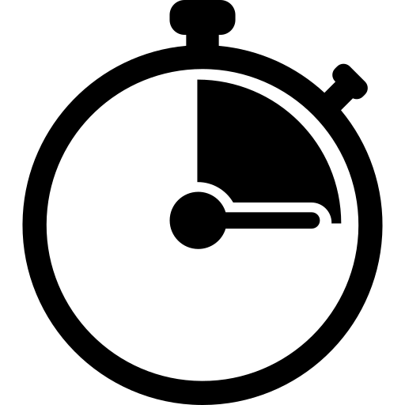


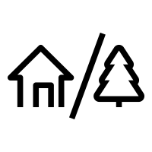
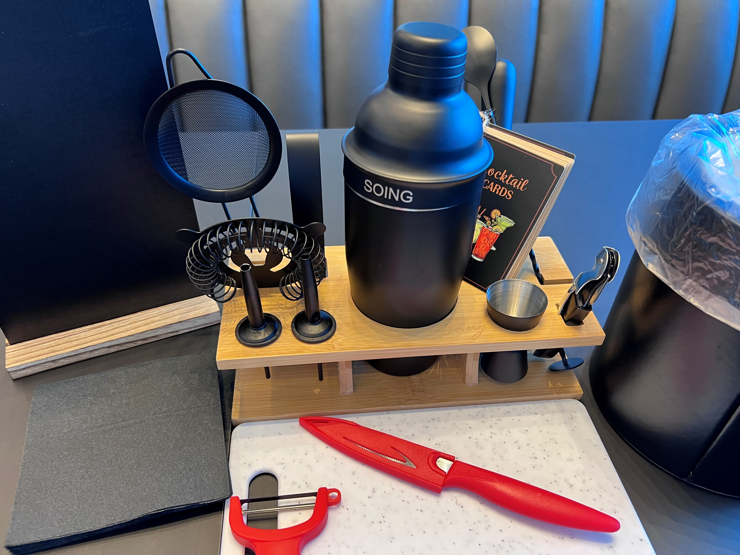
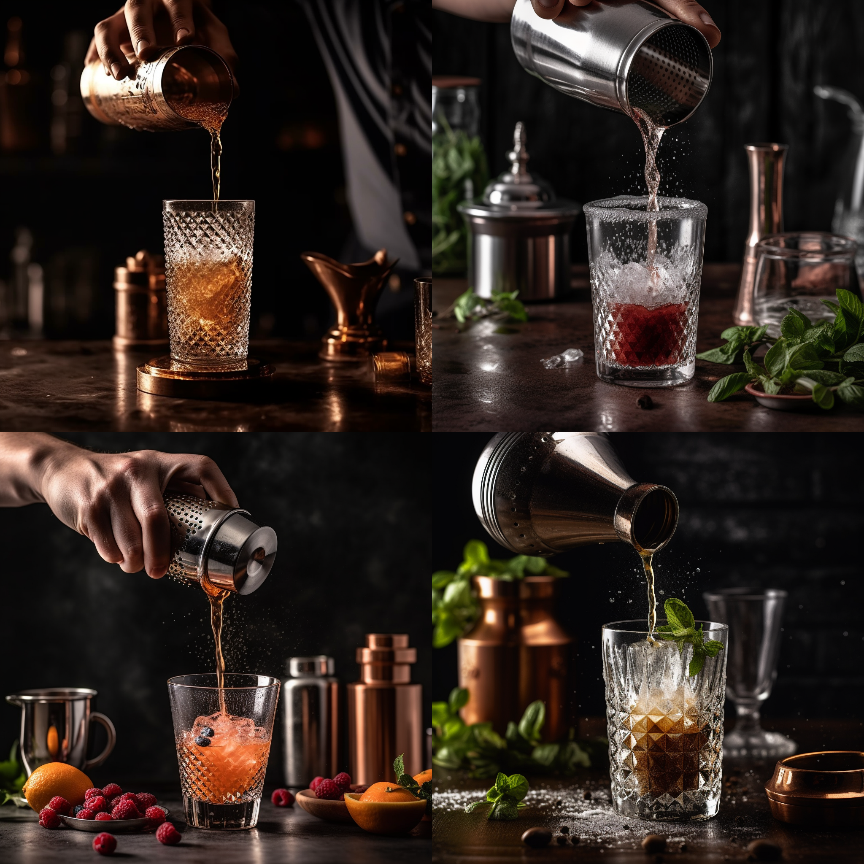
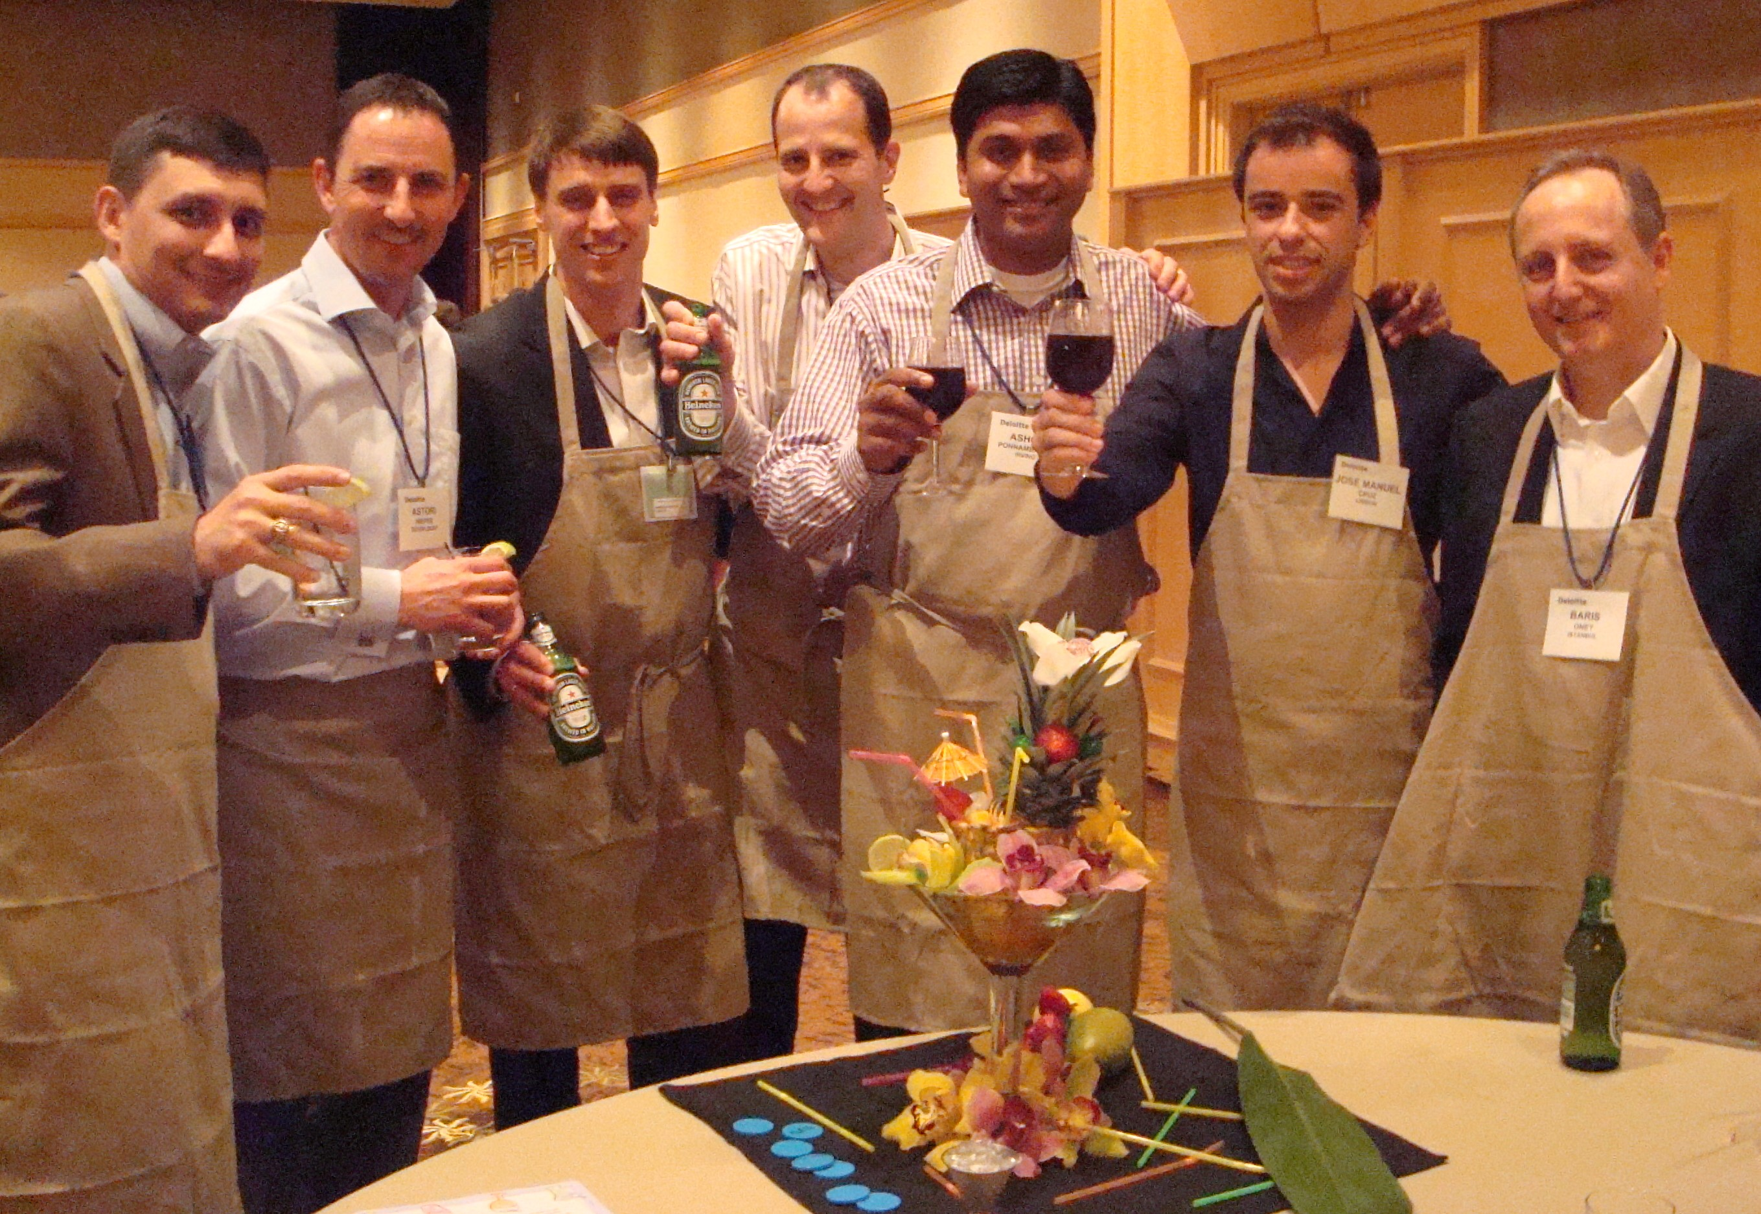
-OLOGY
You Call the Shots!
45 to
90 min
Players: 10 to
Unlimited
Live
Indoor
Outdoor
It’s the end of a productive day of learning, listening and thinking. Now it’s time to cut loose with Mixology ~ where you turn from ordinary business associate into one of the country’s hottest mixologists and conversationalists! Bartender aprons separate the teams for a tasty competition of creativity, resourcefulness and of course presentation.
As you dive into cutting, slicing, icing, mixing, designing, blending, and blinging their drinks, you’ll build relationships, get some useful networking tips, share laughter, and get to know more about your teammates.
Once all the competitors are done shaking, stirring and blending to a supremely first class level, the judges take over and the points are tallied. Awards are given for Top New Drink, but of course bragging rights and a delicious new drink to share with friends at home are more revered!
Intro
60 Minutes
Activity
Awards

