Slide 1
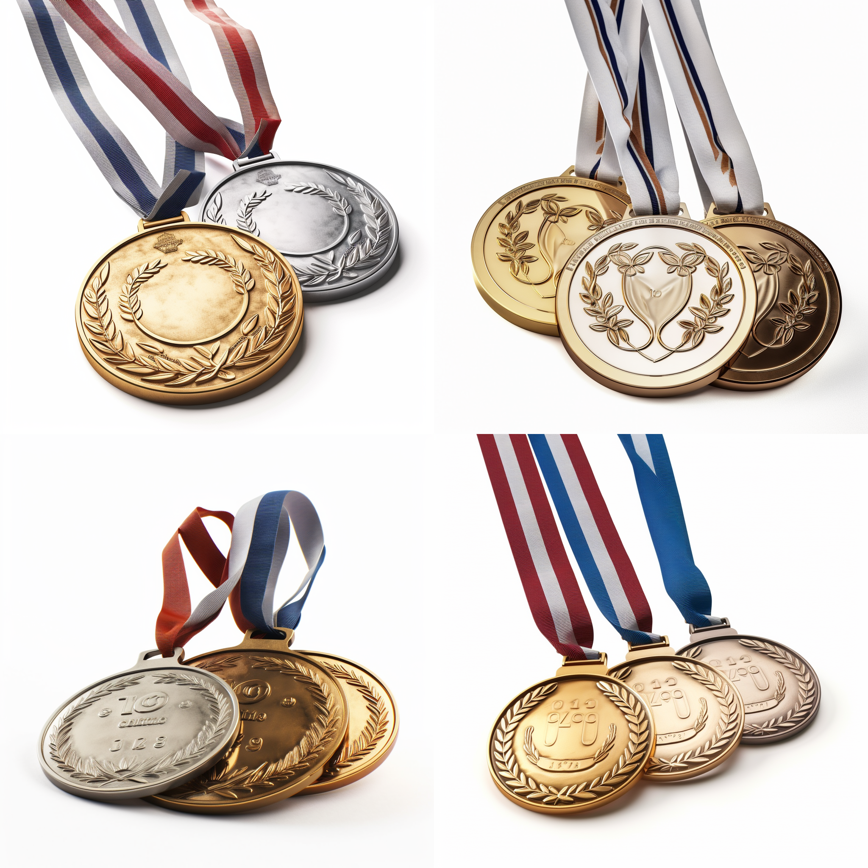




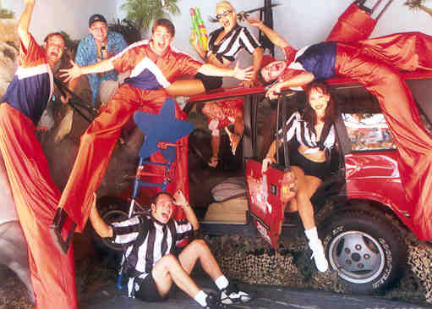
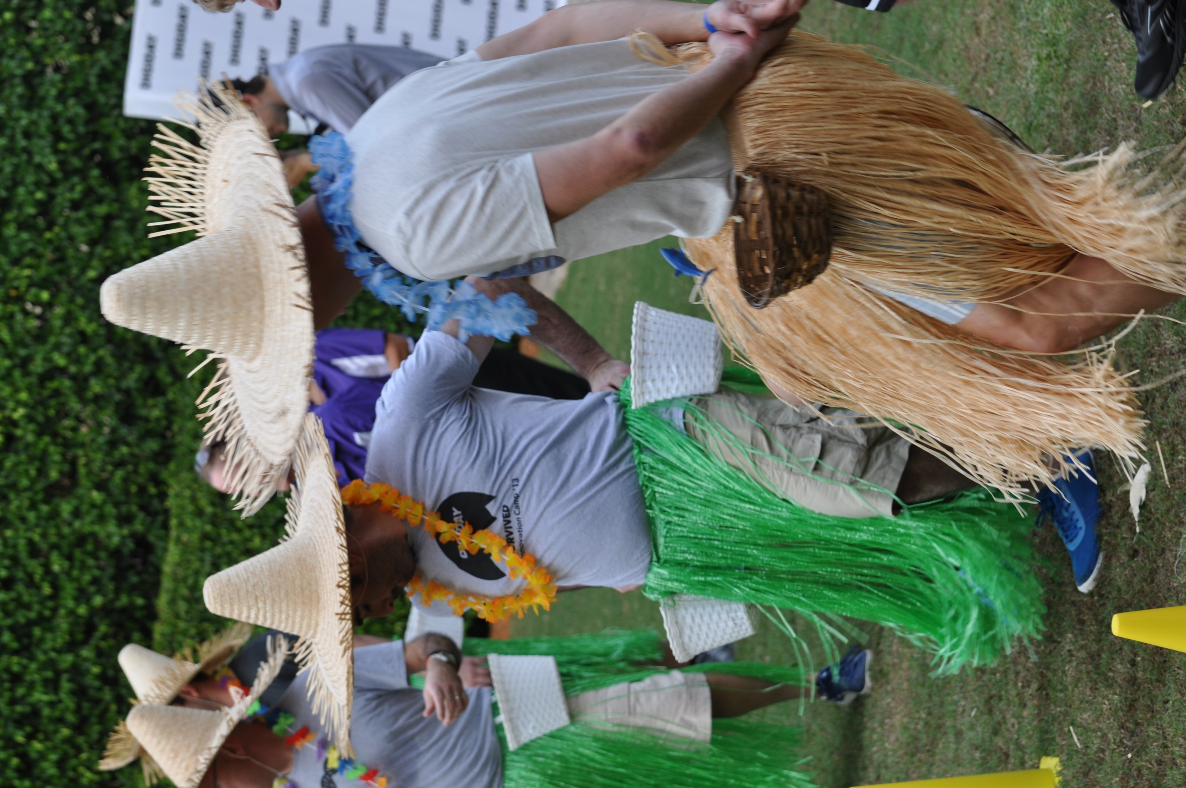
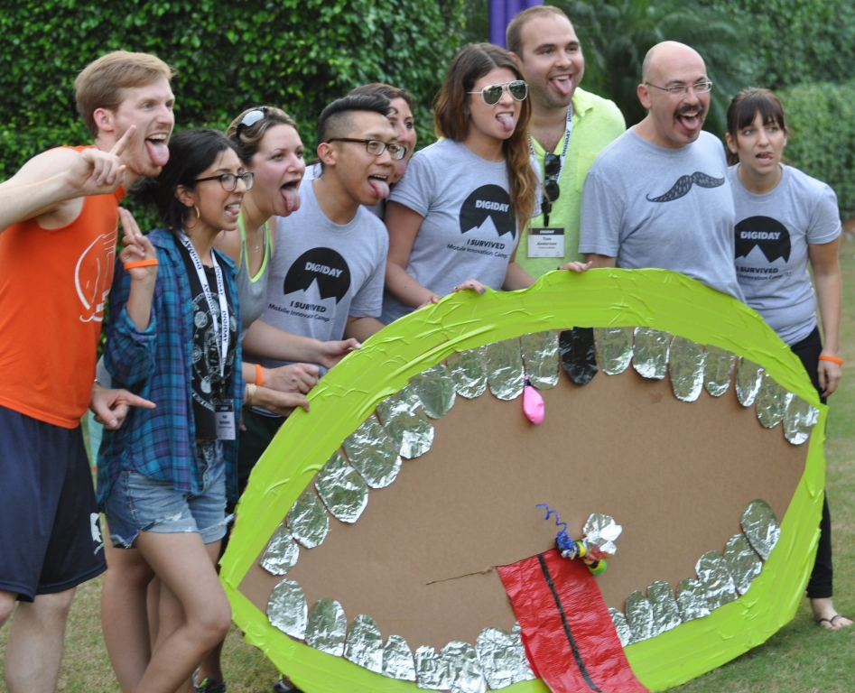
LIMPICS
Wild Take-Off’s of the Famous Games!
60 to
120 min
Players 20 –
Unlimited
Live
Indoor
Outdoor
Experience the ultimate teambuilding event - CORPORATE LIMPICS! No intensive training required, just pure fun and excitement. Laugh, cheer, and bond with your colleagues as you compete in thrilling relays that will leave you breathless. It's a high-energy, physical but non-skill based athletic extravaganza that guarantees unforgettable moments and maximum participation.
From the Un-Obstacle Course to the Cheese Head challenge, every game is designed to bring out your inner armchair athlete. And guess what? The top teams will be celebrated with an Olympic-style ceremony and coveted medals, symbolizing their triumph. Get ready to play with purpose and create lasting memories! Corporate LIMPICS - where camaraderie meets the thrill of victory! Contact us now to ignite your team's competitive spirit.
Intro
Icebreaker
90 Minutes
Challenges 1-6
Awards

