Slide 1
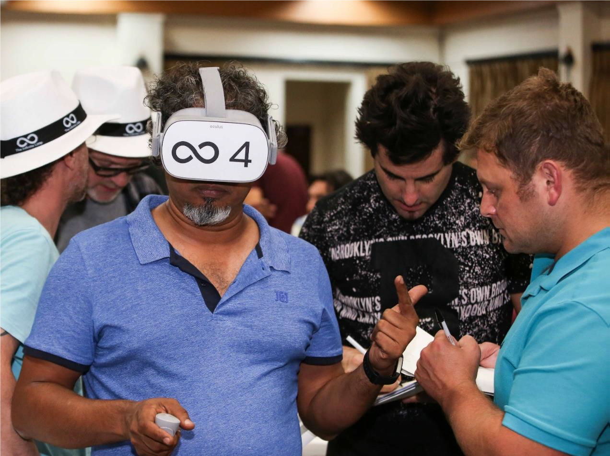
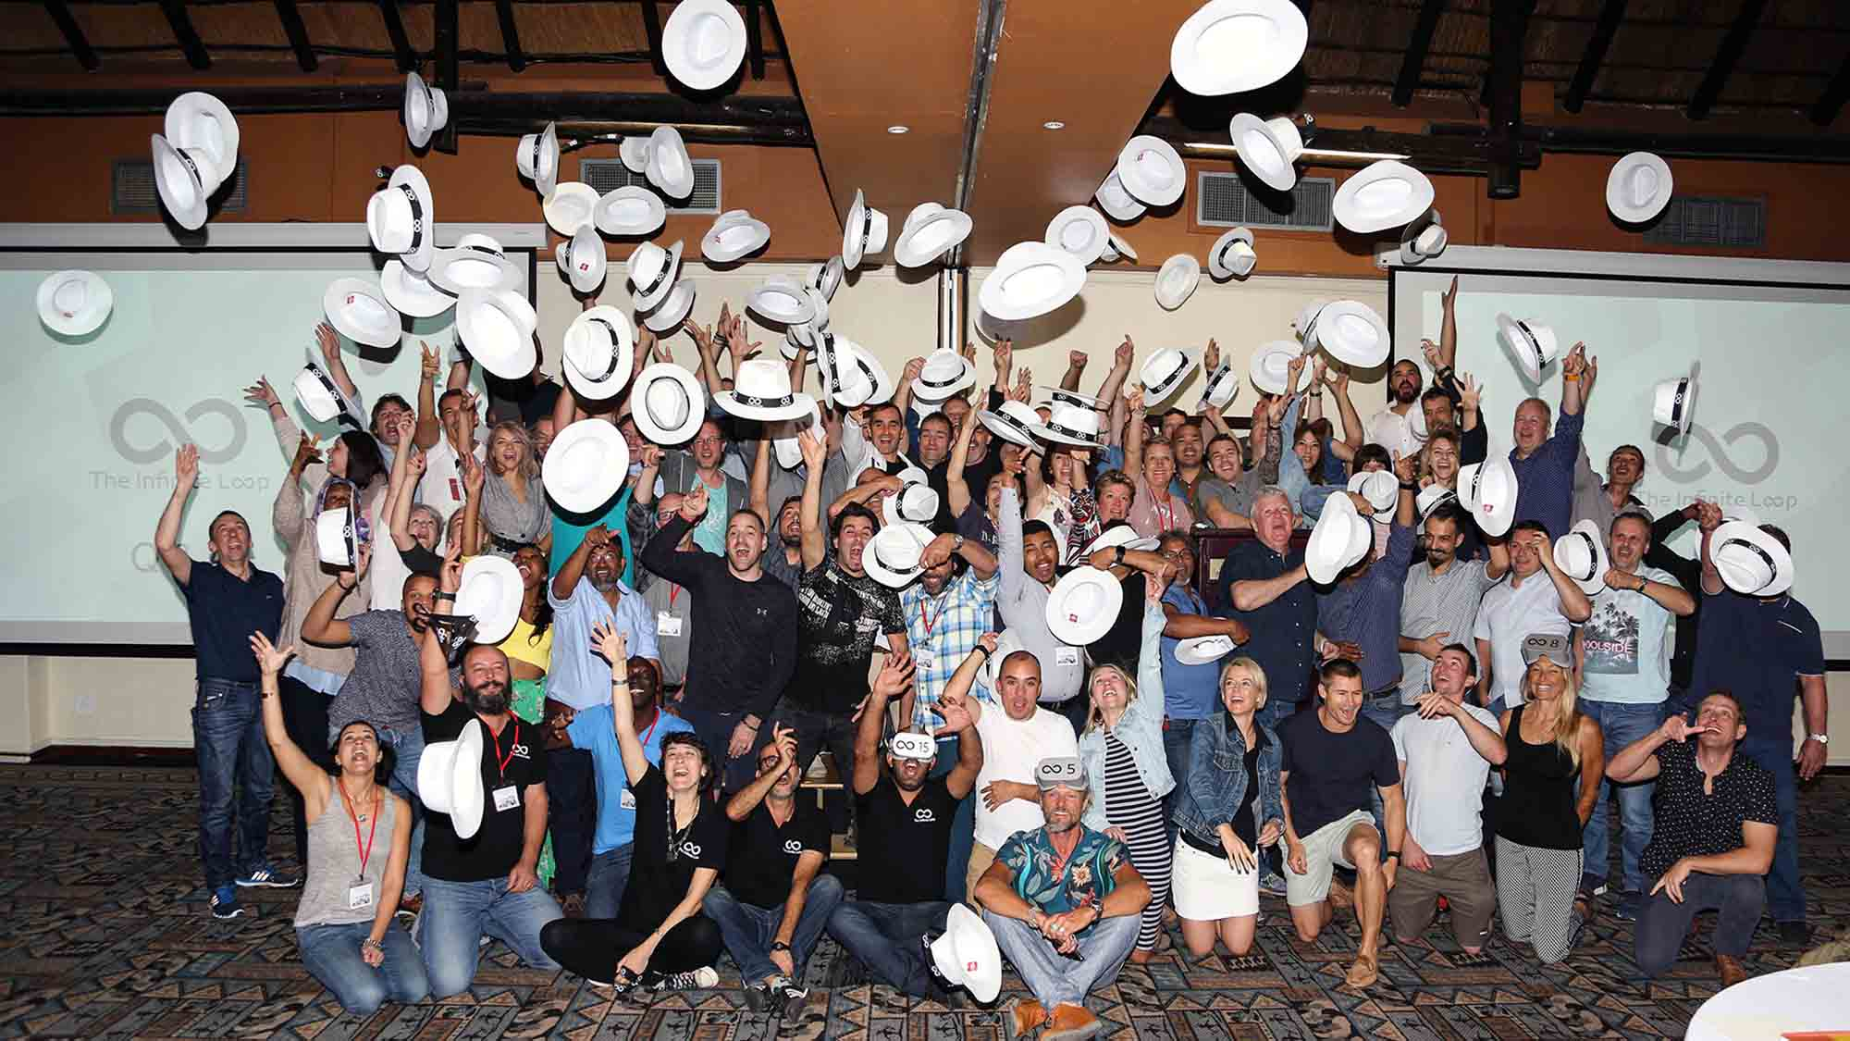
Loop
60 to
120 min
Players 6 - 500
Virtual
Live
Indoor
Enter the world of the “white hat hackers” (tech good guys) to save a teenager caught in the virtual world! Navigate rooms in the virtual world, relaying information and clues with your real-world team to open doors and lead to the release of the prisoner. In the First Level, teams dive deep into the story framework, put together their strategy and build a plan of action.
As they transition between worlds, improved skills lead to solving the final key and release the trapped teen. While extremely engaging and fun, The Infinite Loop is designed for a strong learning purpose. Based on real-time collaboration, the game is a versatile, powerful tool to explore and debrief on complex issues such as learning processes, effective communications, continuous improvement, teamwork and agile methodology.
Intro
90 Minutes
Competition
Awards

