Slide 1
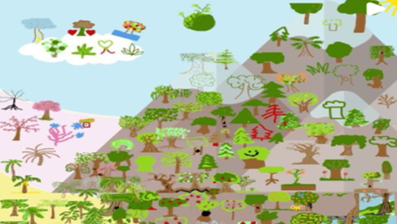
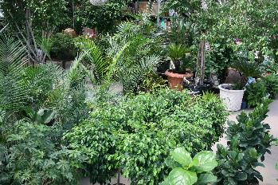
Art for Earth’s Sake
Sustainable Way to Green the World!
10 to 30
Minutes
Unlimited
Guests
Live
Hybrid
Virtual
Indoor
Outdoor
Sustainability is top of mind right now, so kick off your general session sharing your efforts and vision while giving back at the same time!
On the big screen, a forest of trees alive with nature invites your guests to join in efforts to curb the effects of CO2 in our world. Instantly revived by the sights and sounds of the great outdoors, they’re invited to draw an image of their favorite tree – Dr. Suess-like, a holiday tree, leaves from the colorful fall foliage, maybe even a Palm tree! As it’s being drawn, the art is collected and displayed for everyone to enjoy, sparking conversation and laughter. For each person that draws a tree, a donation will be made to One Tree Planted! Not only is drawing a tree an act of charity – it gives you a platform to talk about your sustainability efforts at the event. And it’s participatory, immersive, feels good and creates heart share with your guests.
You’ll receive a mural of all the trees - representing your contribution to saving the environment - that you can share with your team, on social media and with your shareholders!
Welcome
Video
20 Minutes
Tree
Saving
Activity
Wrap

