Slide 1







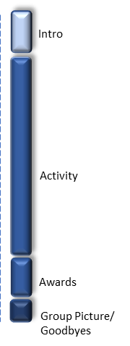
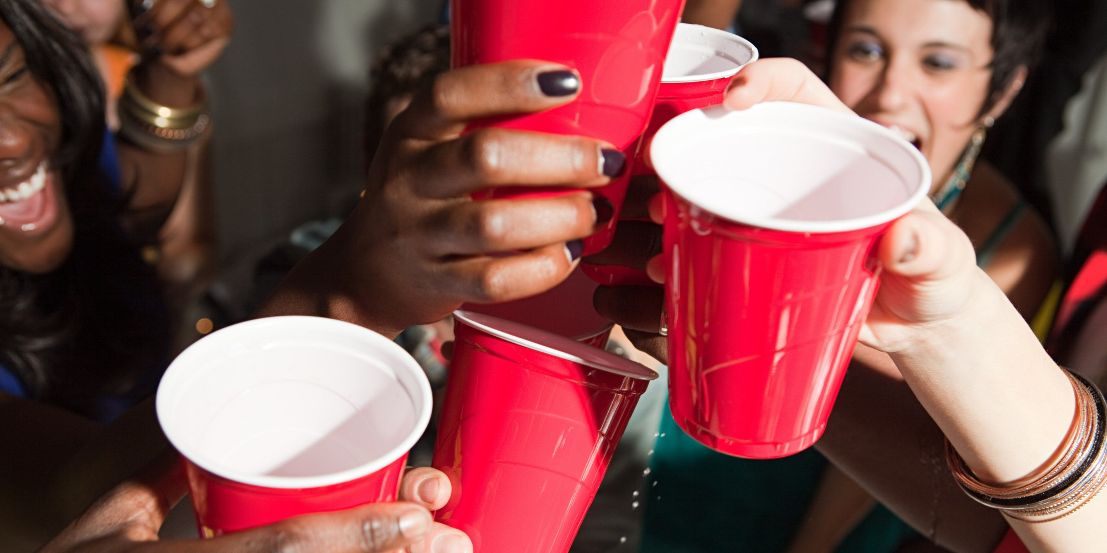
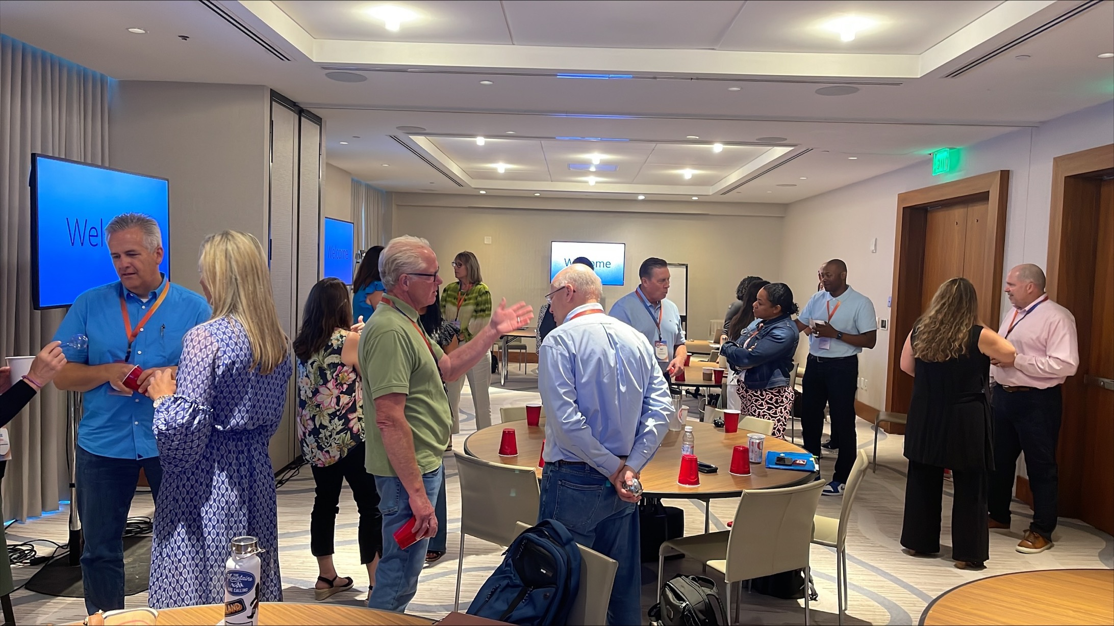
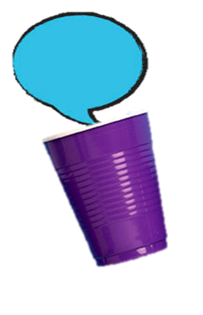
Conversations in a Cup
Stirring authentic and unexpected conversations!
30min
60 min
Players: 10 to
Unlimited
Live
Virtual
Indoor
Outdoor
Fill your reception or networking event with unexpected conversations! For most of us, cocktail conversations revolve around the “same old” – the weather, the family, the big game. Stuck in a rut topics make networking awkward and conversations short.
This event spurs guests to share things that would almost never come up at cocktails, but are interesting, authentic and more importantly spark undiscovered passions, interests and experiences of the people talking. Every guest gets a ‘cup’ that contains an “ideasparker” and they meet others to talk and learn about each other. For competitive groups, we can add an element of competition by awarding points for each person they talk with.
Perfect for a laid-back reception or an intentional network event, perfect for introverts and extroverts, and perfect for getting an insider glimpse of the real people you meet.

