Slide 1
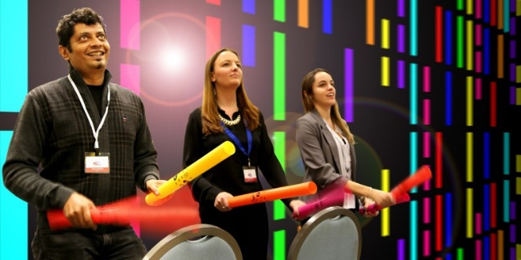
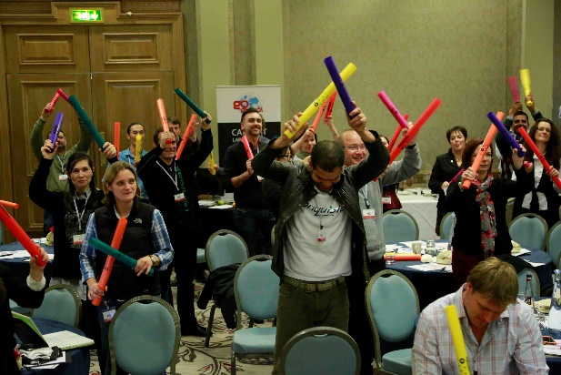
BOOM
TIME
Hits ALL the Right Notes!
10 to
30 min
Players 10 –
Unlimited
Live
Indoor
Feel the beats coursing through your body as your associates unite to create adrenaline-pumping music. Boomwhackers are precision tuned musical tubes which your guests use to smack, thwack and thump themselves into a musical frenzy. This infectious icebreaker transforms any conference room into a colorful, fast-paced orchestra that is sure to get everyone engaged, enthused and energized.
Using our musical teambuilding expertise, we created a high-tech visual interface which guides your group in generating incredible, invigorating sounds. It’s like Guitar Hero on steroids! As the event progresses, the pace and complexity grow; blocks move faster and your team responds more vigorously to keep the rhythm building to an uplifting crescendo.
Boom Time is an exhilarating yet cost effective way to have fun and de-stress with your colleagues. It is like nothing you’ve experienced before and represents a new generation of interactive General Session entertainment.
Welcome
15 Minutes
Activity
Wrap

