Slide 1
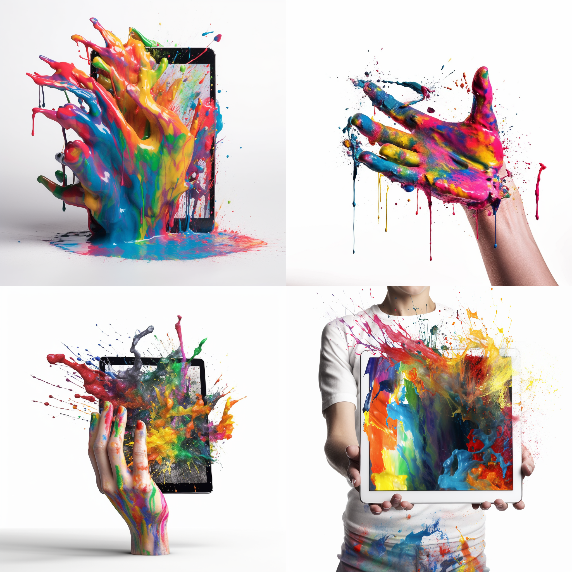




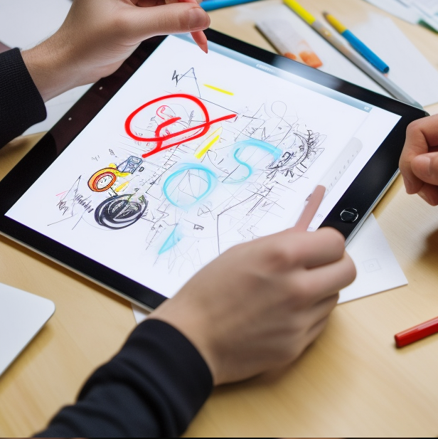
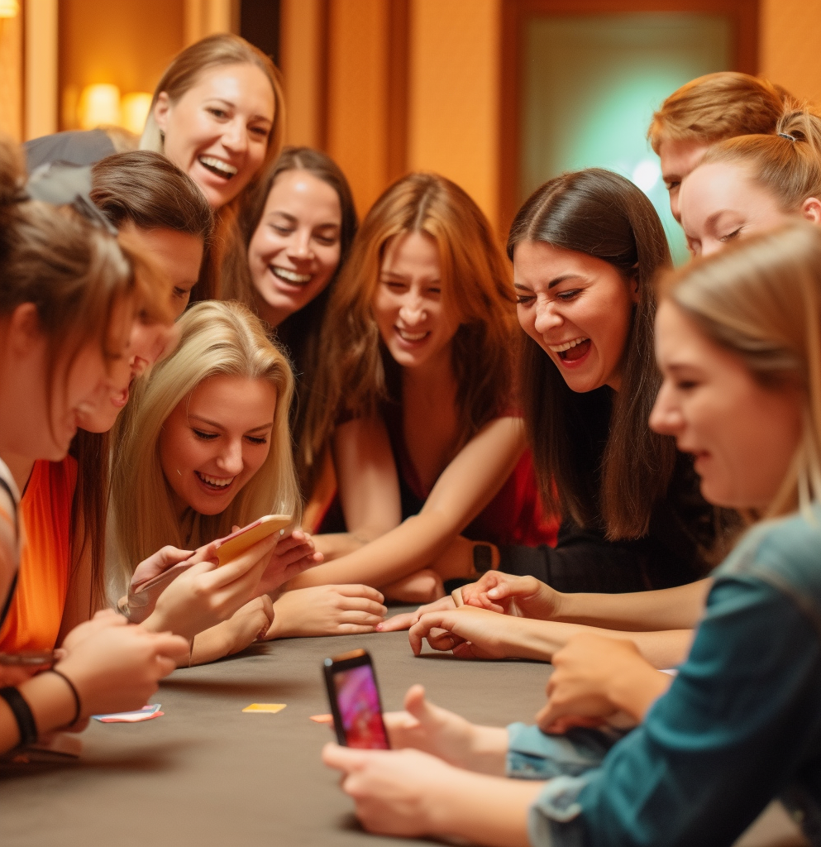
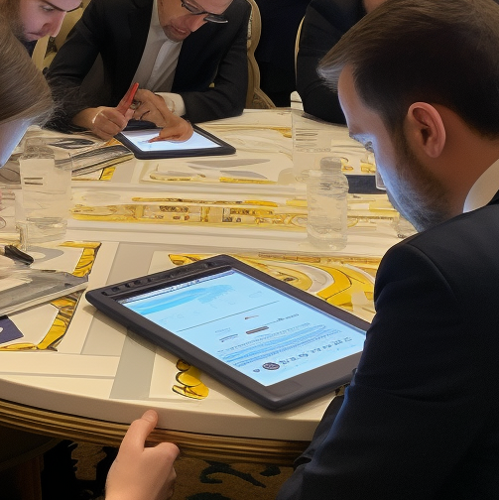
Art of Networking
"Draw, Connect, Inspire: Unleash Creativity Together!"
30 to
60 min
Players 10 –
Unlimited
Virtual
Live
Hybrid
Indoor
Outdoor
Ignite excitement and foster connections with our activity, Art of Networking. Designed for networking, this engaging and secure environment encourages guests to mingle and bond. With designated topics and vibrant energy, it elevates enthusiasm among attendees. Participants are assigned groups and directed to their first table. A dynamic host unveils a QR code on the screen for access to the web platform.
Guided by prompts, attendees engage in dialogue while drawing responses on their devices. After a few minutes, the conversation expands to the entire room, enabling sharing on multiple levels. With table rotations, diverse interactions are ensured. By embracing drawing, the Art of Networking facilitates natural sharing, building relationships, and exchanging creative ideas. The culmination of individual drawings creates a captivating mural, fostering camaraderie. This activity fulfills networking objectives while leaving a lasting impact, keeping attendees engaged and connected beyond the event.
Intro
90 Minutes
Activity
Awards
Group Pictures

