Slide 1







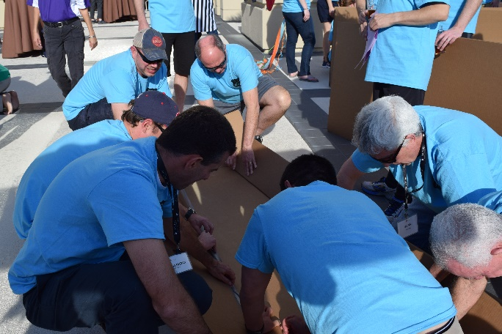
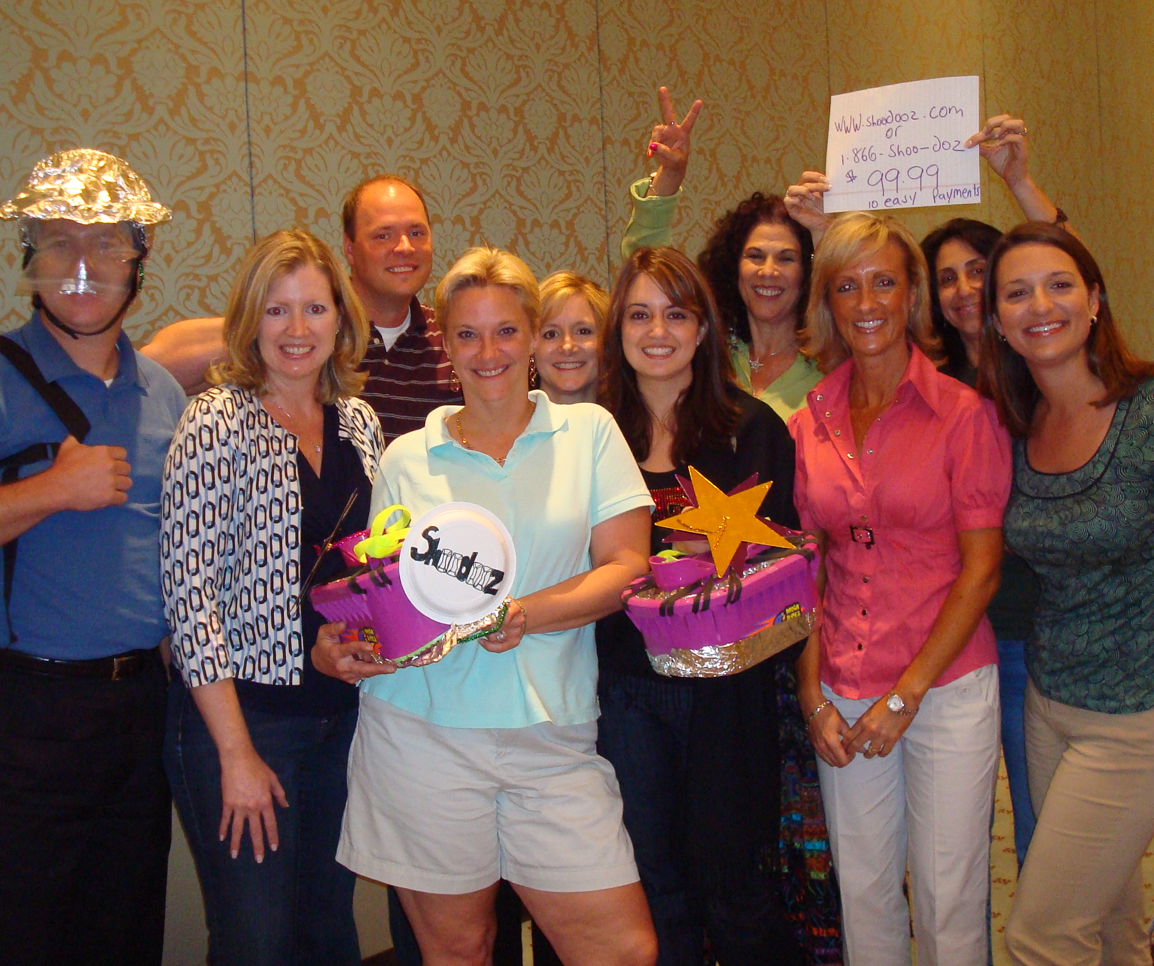


"Everything that can be invented has been invented."
60 to
120 min
Virtual
Hybrid
Live
Indoor
Outdoor
Players 10 - 500
Ignite your team's creative potential with our electrifying event inspired by a hit TV show. Transform into visionary inventors and wow the legendary Sharks with your groundbreaking product ideas. This program equips your teams with practical tools to cultivate crucial creative thinking patterns. Each table becomes a dynamic Research and Development team, using disruptive thinking to identify untapped opportunities and gaps in the market.
Teams embark on an exhilarating journey of invention, defining design specifications, catchy names, purpose, and target audience. Witness resourcefulness, ingenuity, and forward thinking as teams create dazzling prototypes, compelling presentations, and visualize their inventions taking the world by storm. From wacky to heartwarming, these products leave a lasting impact. The suspense builds as esteemed Sharks decide who receives funding to turn their visionary inventions into reality. Experience the thrill of groundbreaking innovation!
Intro
90 Minutes
Challenge
Teams Present /Judging
Awards

