Slide 1






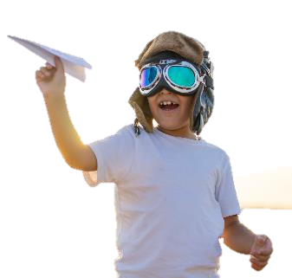
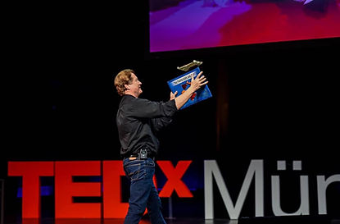


A Rare Combination of Playing, Learning & Giving
75 to
120 min
Players 20 –
Unlimited
Indoor
Outdoor
Live
This event combines playing, innovating, throwing, experimenting, laughing, teaming, learning and just plain ‘growing down’ for a fun way to bring the spirit of community service to your group. The “aha’s” and feel good your team will reap are sure to shape the future (both yours and the organization you help) with creative and innovative solutions.
Giving Wings weaves inspiration and learning. Part keynote, part playground, John Collins, the current Guinness World Record holder for the longest flight by a paper airplane, relates the business world to the flying world. Next its time to get moving! We’ll hand out the paper, and John shares tips on how to build all kinds of airplanes. Filled with metaphors for relating work and flying, the lab includes flying machines such as the tube, the arrow, the bullet, the glider, the interceptor and even the boomerang, an airplane built so you don’t have to chase it!
Your donation is a live-learning STEM LAB for a local school, where John teaches engineering, aerodynamics and science using – of course – paper airplanes!
Intro
Keynote Welcome
90 Minutes
Activity
Charity Speaks
Awards

