Slide 1
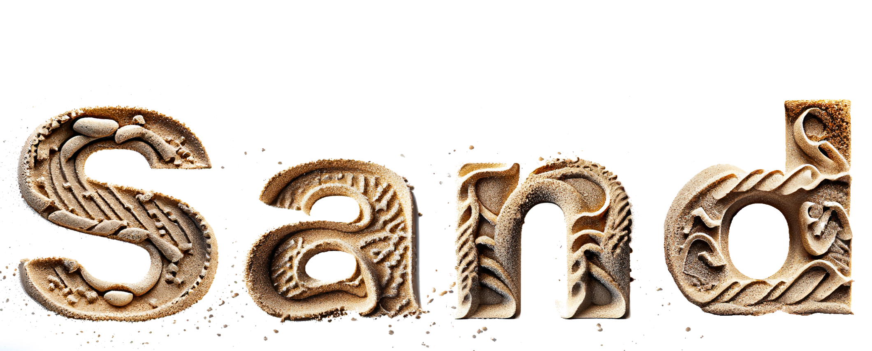
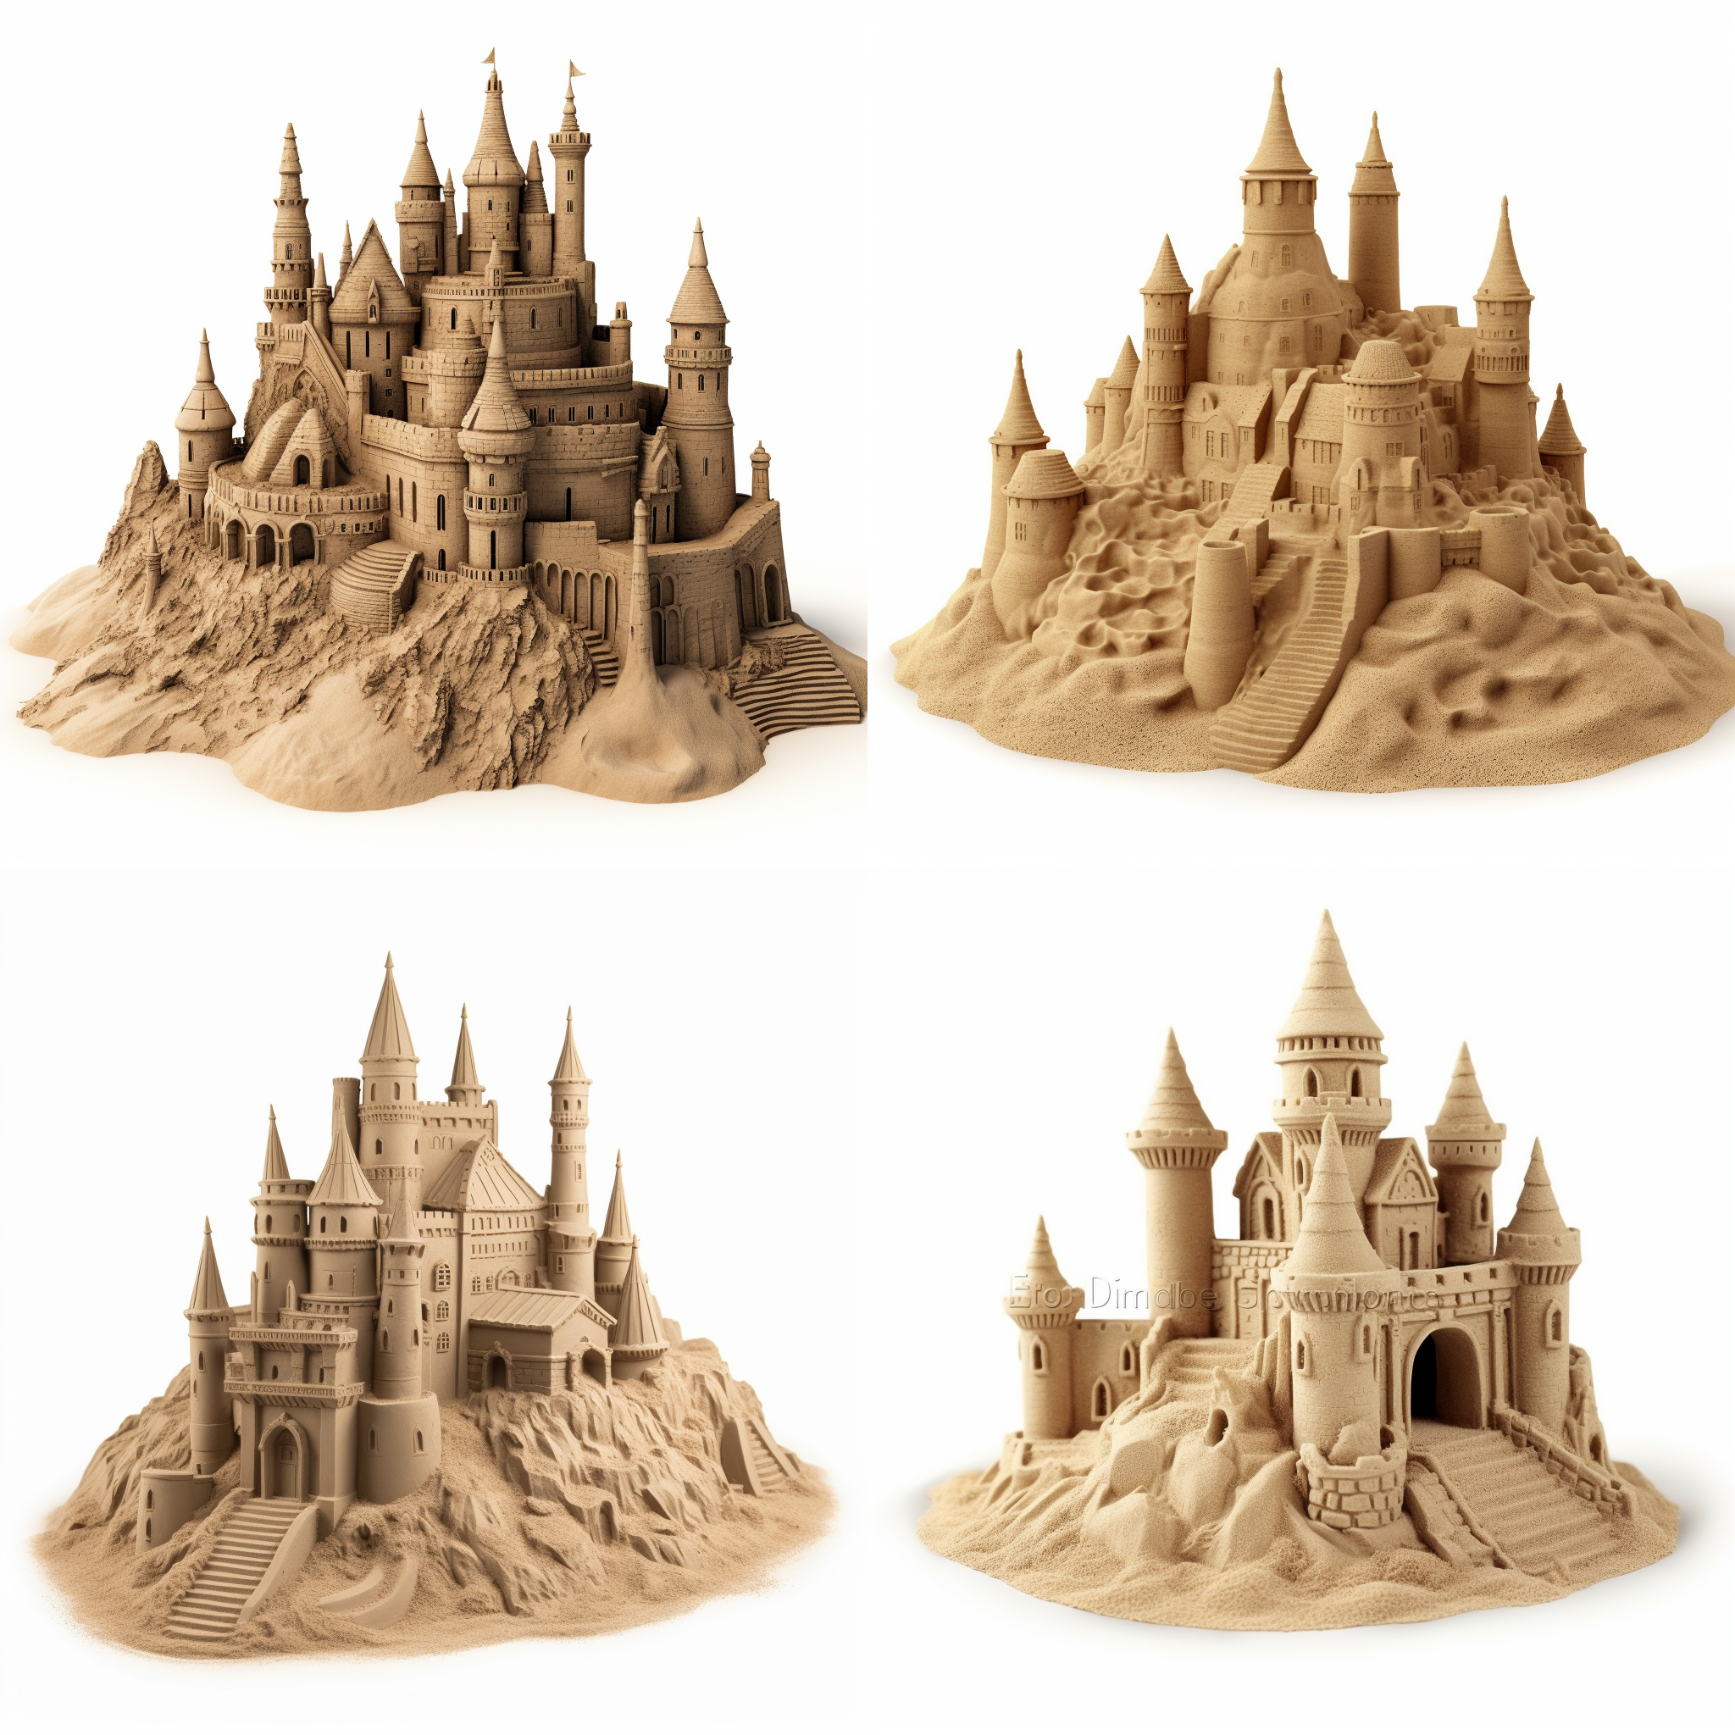




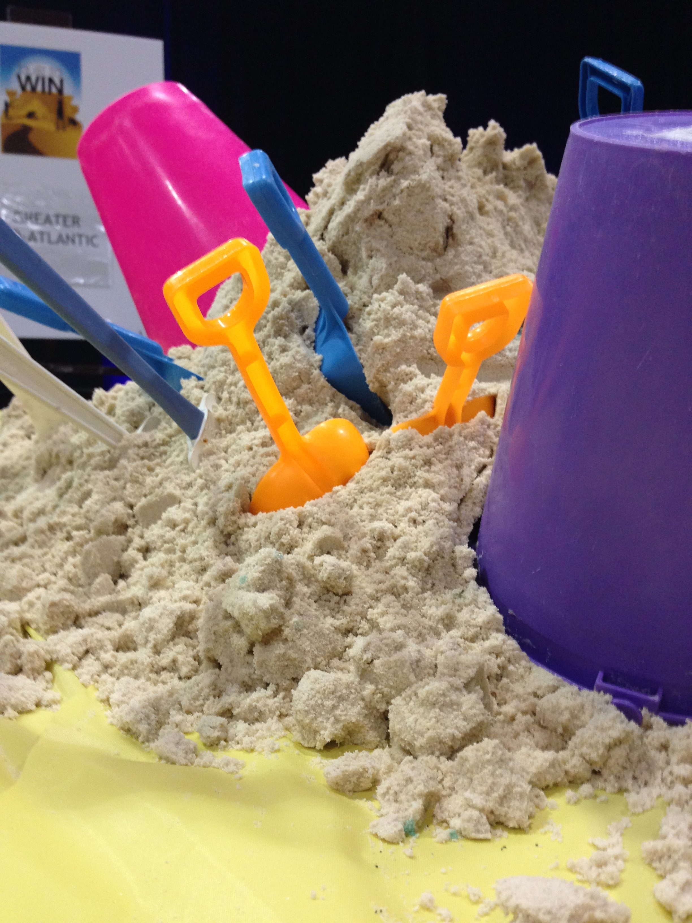
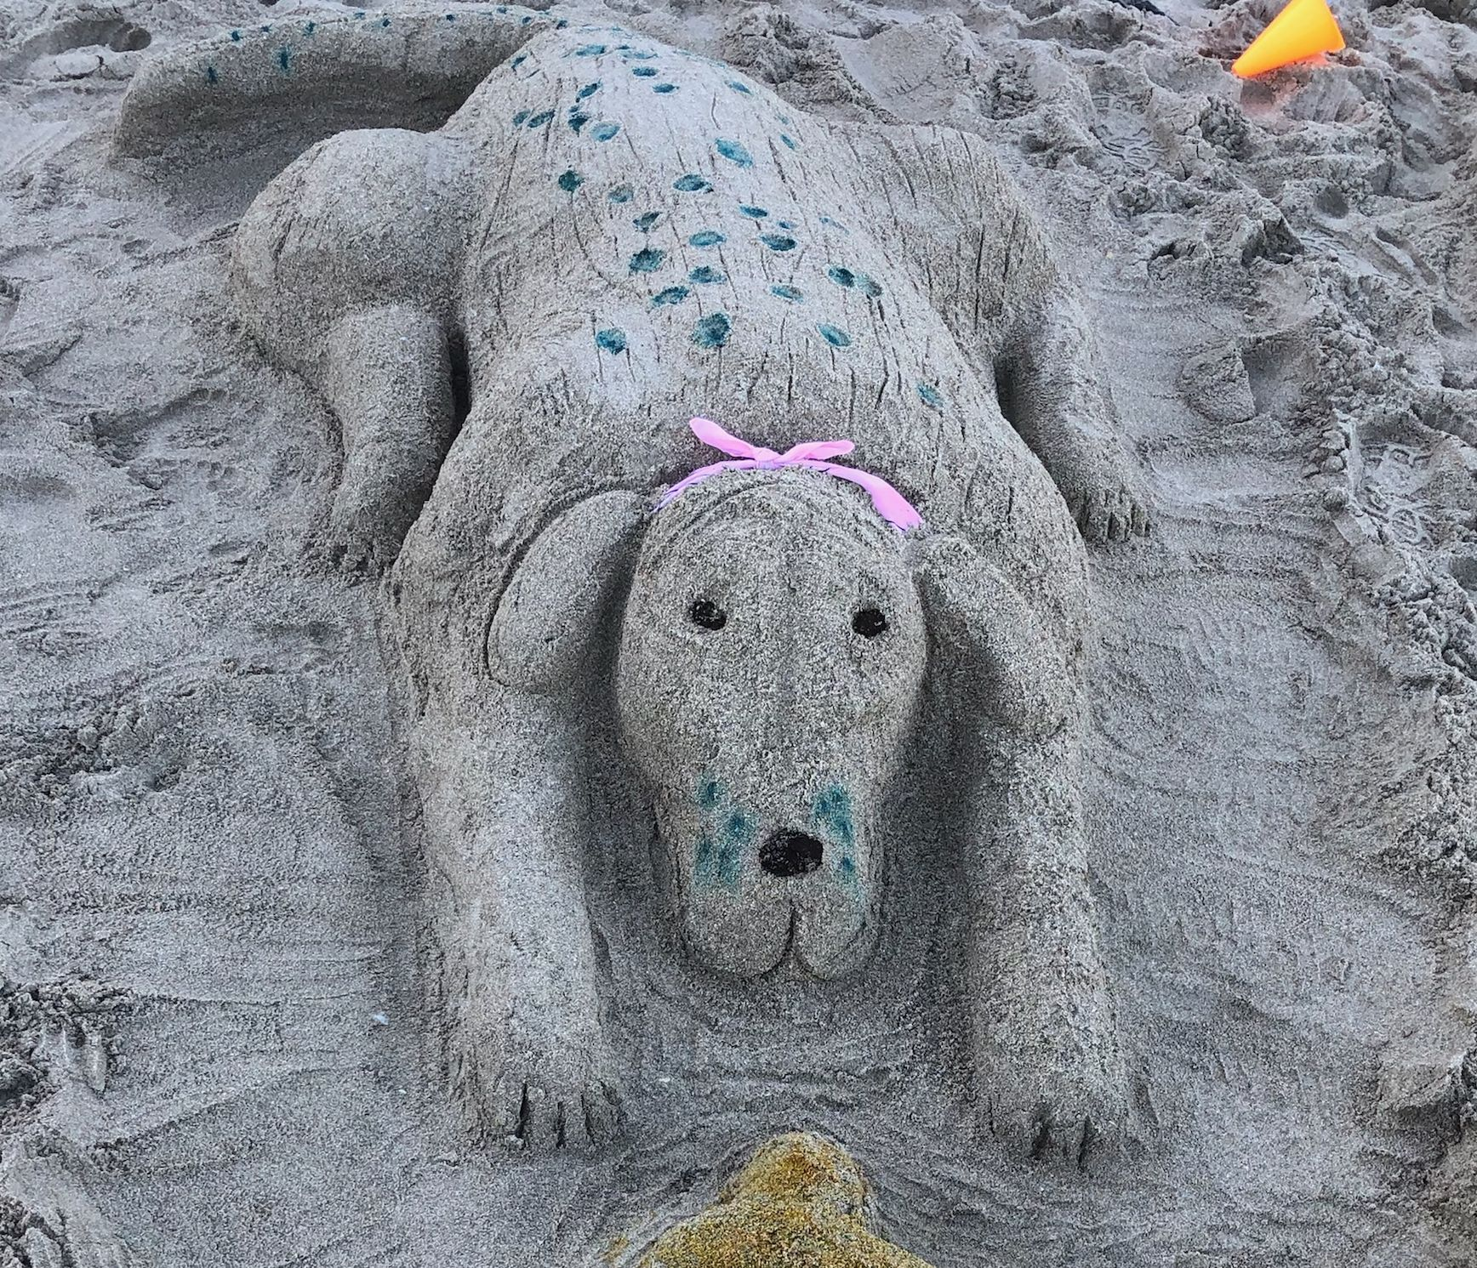
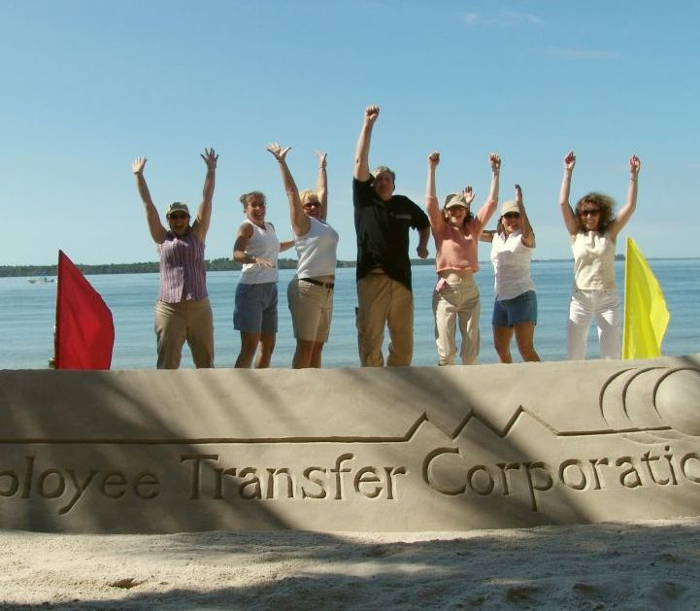
Sculpture
Sculpting with a Side of Laughter!
60 to
120 min
Players 6 –
Unlimited
Live
Indoor
Outdoor
Unleash your creativity at the Sand Sculpture Extravaganza and leave ordinary sandcastles behind! Competitors in the past have designed Jacuzzis with bikini-clad bathers and even an Olympic swimming pool with the USA taking the gold. The only rule here is… no boring sandcastles!
This seaside event invites teams to bring their imagination to the beach, armed with all the necessary tools like shovels, buckets, scraping tools, water bottles, and dye. Our energetic staff, accompanied by pumped up beach music, keeps the energy high. Win amazing prizes for the Best Demonstration of Theme and the Most Exacting Execution. Prepare to turn the beach into a captivating sand art gallery, where unforgettable memories are made and team spirit thrives.
Intro
Strategy
90 Minutes
Build
Present

