Slide 1
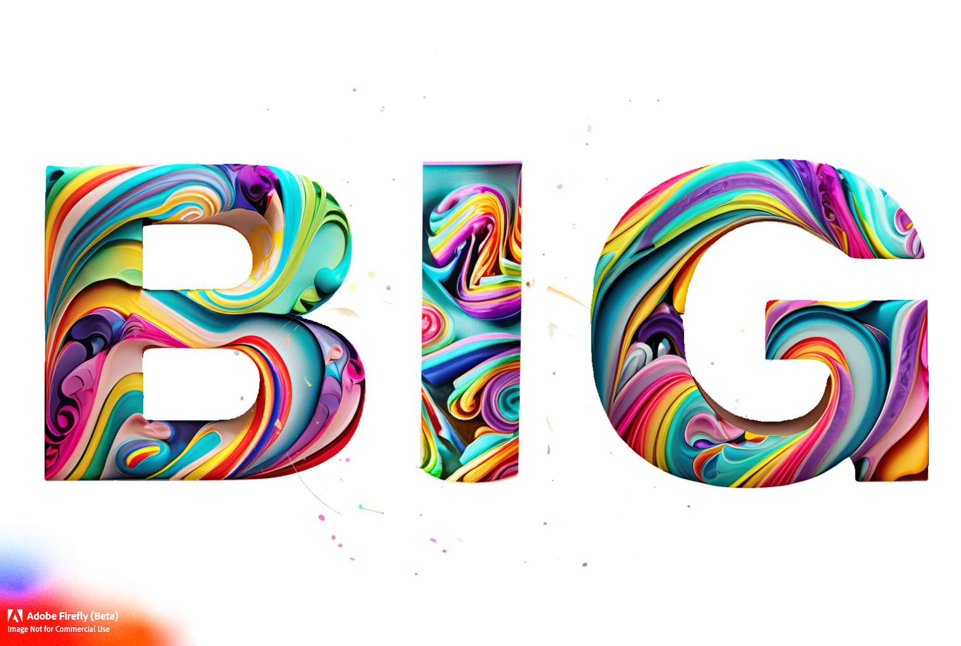
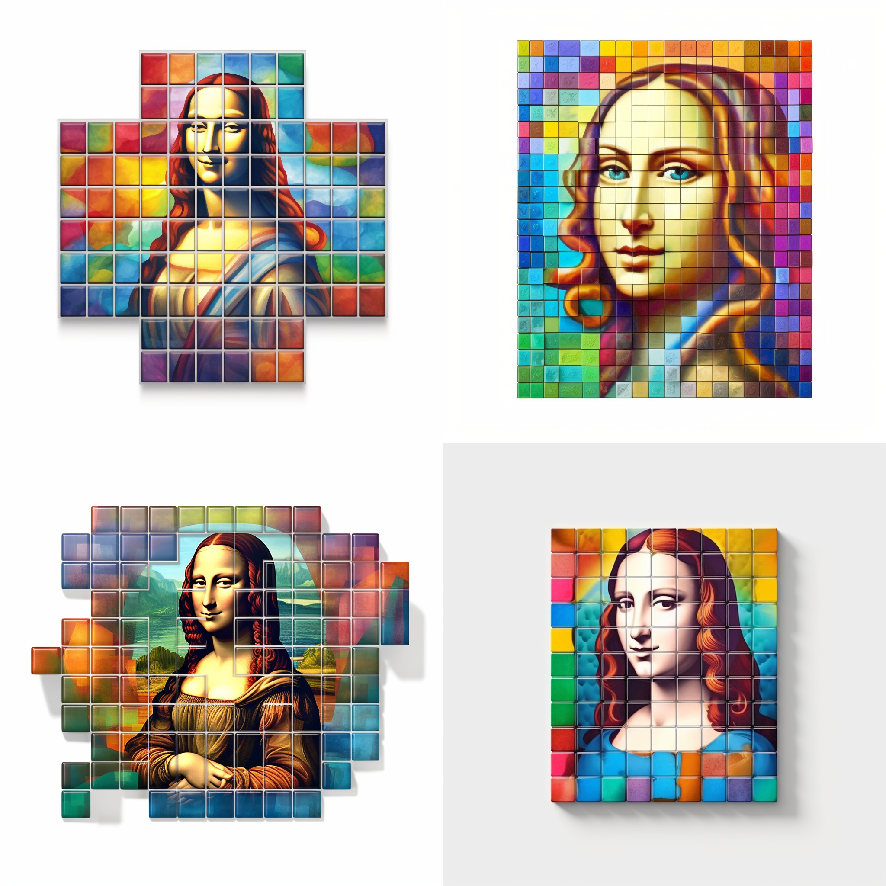




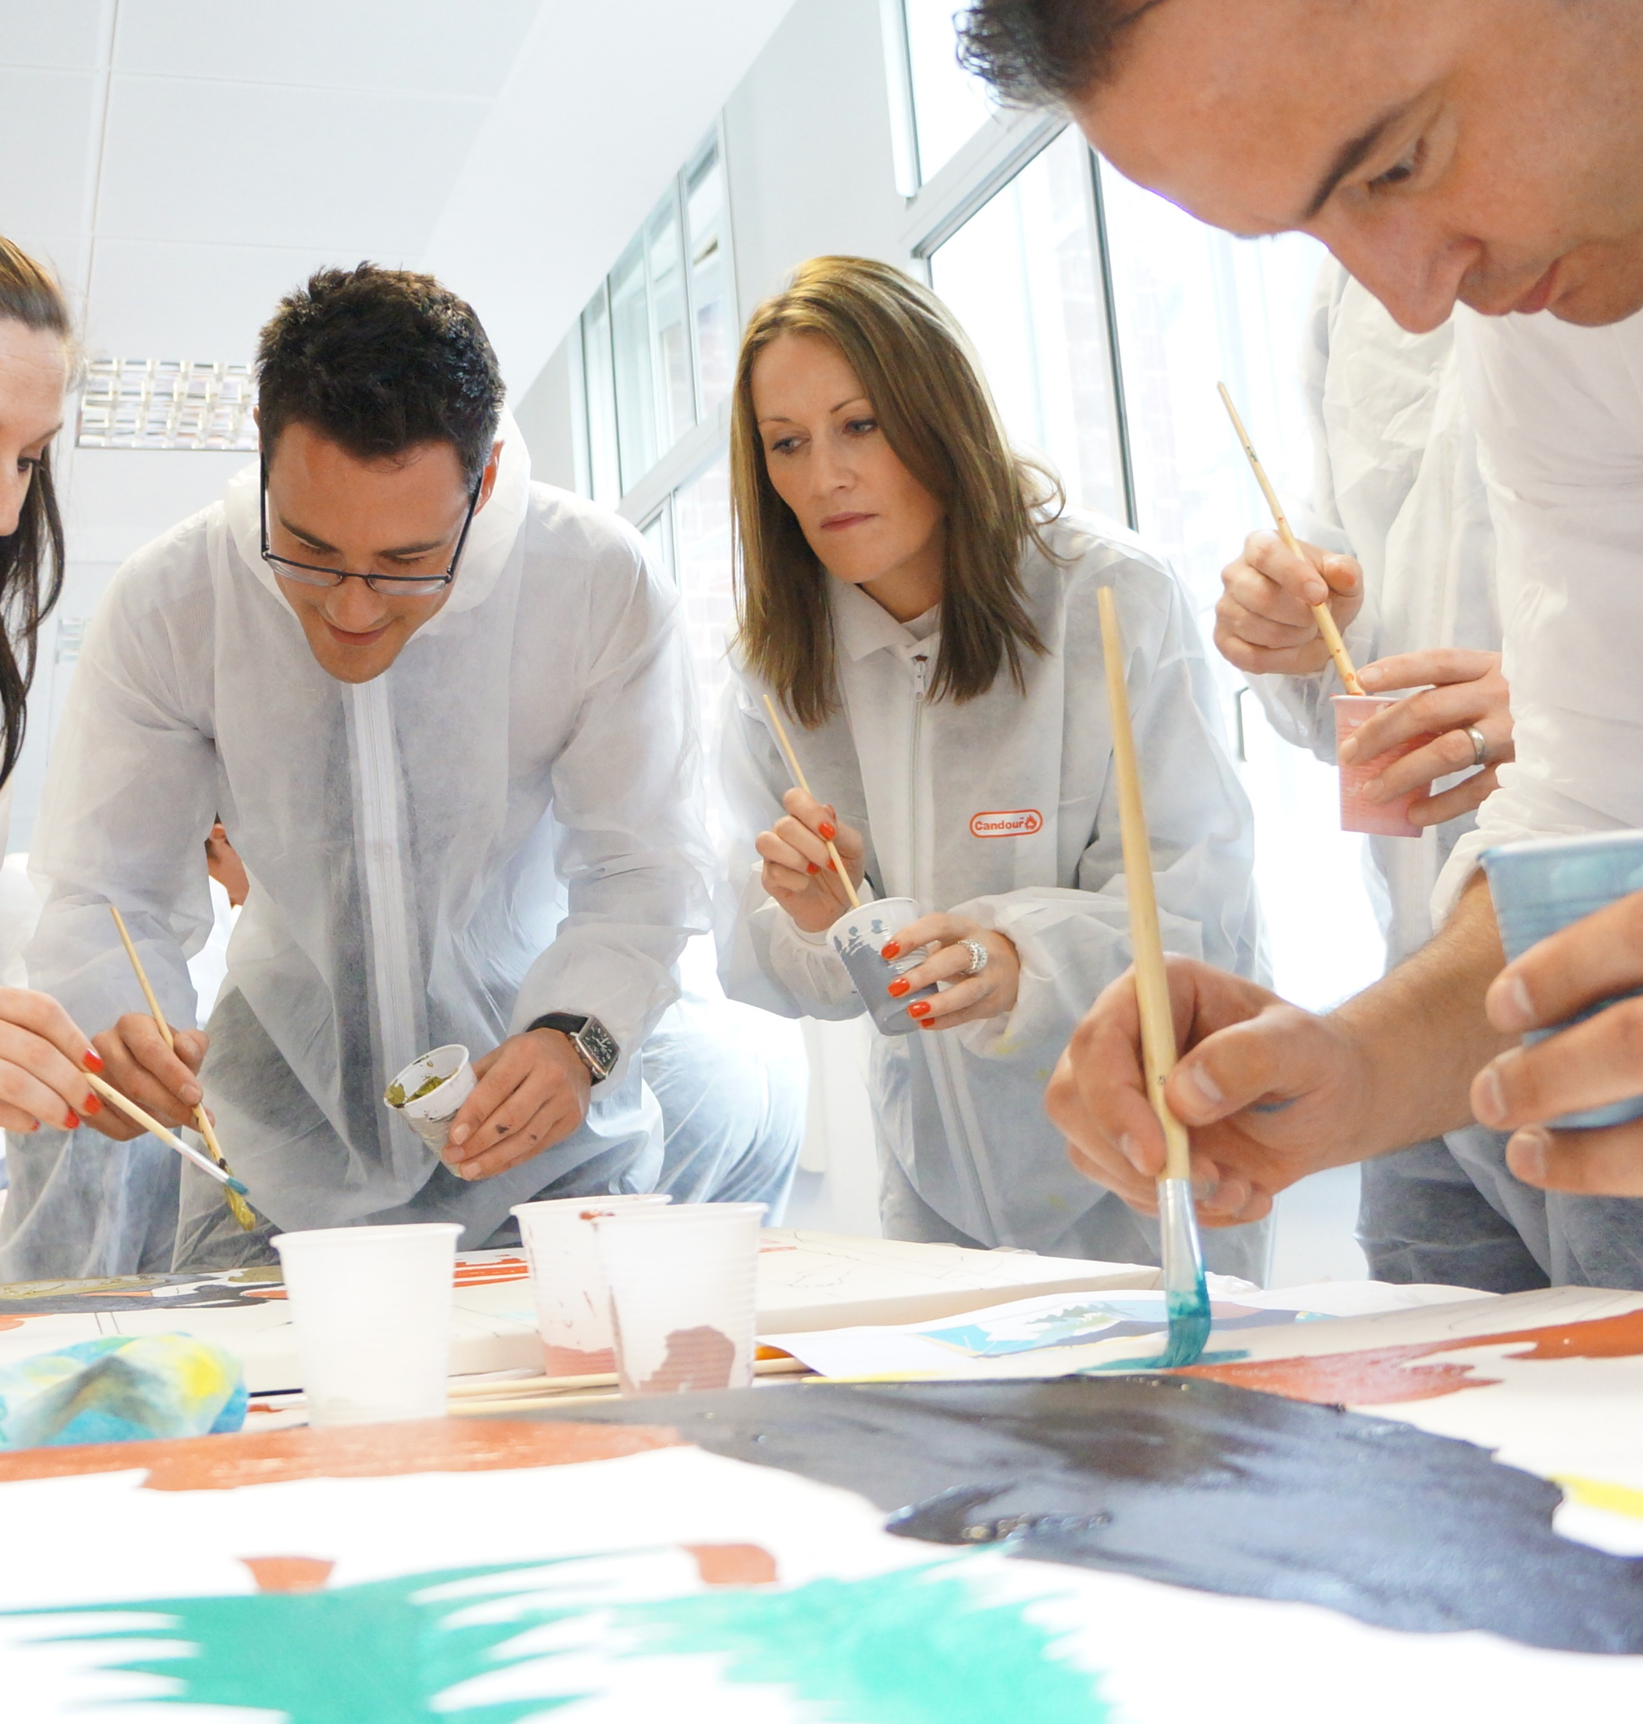
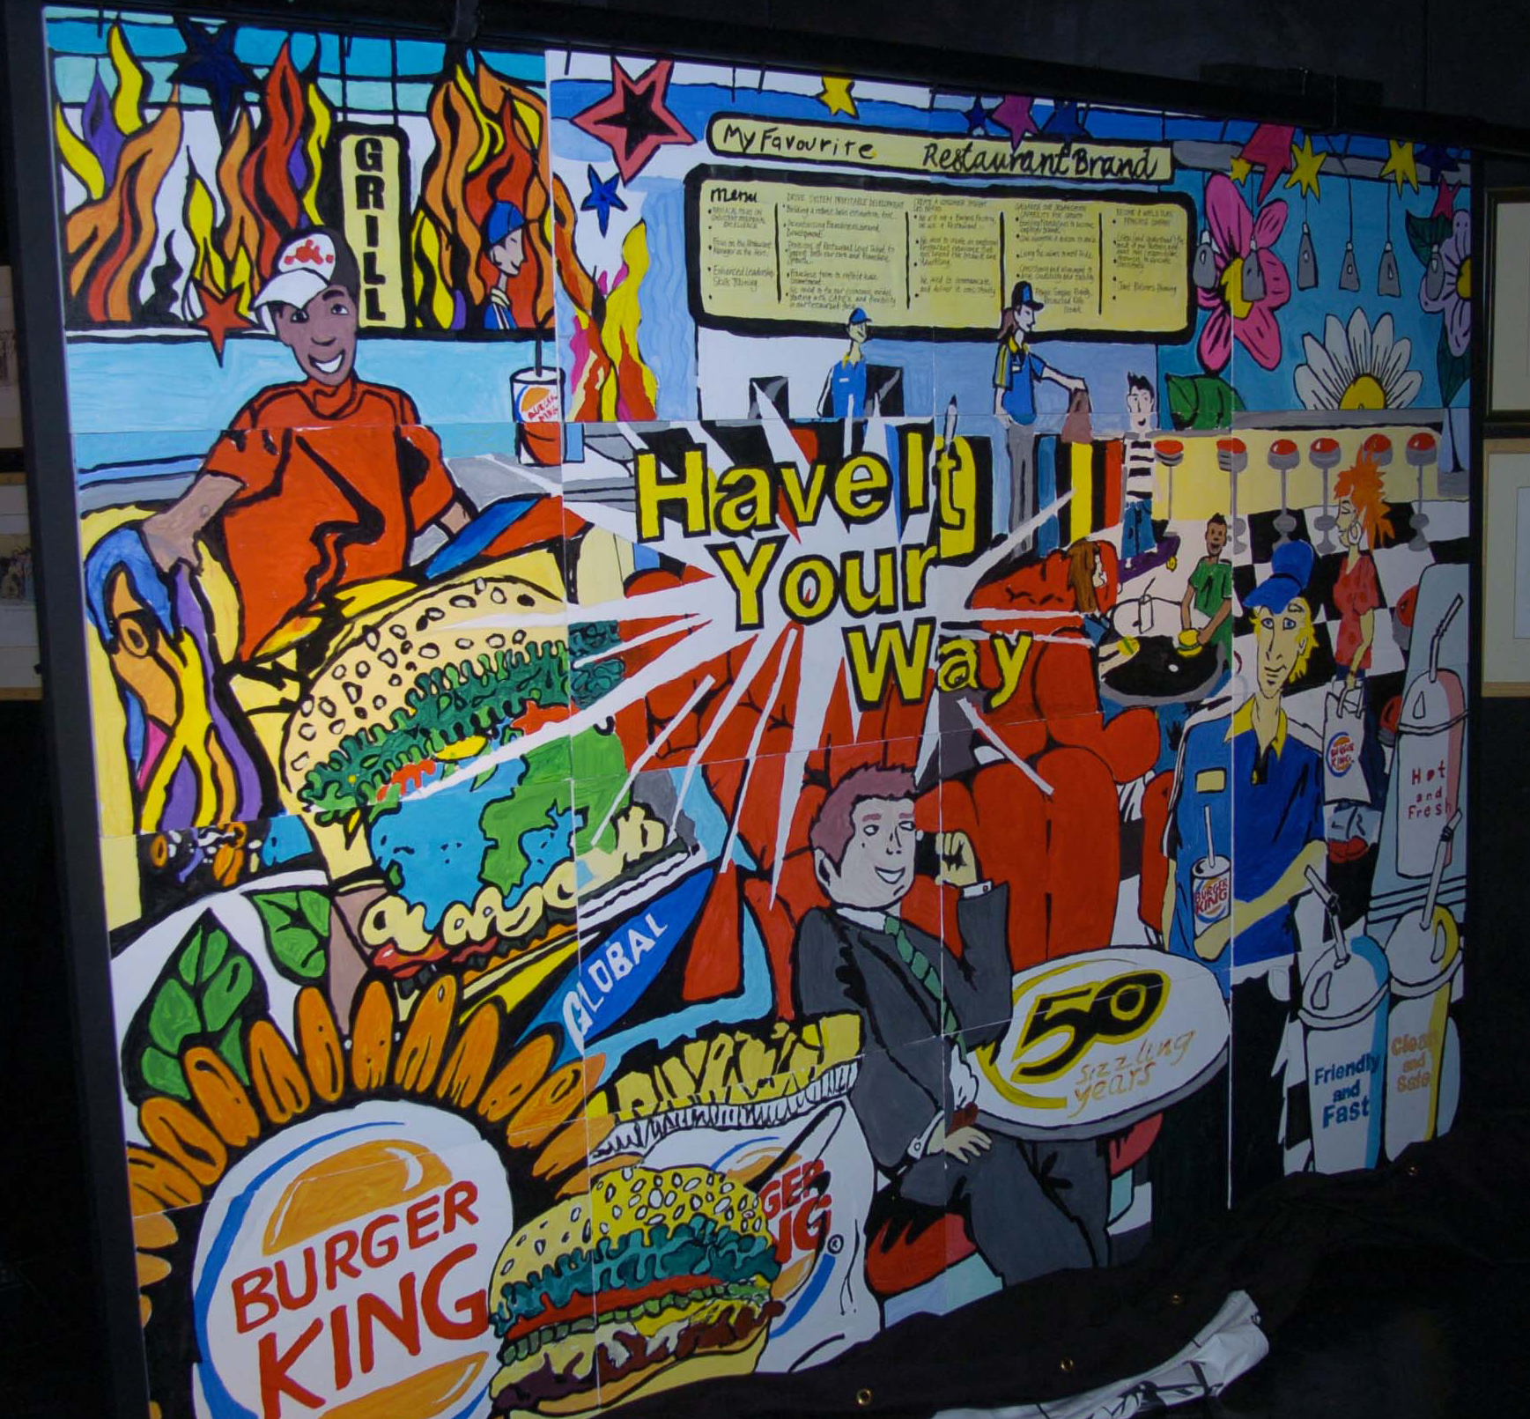
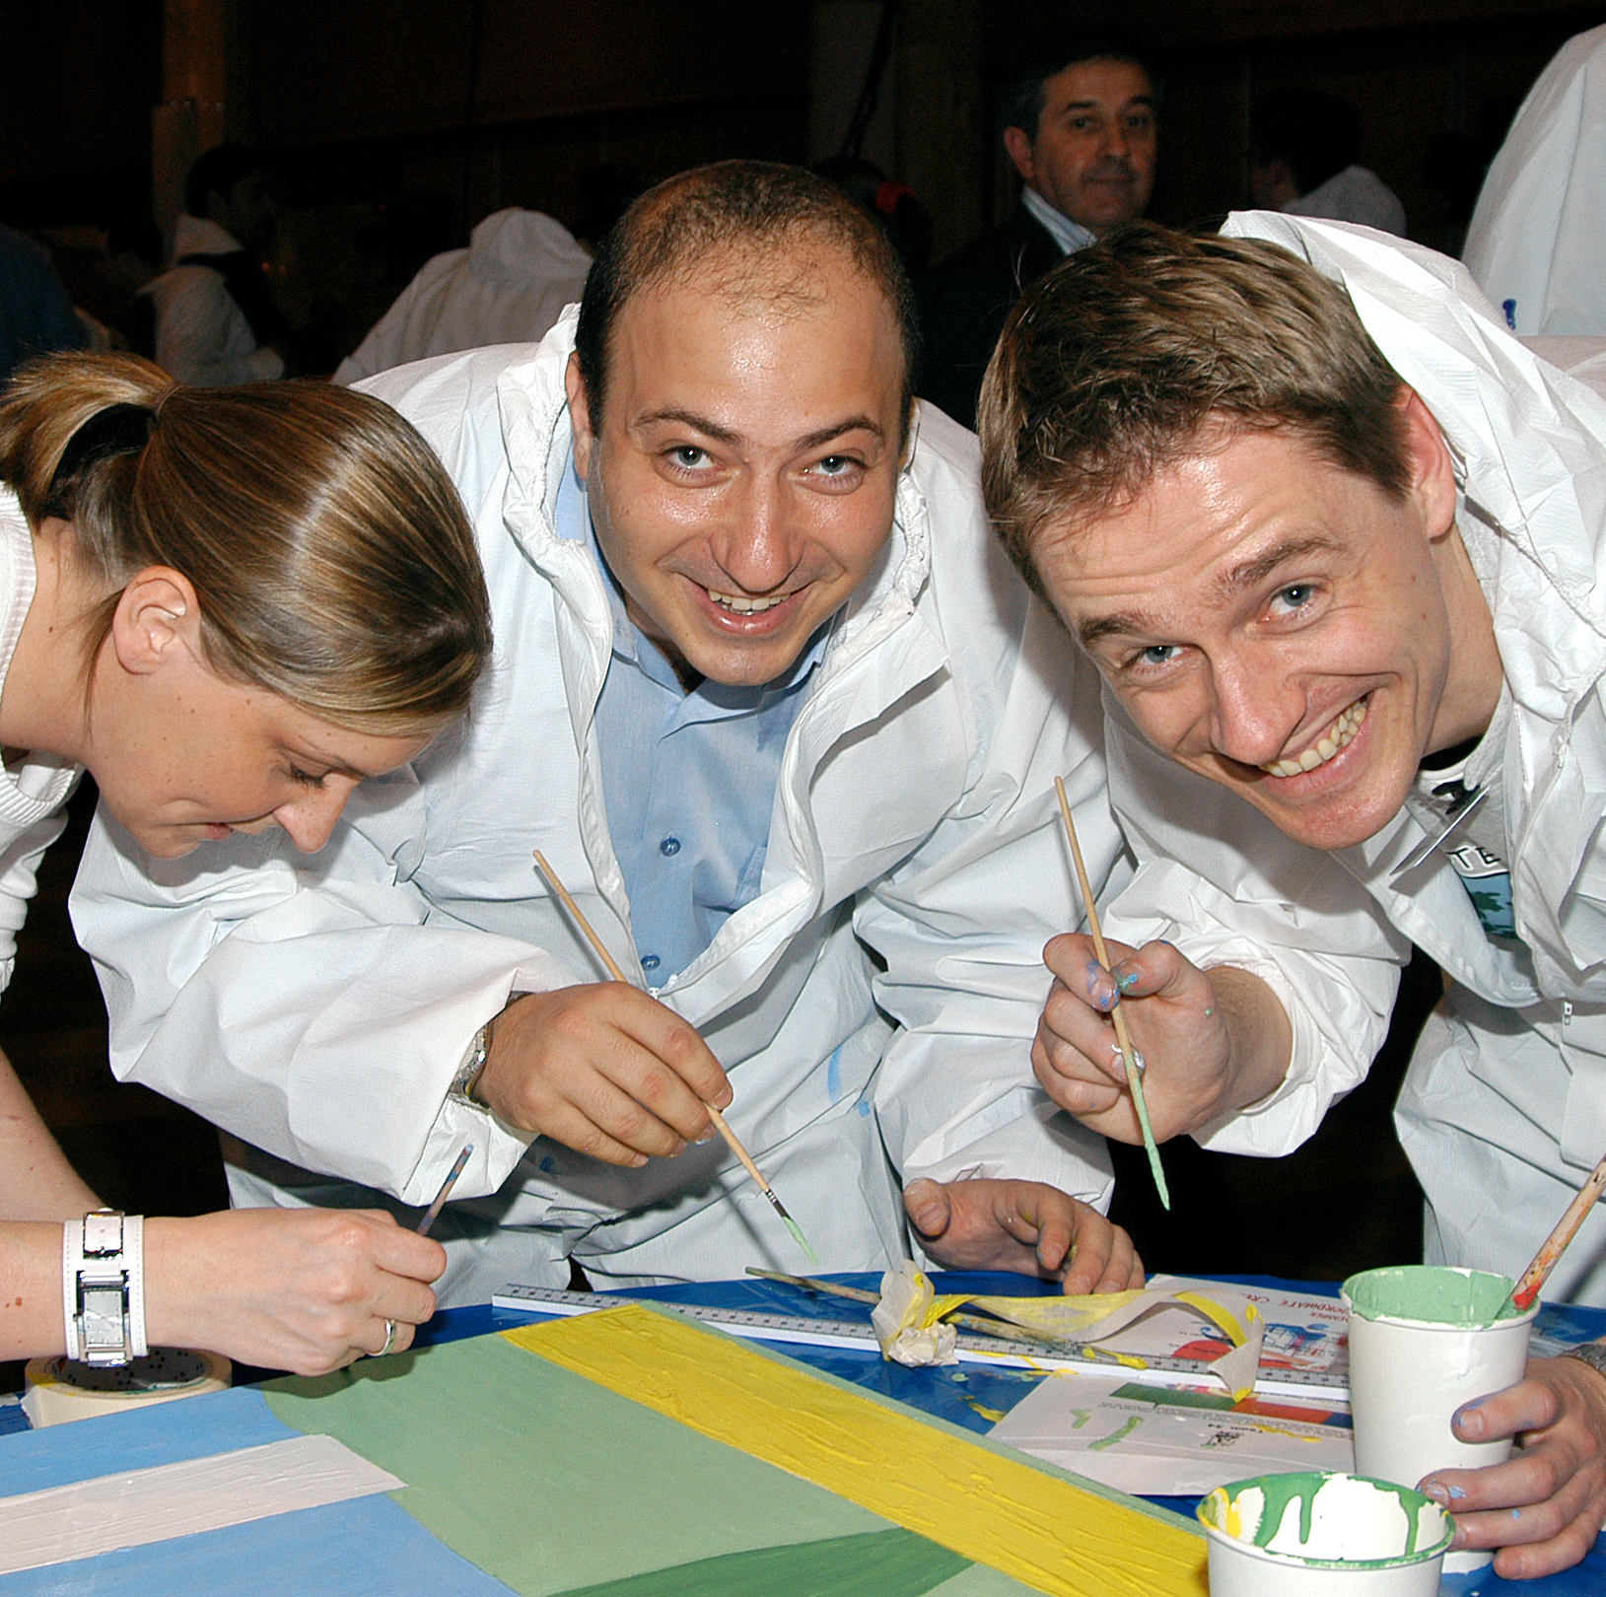
Picture
Paint. Collaborate. Create.
90min
120 min
Players 20 –
Unlimited
Virtual
Live
Hybrid
Indoor
Outdoor
Unleash your team's artistic prowess and witness the incredible power of collaboration with The Big Picture! This extraordinary event invites your team to create a masterpiece of epic proportions while reinforcing the value of teamwork, cooperation, and communication.
Imagine your team, armed with brushes and vibrant paint, embarking on a thrilling journey of creativity. Each small group is entrusted with painting a segment of the mysterious Big Picture artwork, guided by a 'big picture' perspective where lines meet and colors blend seamlessly. It's a mesmerizing experience that brings out the best in your team.
But the true magic lies in the final reveal. As the individual canvases are collected, framed together, and shrouded in secrecy, anticipation builds. Then, amidst thunderous applause, the completed masterpiece is unveiled, showcasing the remarkable collaboration and collective brilliance of your team.
Beyond the event, The Big Picture serves as a lasting reminder of the importance of teamwork, proudly displayed in your office as a symbol of achievement and inspiration.
Welcome, Strategy
Design, Collaboration, Painting
90 Minutes
Reveal & Celebration

