Slide 1






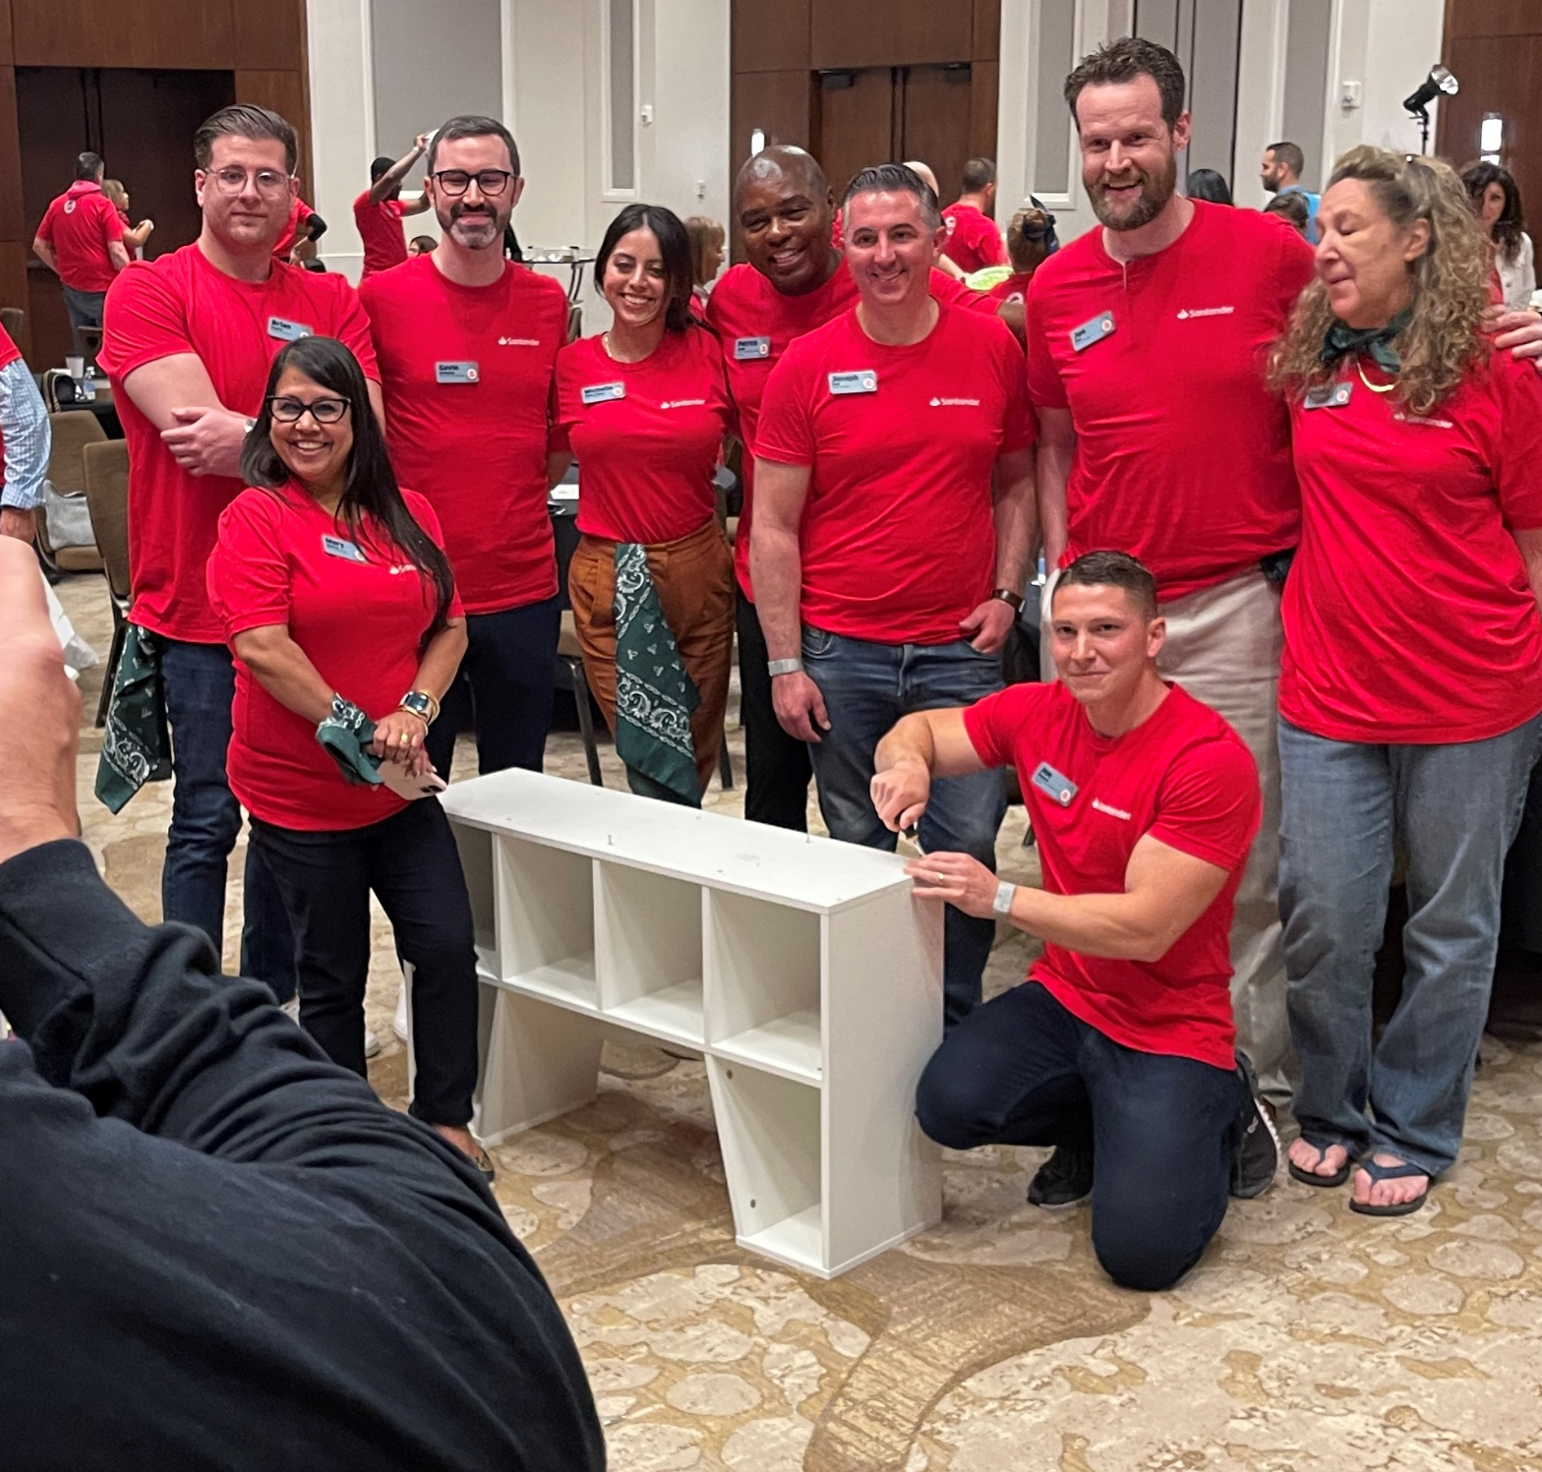
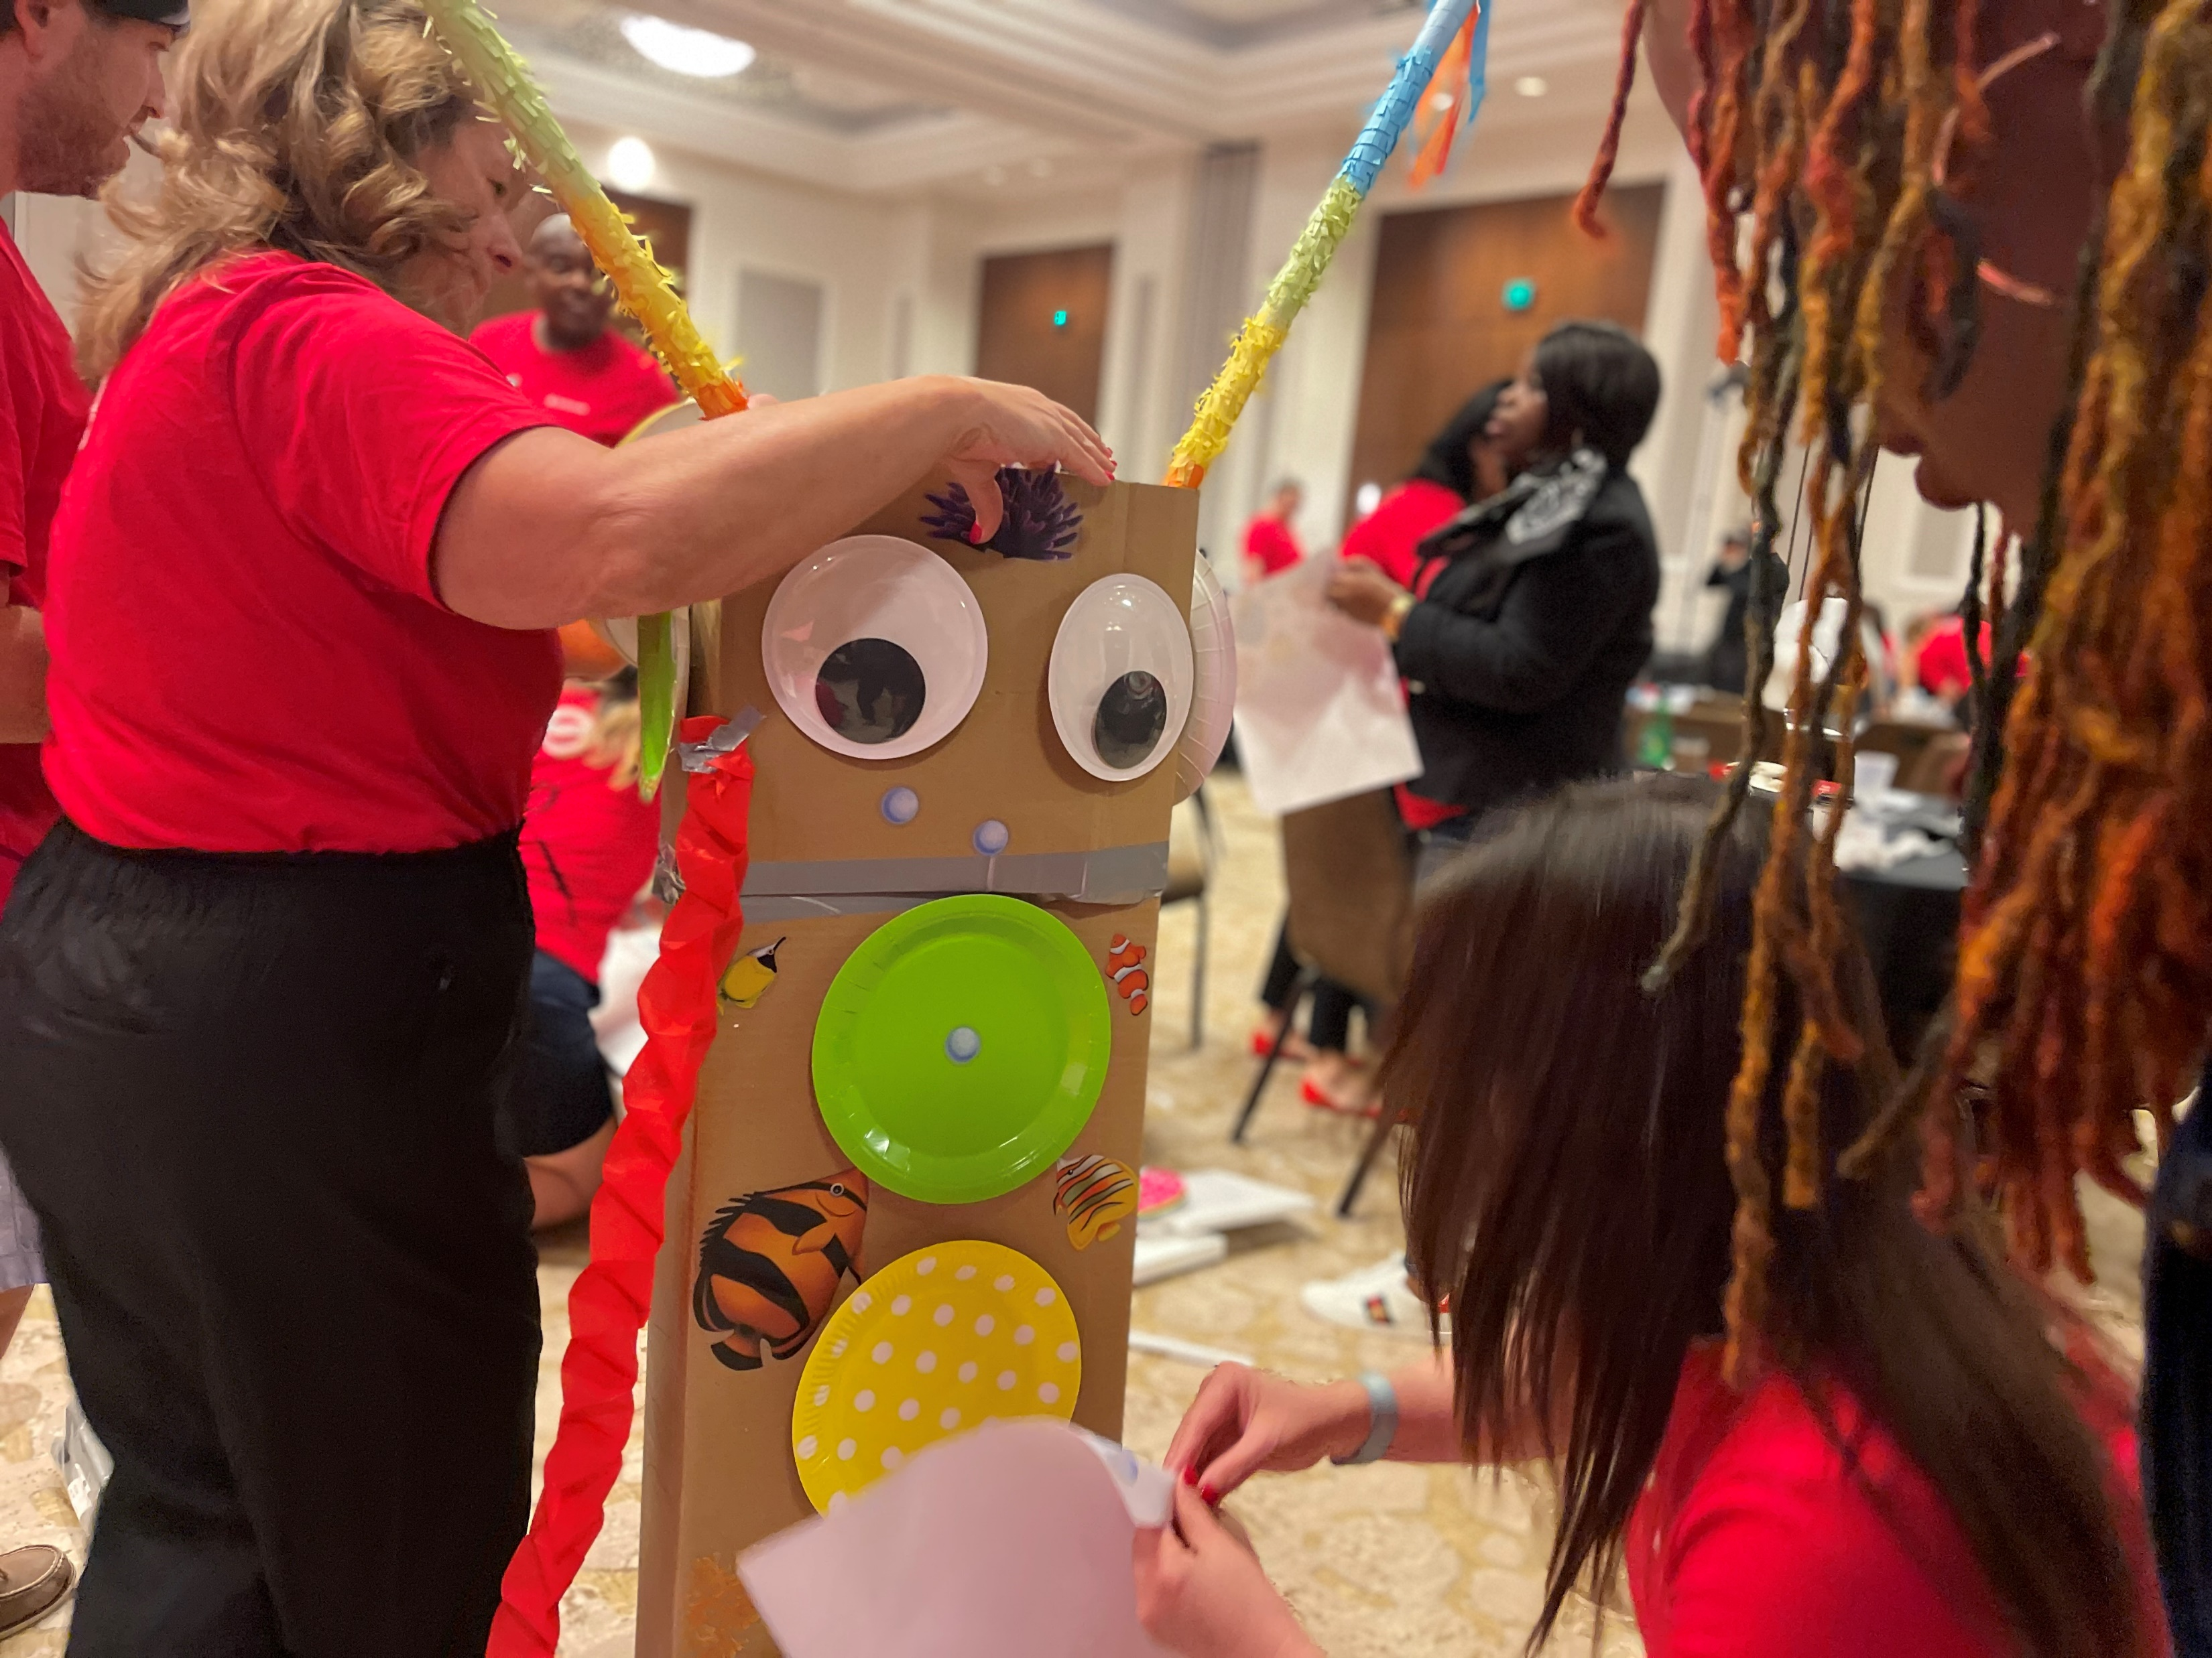
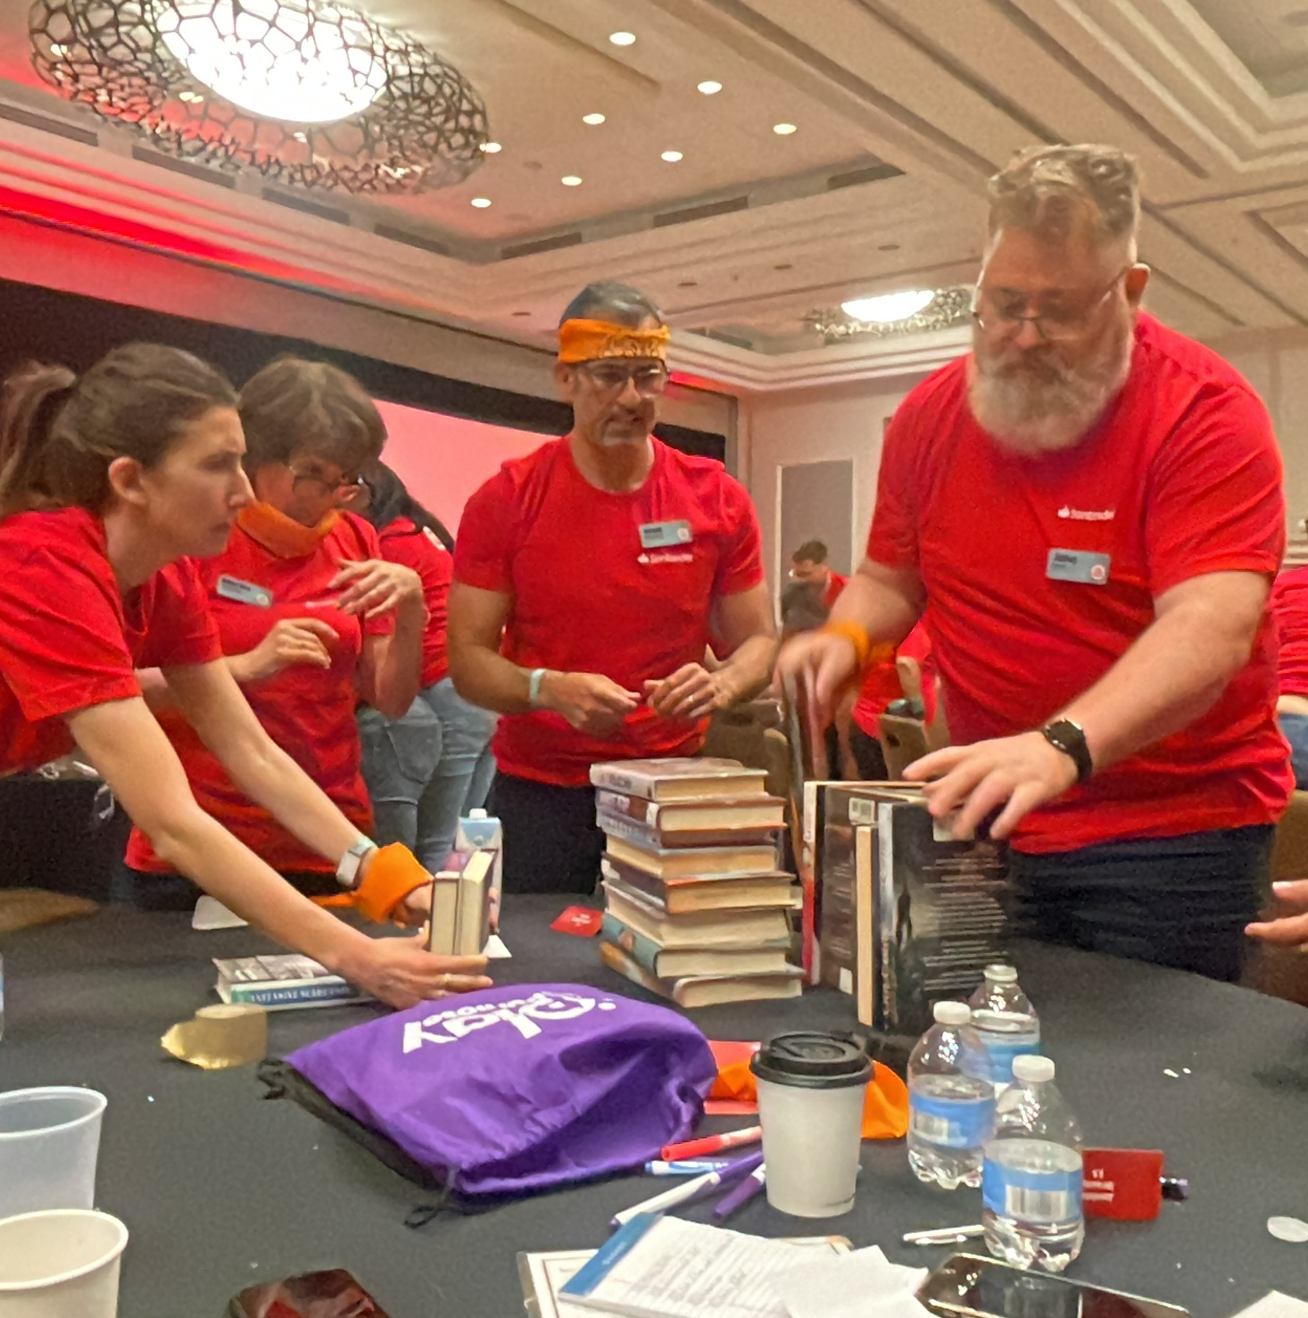
Worms
Unleash Your Inner Bookworm!
60 to
90 min
Players 10-Unlimited
Live
Indoor
Outdoor
The love of reading starts at a young age, where kids explore fascinating worlds, cool animals, scary escapes and wonderful people. But for many young children, the joy of owning their own books or having access to a library is only a dream. Bookworms combines friendly competition, hands-on construction and a powerful display of caring in an extraordinary event that provides children in need with their own books and stories.
Teams engage in competitions to gather building supplies and decorating materials, then construct and decorate unique bookshelves. Representatives from local agencies share touching stories and introduce the children who will benefit from your generosity. Additionally, a book drive can be hosted to encourage associates to donate books and leave an enduring legacy of knowledge and empowerment. Bookworms is an extraordinary event that kindles a love for reading and changes lives.
Intro
Icebreaker
Strategy Stage
90 Minutes
Building
Present
Charity Speaks
Awards

