Slide 1
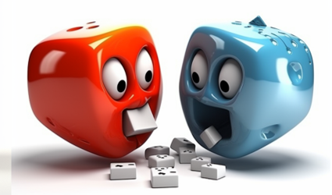
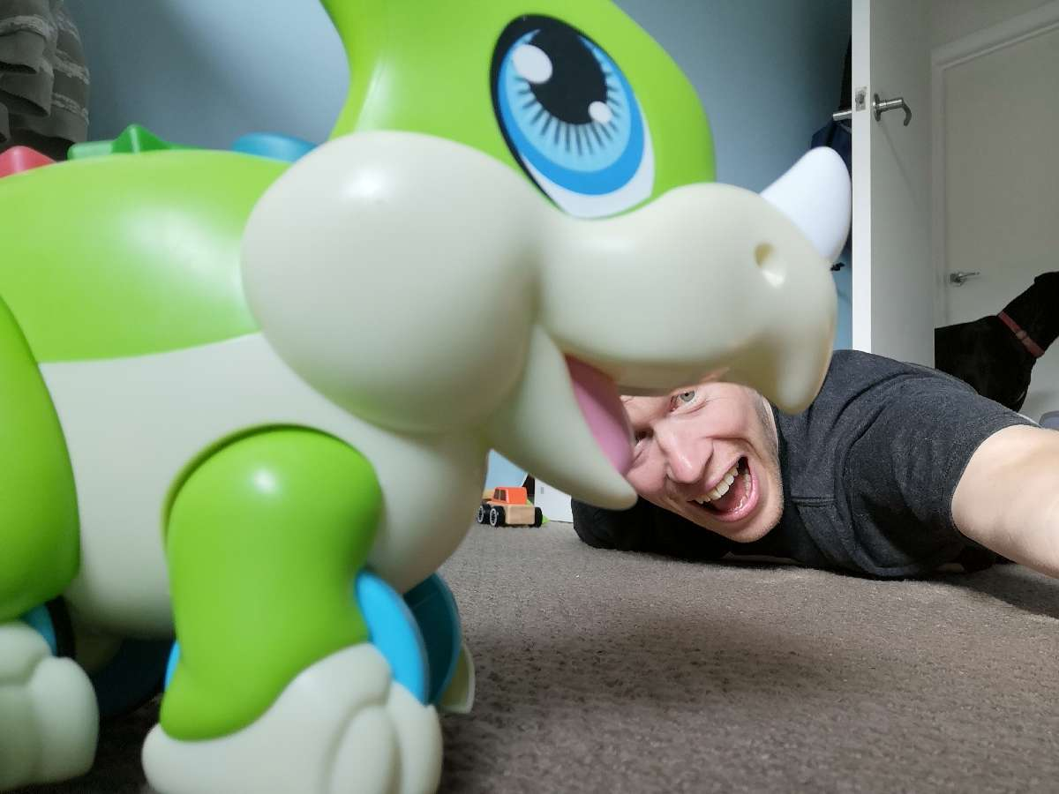
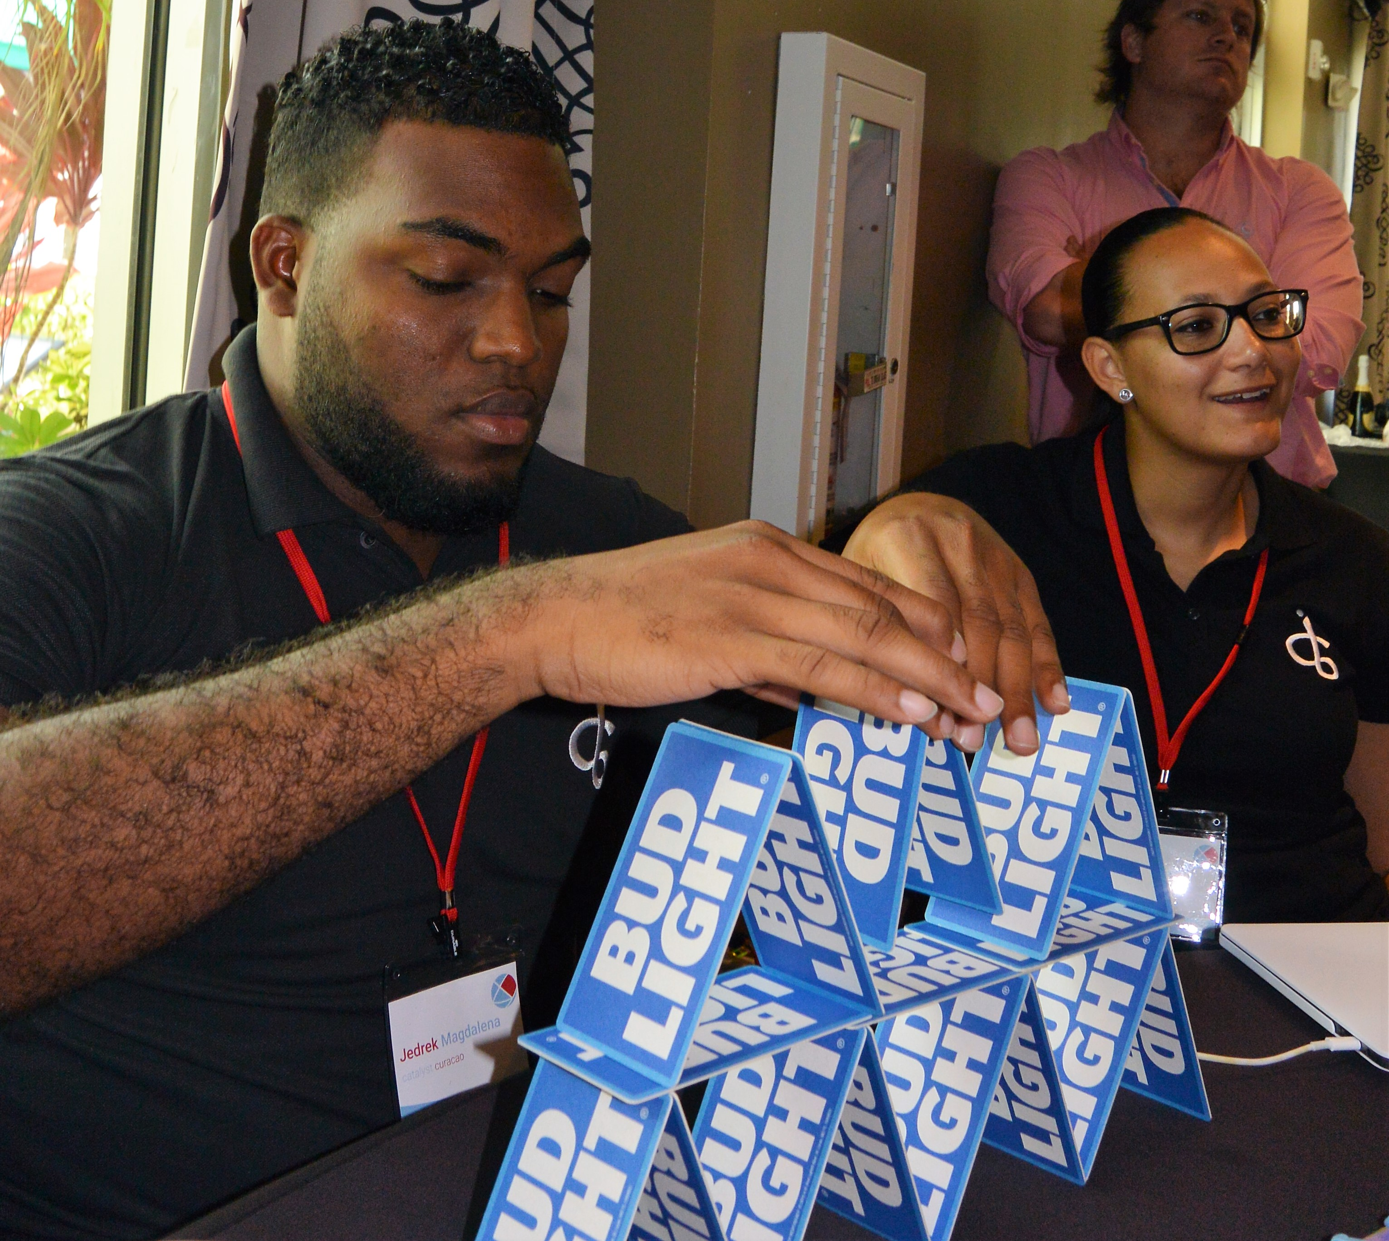
Face Off
Frenzy
High energy LOL fun to engage your guests!
60min
90 min
Players: 10 to
Unlimited
Indoor
Outdoor
Live
This high-tech, fast paced game pits mano-a-mano in zany challenges sure to bring out the fun of your group! After downloading our custom game app, all kinds of ways to earn points pop up on the screen. Even though guests are playing for themselves, they must engage with others at the event in face-to-face playoffs of varying kinds. It’s up to them whether they choose competitive or collaborative options and also who they play with! Everything is captured in the app for points and pictures to remember the event.
It’s a high energy environment, where in every direction something exciting is happening! One corner has a pair arm-wrestling, where another has a group trying to hold as many pretzel sticks as they can in their mouth. In the front of the room someone has grabbed the mic and is singing “You are so Beautiful” while the table next to them is stacking Jenga blocks. Earn points by playing with or competing against the others in the room – the choice is always yours! There is never a dull moment right up until the leaderboard reveals our winners!
Intro
Activity
Awards
Group Picture/
Goodbyes

