Slide 1
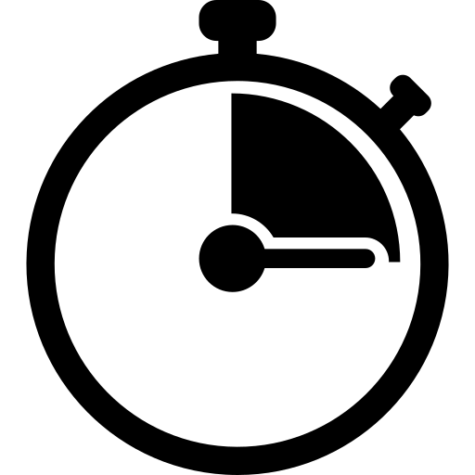
Opening
Try Out the Latest Market Moves!
75 to
120 min
Players 15 -1000
Indoor
Outdoor
Live
Get ready for the most thrilling and clever trading simulation experience with “The Opening Bell"! In this fast-paced adventure, you'll immerse yourself in a dynamic market where your negotiation and strategic skills will determine your financial success. With a diverse range of commodities to sell and trade, like gold, diamonds, bitcoin, and more, you'll embark on a four-year journey to maximize your earnings. But beware, relying solely on resources won't be enough; you must engage in skillful information trading and shrewd negotiations to outsmart your competitors.
Collaborate with fellow traders, share insights, and learn from winning strategies. “The Opening Bell" is not just a game—it's a transformative experience that unleashes your trading potential, enhances decision-making abilities, and translates real-life lessons into practical applications. Don't miss this opportunity to become the ultimate Master of the market!
Intro
90 Minutes
Challenge
Awards

