Slide 1
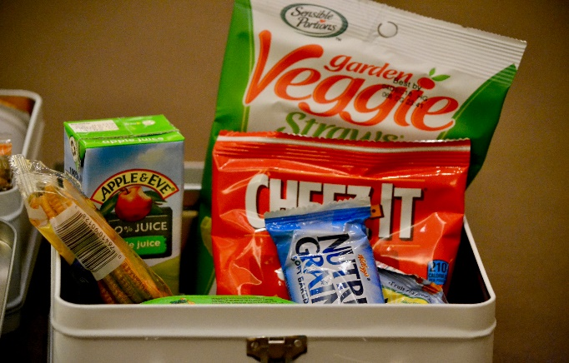
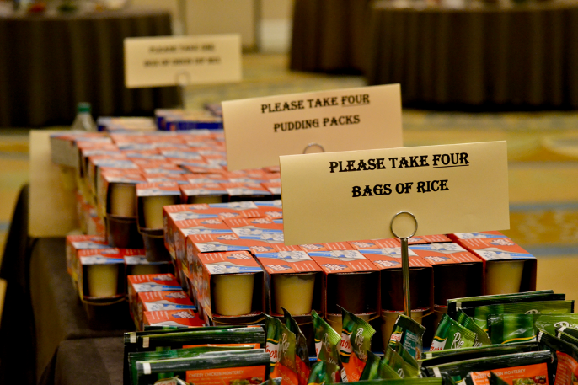
Caring Connections
Win big for local kids!
60min
120 min
Players 10-
Unlimited
Virtual
Live
Indoor
Outdoor
Experience the Ultimate Connecting Games, an exciting event designed to bring your team closer while making a positive impact on hungry children in our local community. As your colleagues engage in thrilling "connecting games," they'll not only build stronger relationships but also contribute to a worthy cause. Each table becomes a team, striving to earn as much "cash" as possible. But here's the best part: Every dollar earned translates into a gift of comfort and tasty treats for a child in need.
By partnering with the Boys and Girls Club, whose mission is to empower children to succeed and serve their communities, your contribution will have a lasting impact. It’s no surprise that 54% of alumni surveyed nationally say the Club actually saved their life. Imagine the emotional connection when a representative from the Boys and Girls Club expresses their heartfelt thanks to your team, highlighting the profound difference they're making. Join us for the Ultimate Connecting Games and create unforgettable memories while changing lives.
Intro
Icebreaker
90 Minutes
Activities
Charity Speaks
Awards

