Slide 1
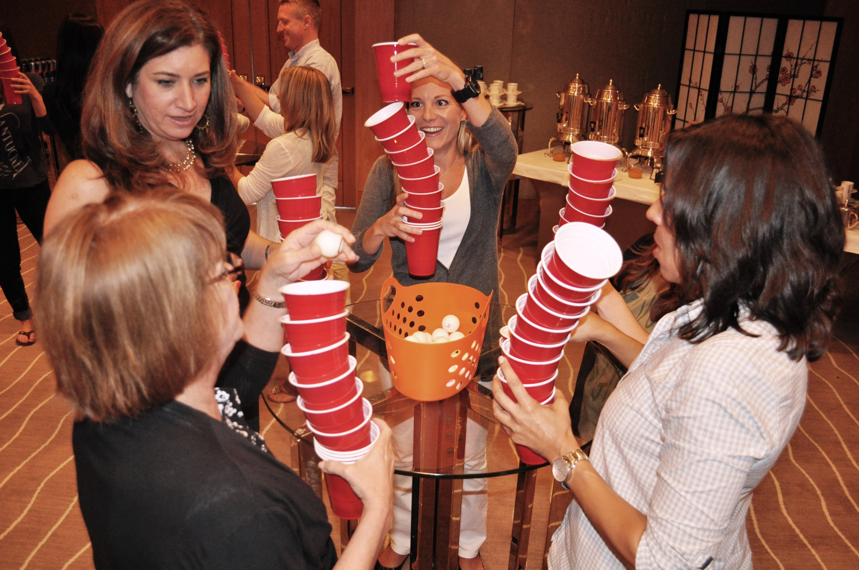
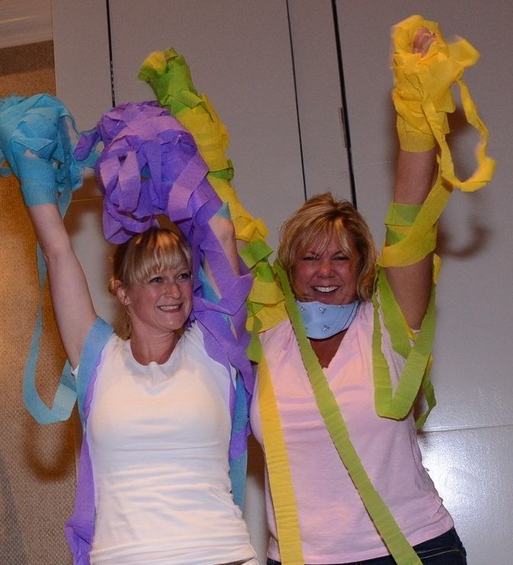
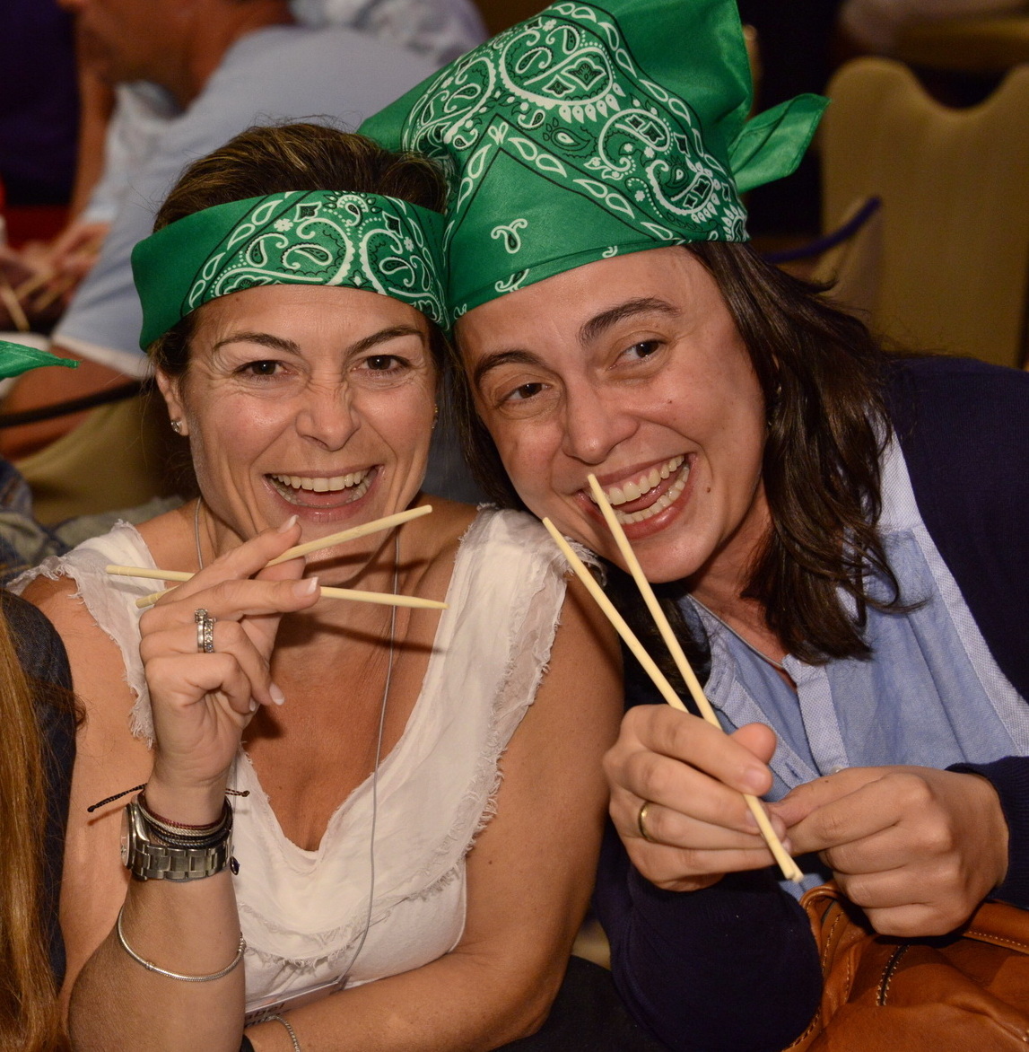
IN it TO
IT
Unleash Your Inner Champion!
60 to
90 min
Players 10-
Unlimited
Virtual
Live
Indoor
Outdoor
Intro
Are you ready for explosive fun wrapped up into 60 second bursts? Introducing the ultimate game show experience inspired by the hit TV show! With our exhilarating challenges, your teams will be put to the test in 60-second activities that will push their nerves, wits, and talents to the limit, all in pursuit of being the ultimate winner! From table games that require teamwork and creative thinking to practice rounds that build skills and confidence, every moment is filled with tension and excitement.
The pressure reaches its peak as MVPs from each team compete head-to-head in front of a cheering crowd, and the grand finale pits the best of the best in a wildly entertaining showdown. Our unique scoring system ensures non-stop engagement and the thrill of the gamThis is the best way to wake everyone up, get them energized and ready for great things to come. It sets a fun and team-centric tone for the entire conference. Are you in it to win? You can’t lose with this event!
Game 1
Game 2
90 Minutes
Game 3
Game 4
Awards

