Slide 1
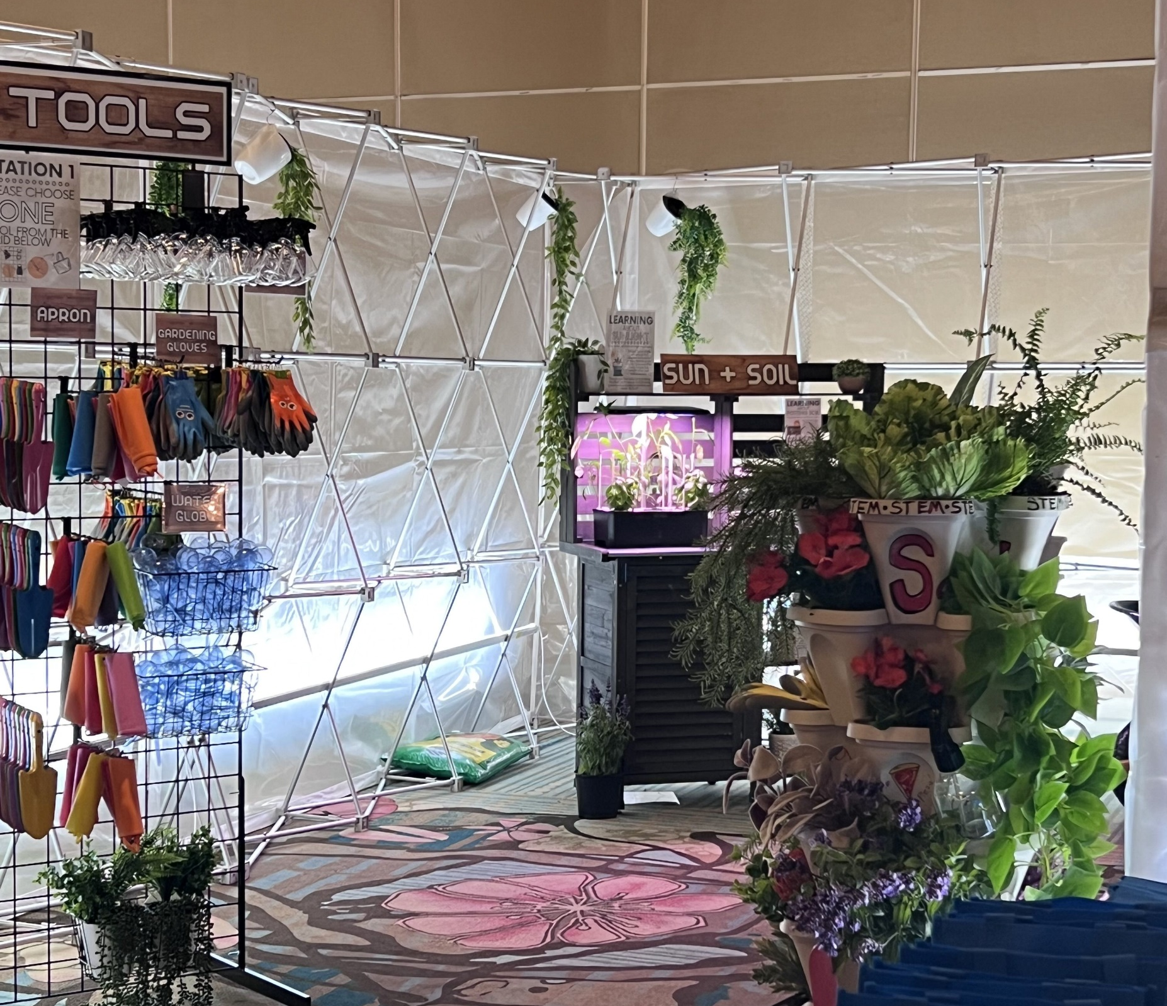
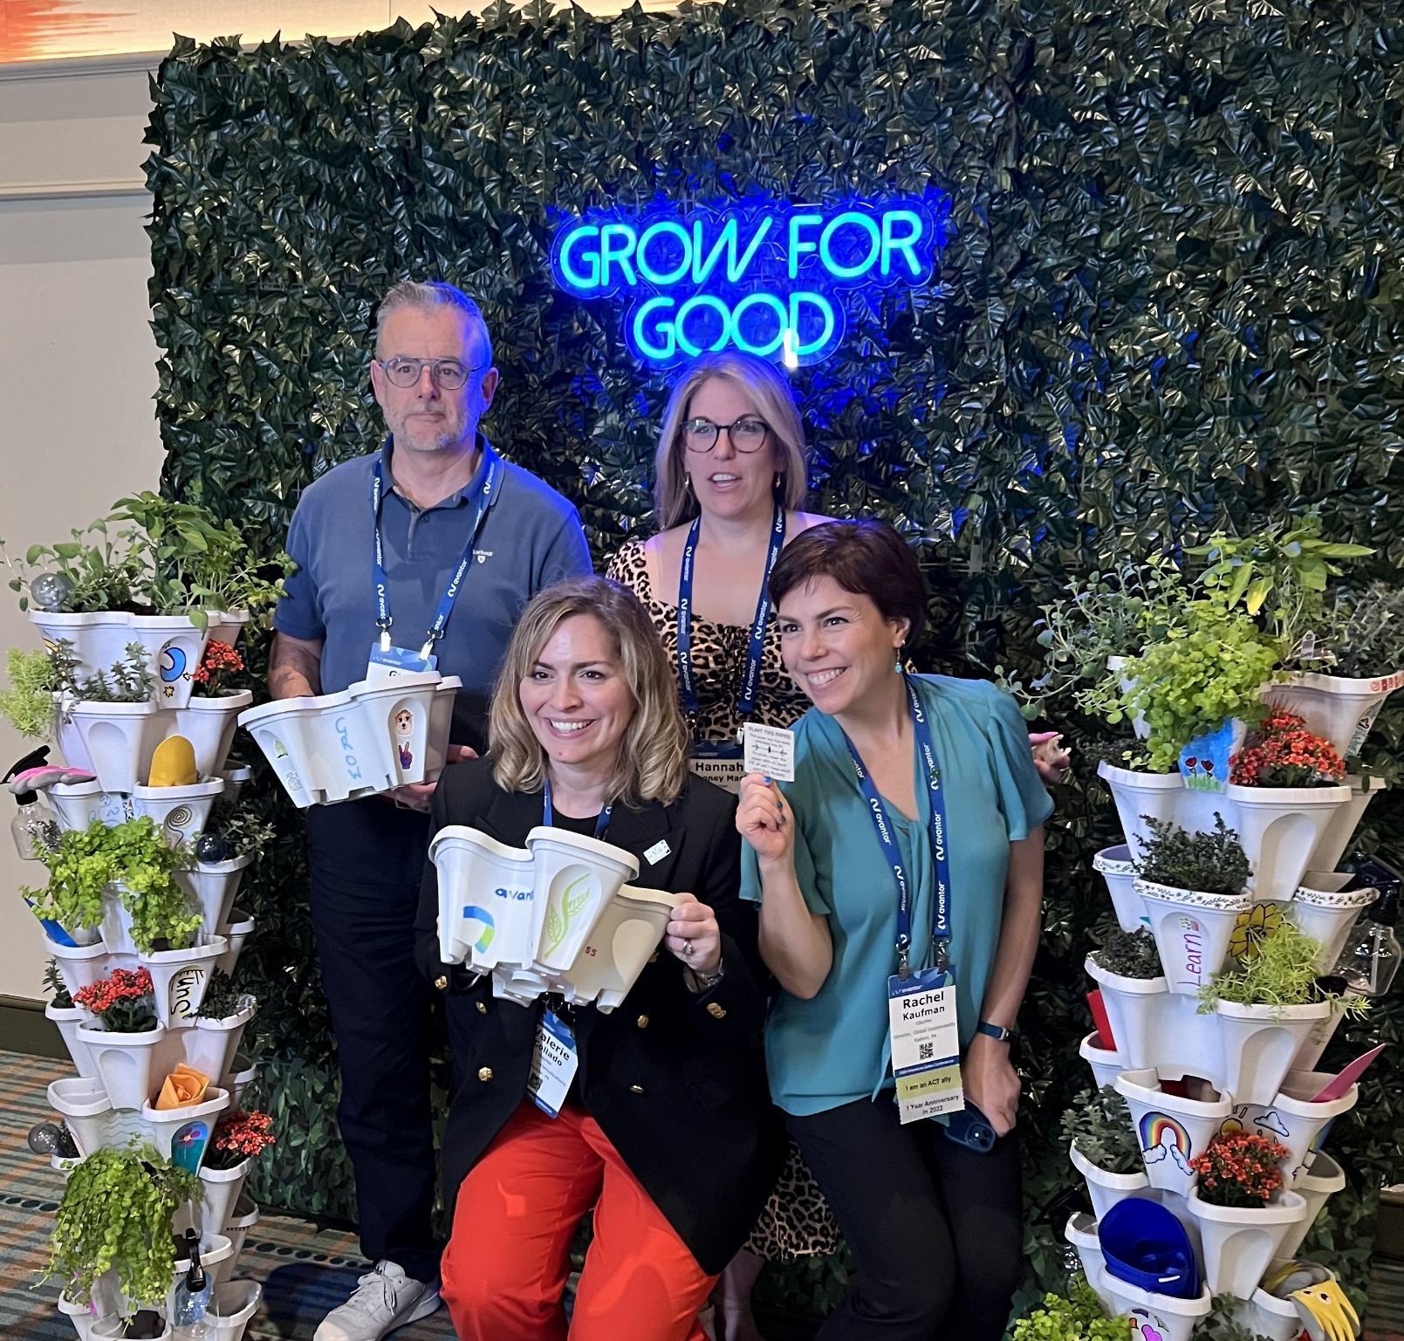
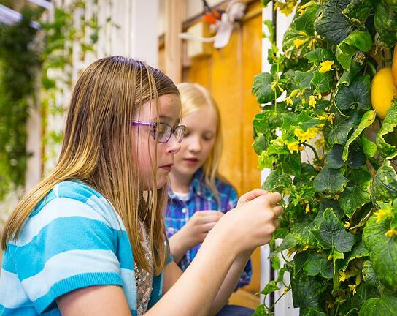
GROW for GOOD
Nurturing Curiosity, Harvesting Potential!
Unlimited
Guests
Indoor
Outdoor
1 to 3 hours
Live
Is pizza your child’s favorite food? Does she love a fruity smoothie? While enjoying those treats, do you think they ever consider where they came from? This sustainable AND educational community give-back event allows kids to discover those facts – and a literally a zillion more! Your gift of Hydroponic Gardens and growing supplies teaches kids a treasure trove of STEM skills – science, math health, nutrition, and even reading!
Guests at your reception or tradeshow are immediately captured by the warm glow of garden lights and the lush towers of gardens at this STEM CSR experience. They’ll discover a healthy, sustainable and educational project – decorating and assembling Hydroponic Garden Towers and packing Grow Kits to donate to a local school. They are sure to learn and be inspired by this unique form of growing food, and all the potential it has for stimulating young minds in the sciences
Greenhouse
Open on
Free Flow
Basis
120 Minutes

