Slide 1
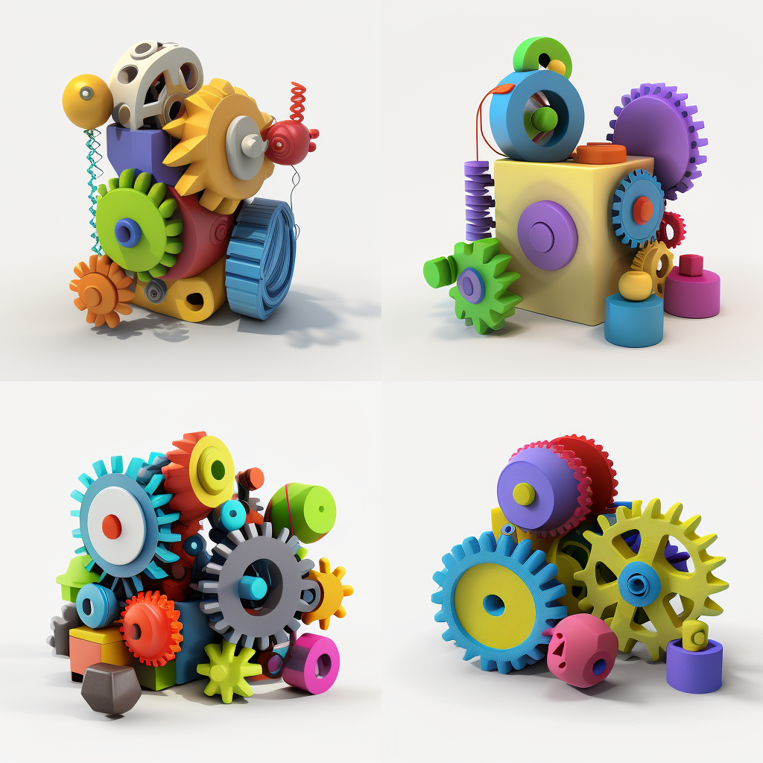





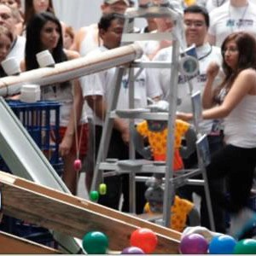
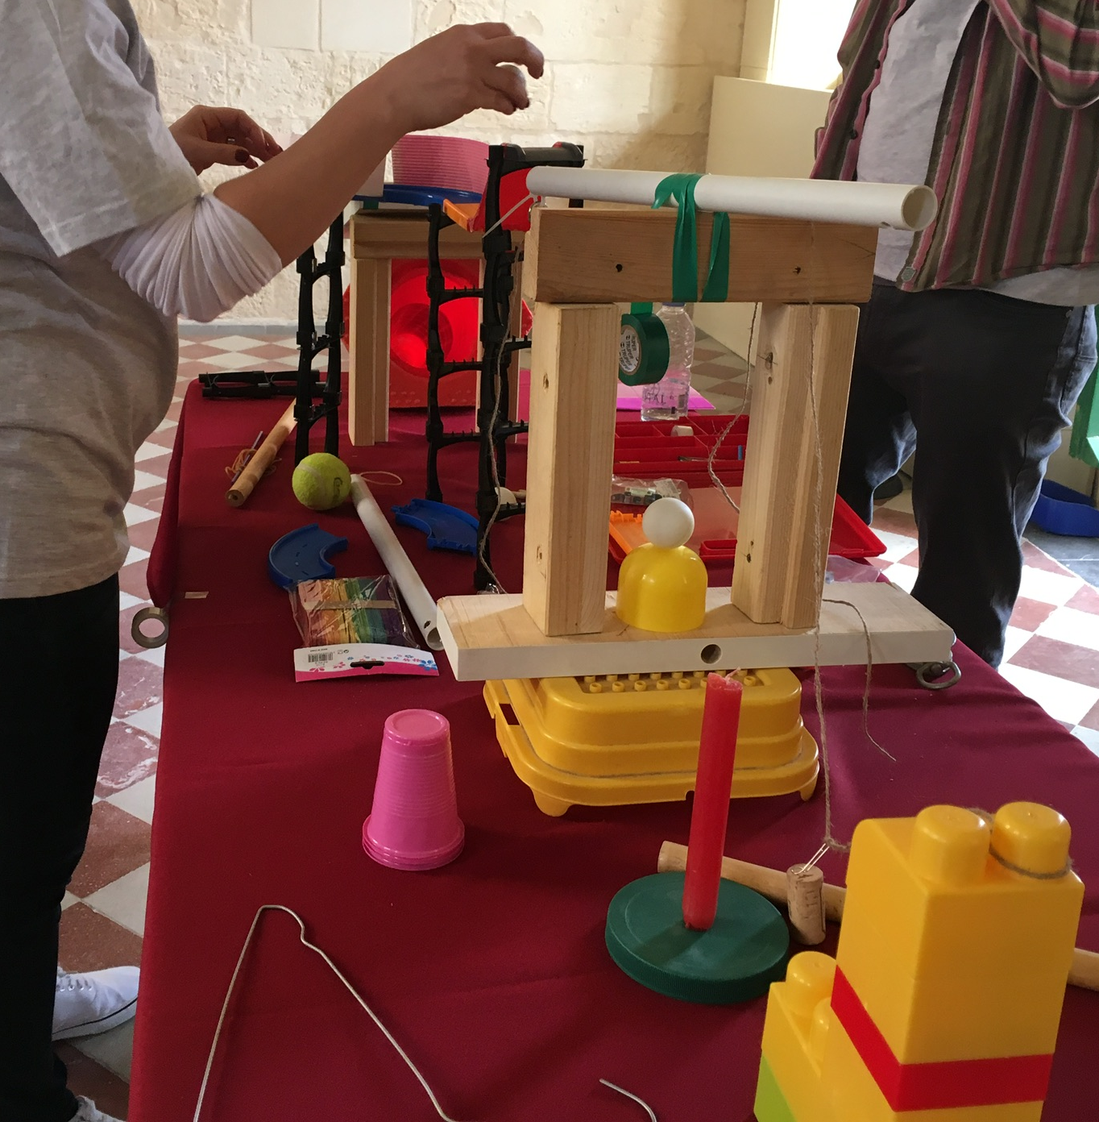
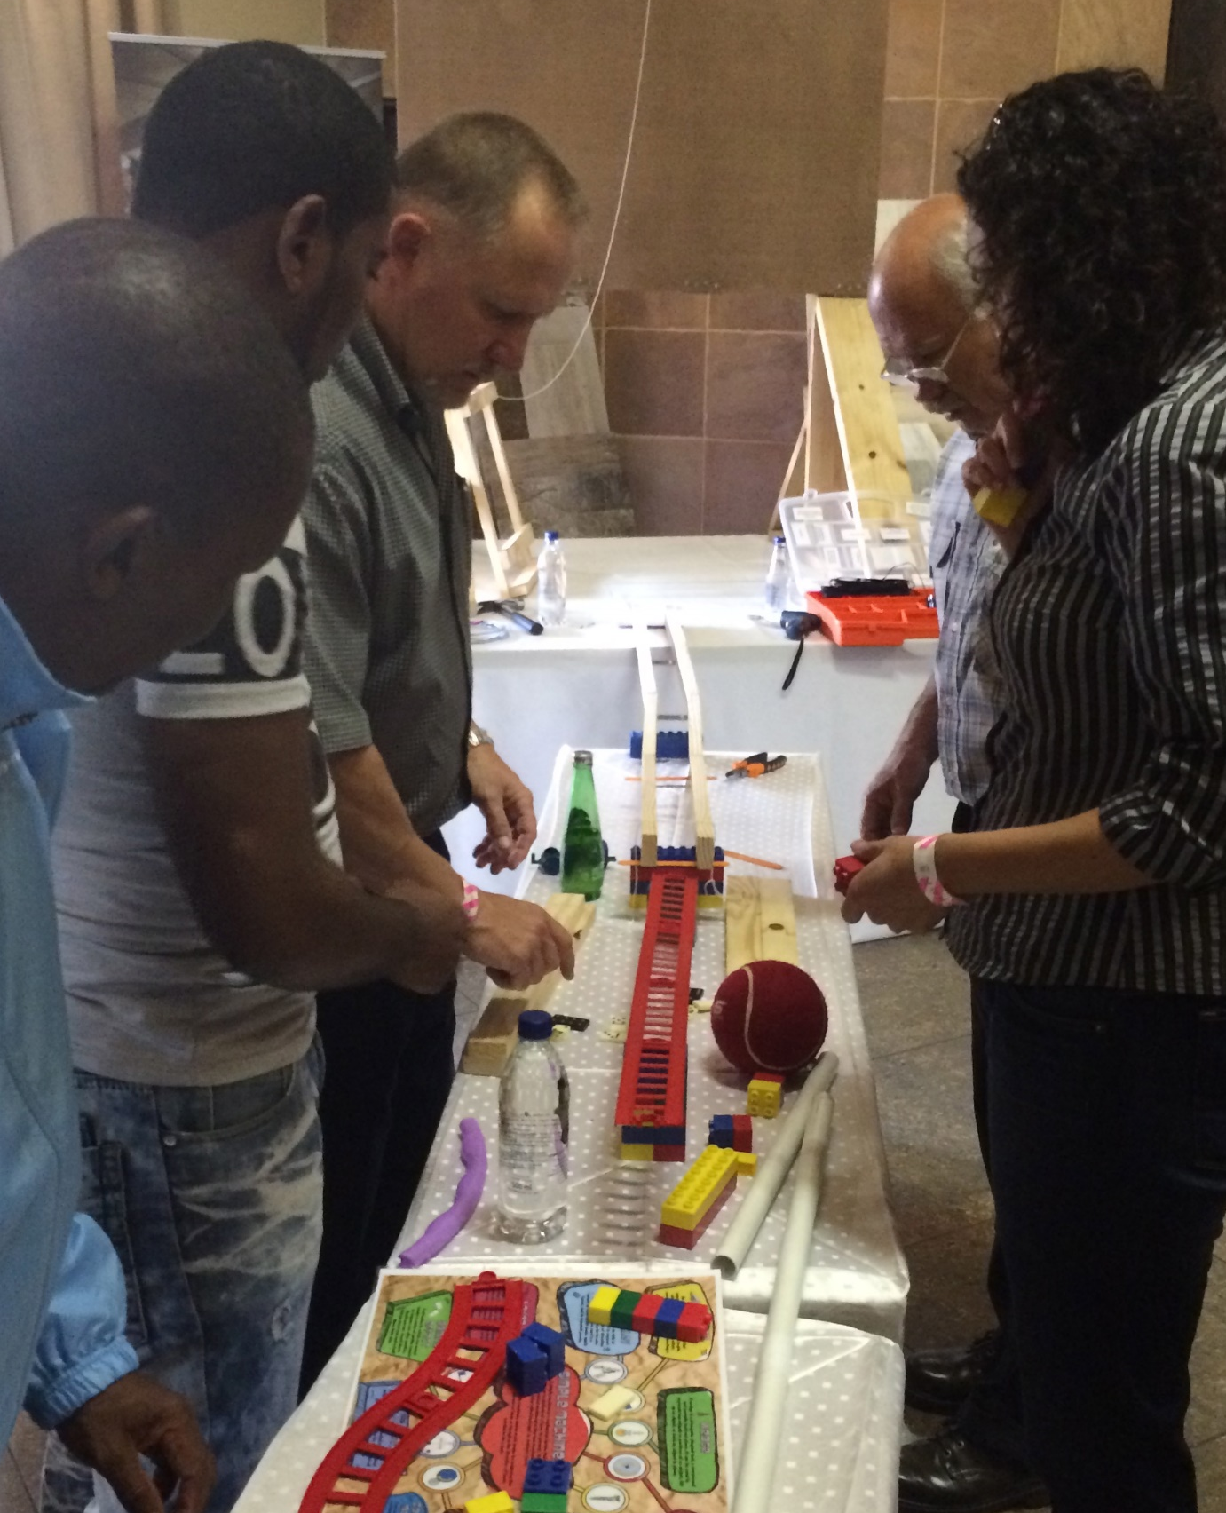
hain Reaction
Momentum Gone MANIC!
60min
120 min
Players 10-
Unlimited
Virtual
Live
Indoor
Outdoor
Immerse your team in the electrifying world of Chain Reactions! This one-of-a-kind event is a captivating fusion of creativity, collaboration, and pure excitement. As teams navigate through the design, plan, build, and test phases, they'll discover the power of effective teamwork and problem-solving. With limited time and resources, teams build a Rube Goldberg-esque contraption utilizing dozens of ups, downs, twists and turns.
The thrill intensifies as each component connects seamlessly, triggering a mesmerizing chain of cause and effect. Each smaller segment propels the next to a tense and climatic finish! Optional competitive elements based on innovation and function add an extra layer of excitement. The result? An unforgettable experience that unites your team, ignites their passion, and leads to a victory celebration where everyone wins!
Intro
Strategy
90 Minutes
Build
Present

