Slide 1

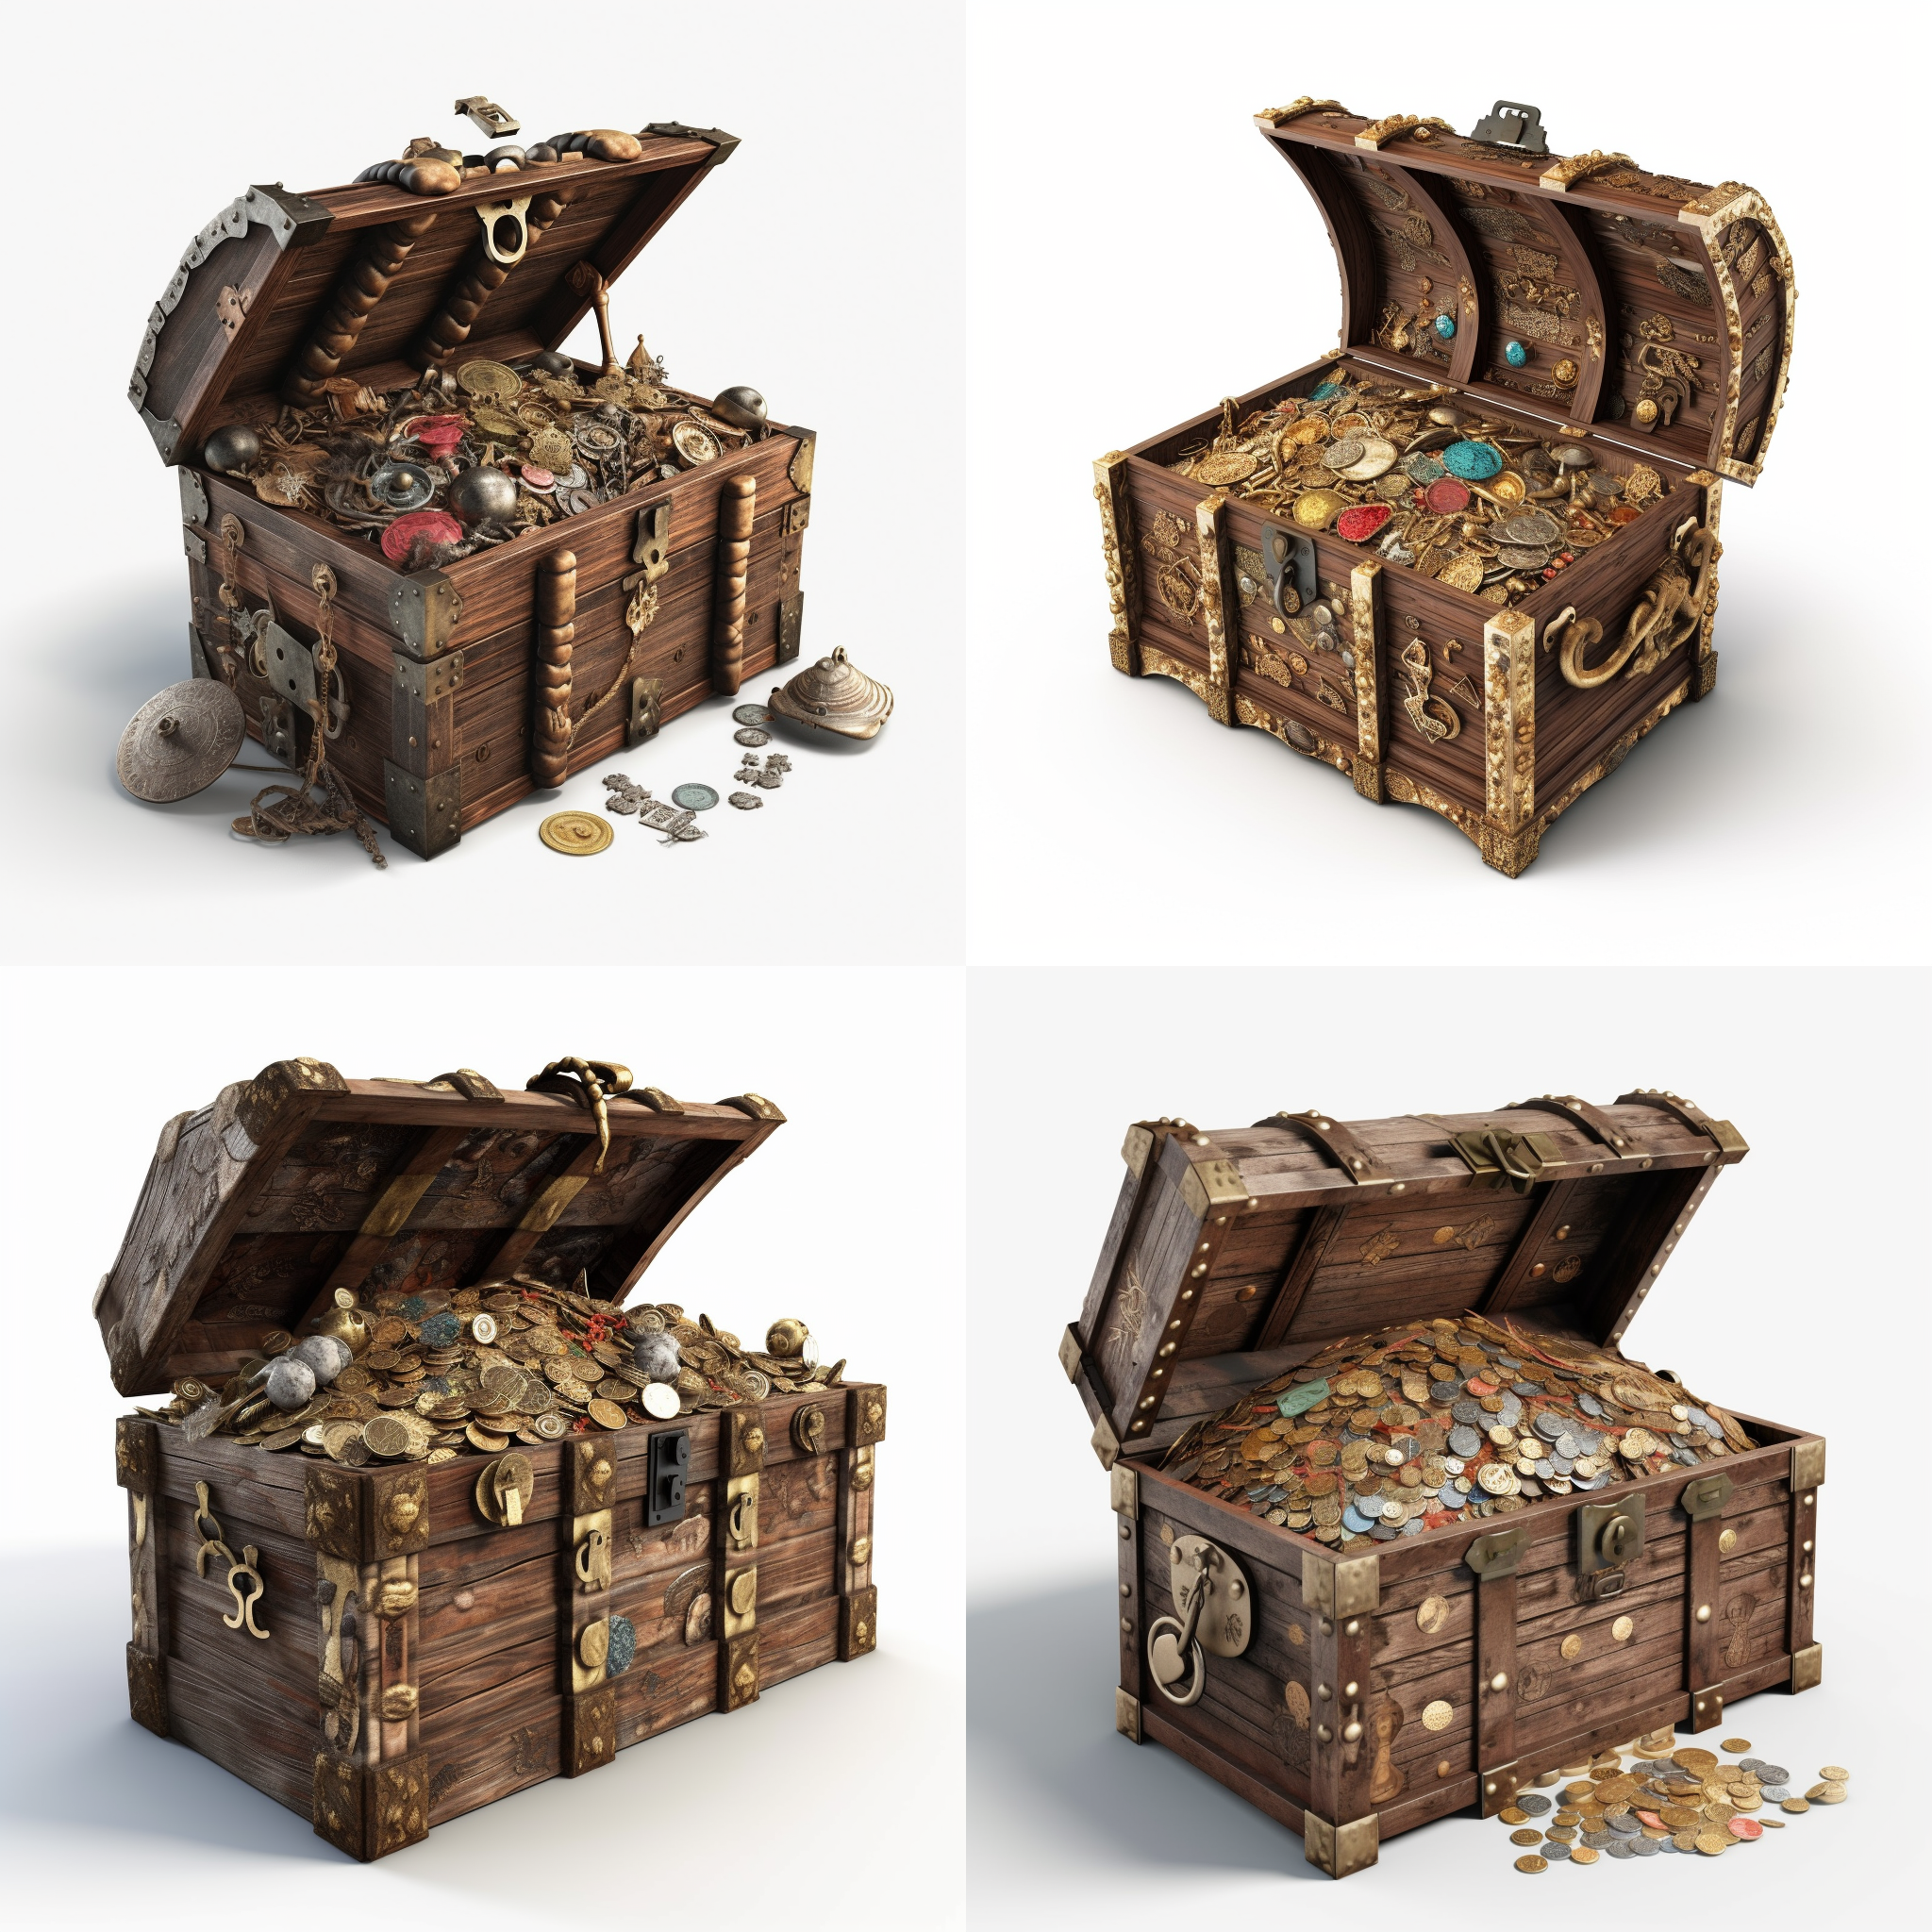




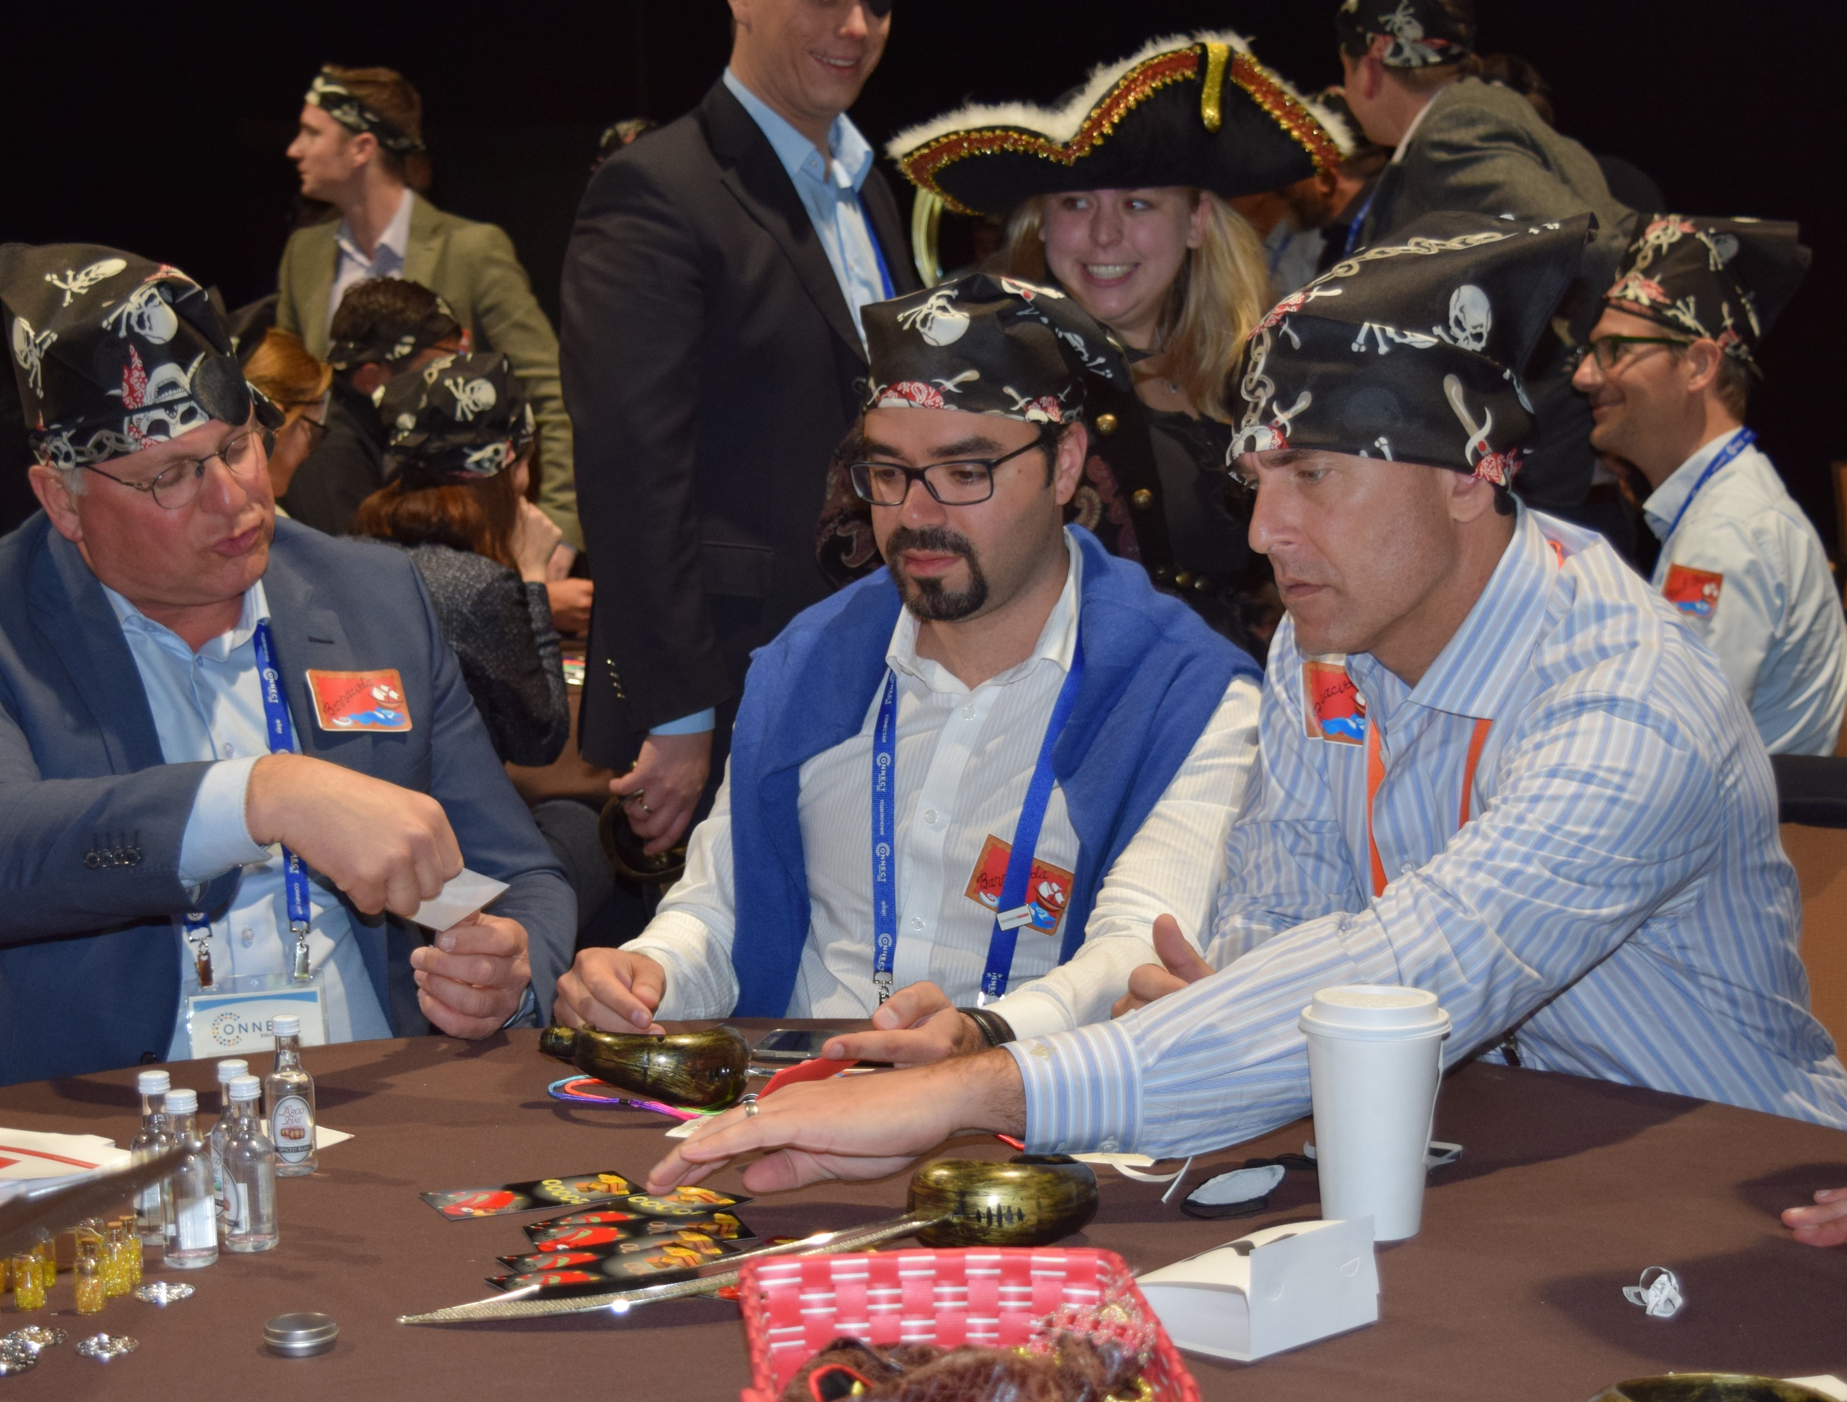
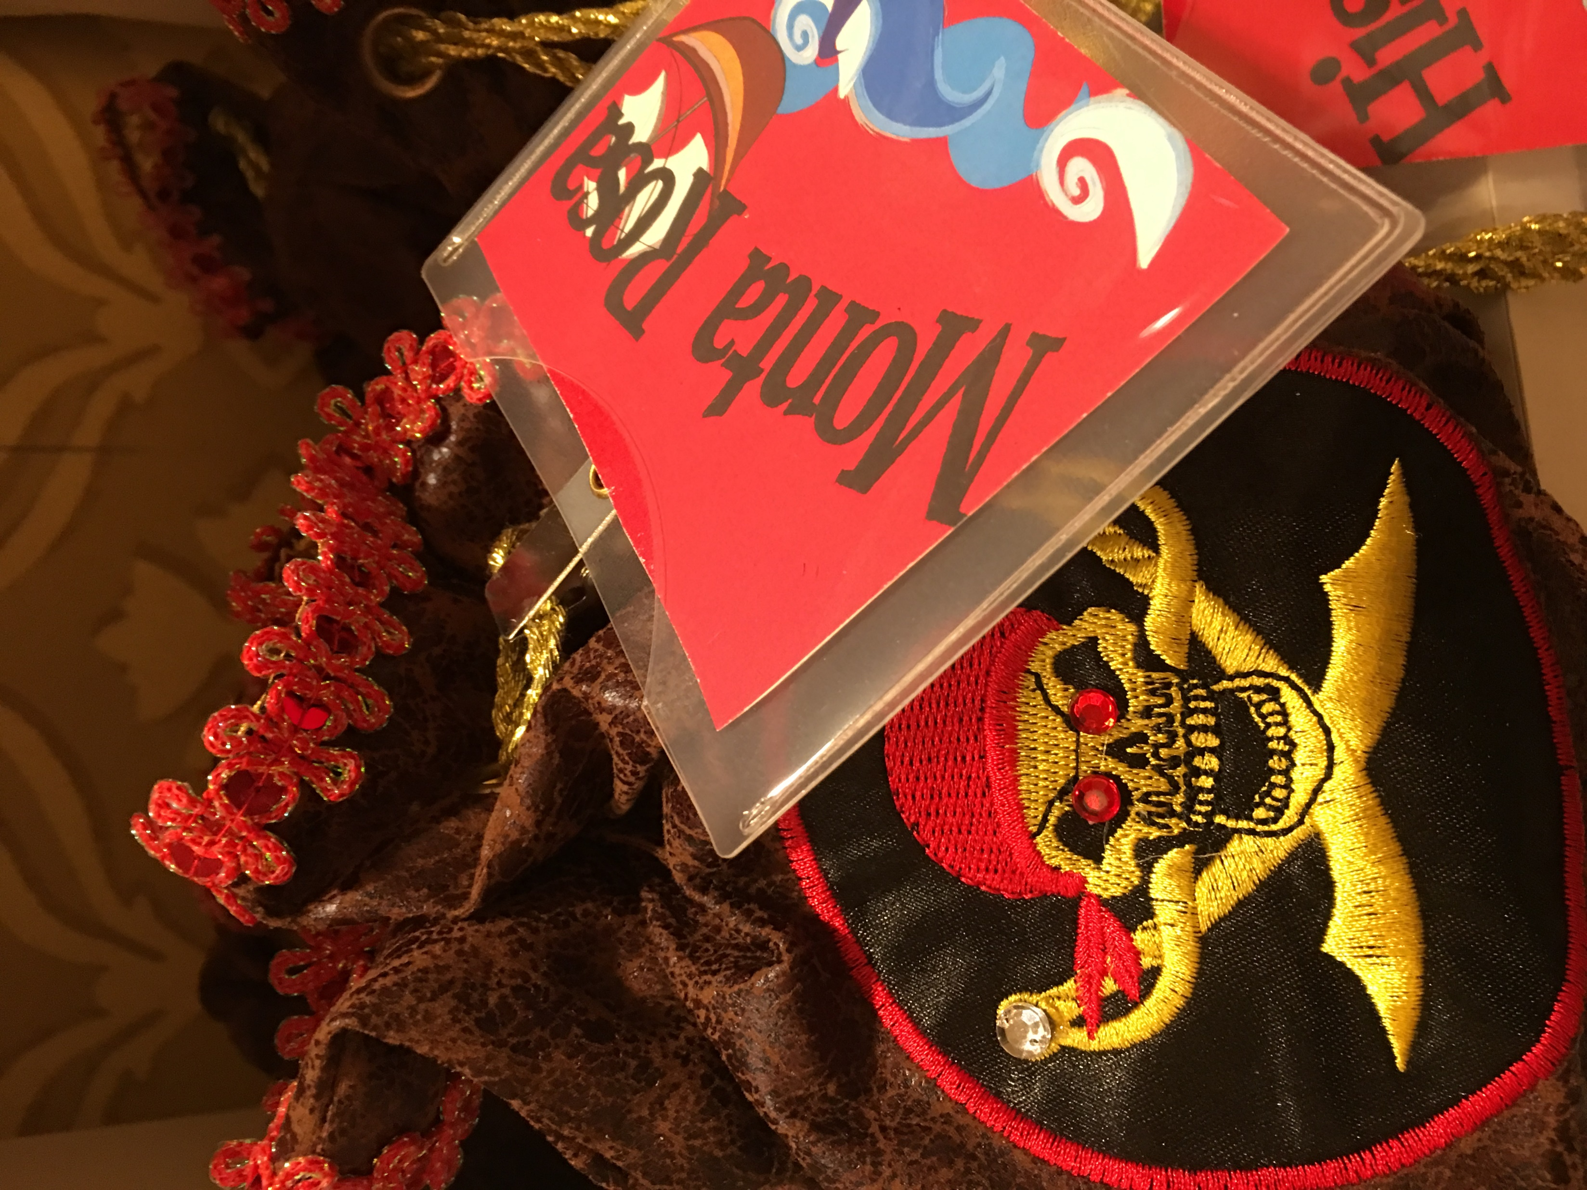
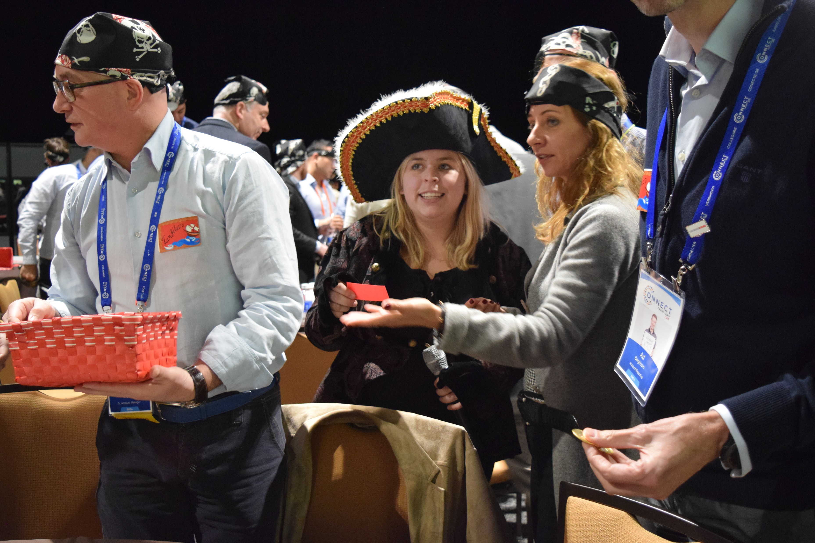
Winds
Chart Your Course; Seize the Treasure
75min
120 min
Players 20 –
Unlimited
Live
Indoor
Outdoor
“Always be yourself, unless you can be a pirate. Then always be a pirate.”
Good words to live by in this fast moving and highly immersive game that explores the skills of negotiation, information gathering, and networking. Choose your sword and your strategy carefully when you board approaching pirate ships to trade silver, gold, spices, and jewels. They have what you need, but what price are you willing to pay?
The goal in Trade Winds is to accumulate specific treasure by meeting other pirate traders and negotiating the exchange of treasure. Perfect for large group networking, it allows attendees to role play and have fun while exercising their skills of persuasion to get what they want! The big question is – can you really trust a Pirate? You’ll have to figure that out for yourself.
Not all treasure is silver and gold. This event provides a different treasure – a wealth of new relationships and winning strategies to apply to your business.
Intro
90 Minutes
Trading
Awards

