Slide 1






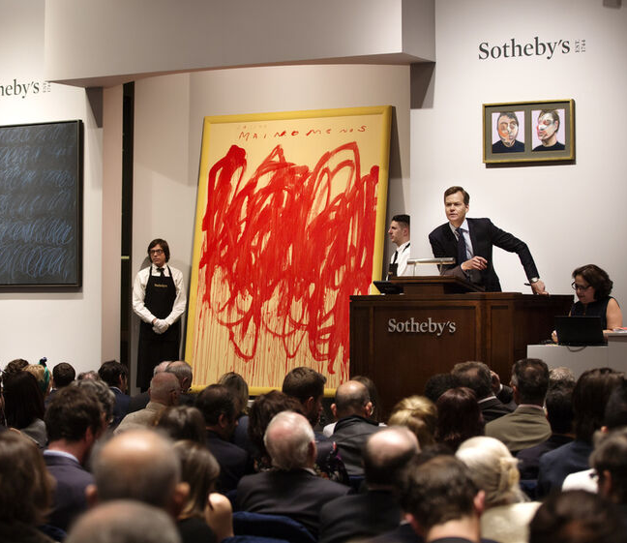
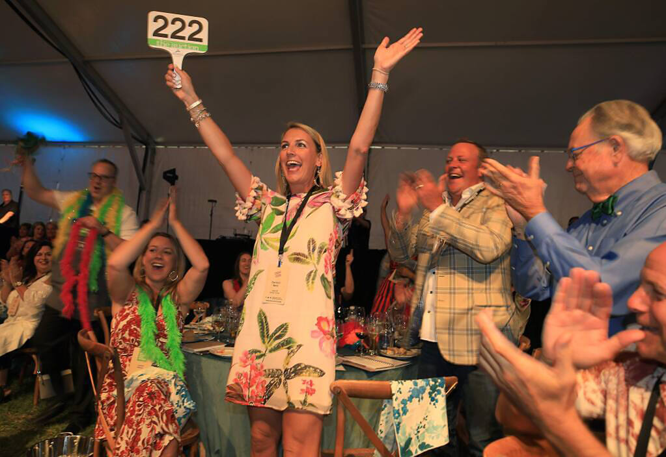
Blind Auction
Will wine, jewelry or art win the day?
60min
Players 10 -500
Virtual
Live
Indoor
Outdoor
The auction market is one of the most lucrative and glamourous industries in the world, with billions of dollars of luxury art, jewelry, furniture, whiskey and more sold each year. Experience the record-breaking, high-end exhilarating world of The Blind Auction, where teams compete, strategize, and reach consensus to secure valuable items in a game bursting with excitement and surprises. Each round, players reveal their item preferences and individually propose bids, creating a suspenseful and strategic atmosphere.
With limited investment money, teams then deliberate and choose their bid, facing the tough decision of risking it all or playing it safe. The game evolves with each round, captivating players and keeping them on the edge of their seats. The Blind Auction offers a unique networking experience that combines fun, sneakiness, and strategic thinking. With the right research and due diligence, can your team diversify your investments to be the most profitable collector at the auction?
Intro
60 Minutes
Bidding
Awards

