Slide 1
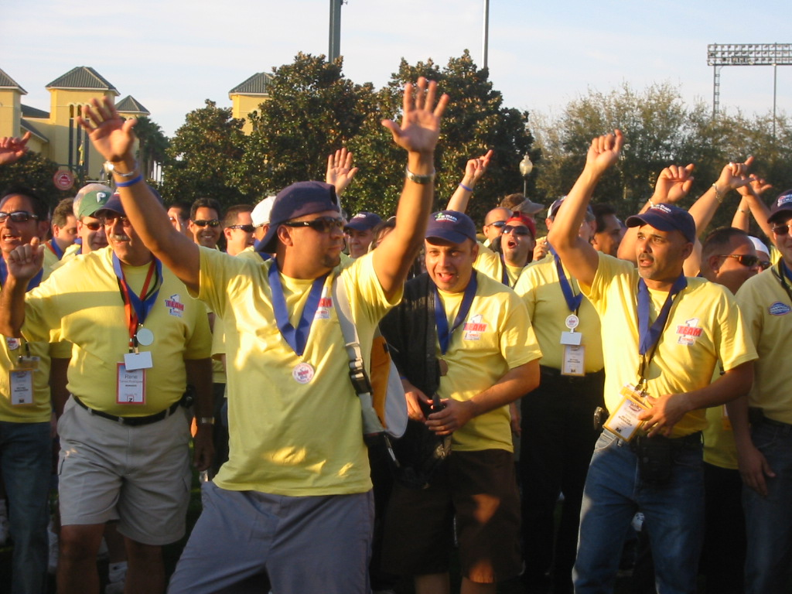
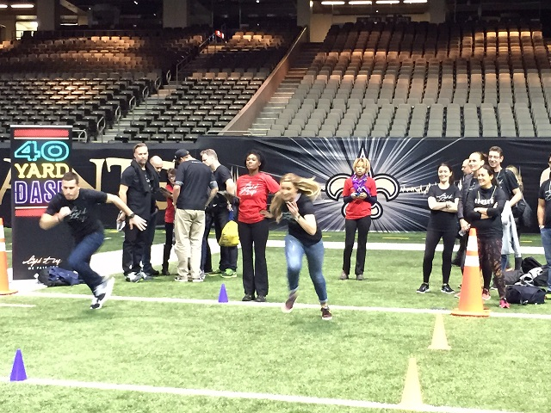
Qualify to Compete
Embrace the Olympian Within!
60 to
120 min
Players 10 –
Unlimited
Live
Indoor
Outdoor
Do you have what it takes to be a top contender? Qualify to Compete - The Olympics Edition - ignites the competitive spirit within your guests. Each team represents a state and tackles a range of engaging themed challenges, from capturing training photos to analyzing form and choreographing moves. Once their skills are honed, participants face heart-pounding physical trials such as relay races, long jumps, obstacle courses, and more. With each passing second, the atmosphere becomes more inclusive and the pressure intensifies, creating an unforgettable high-energy experience. The winning team, adorned with gleaming Olympic medals, proudly ascends the podium for the finale. Qualify to Compete - The Olympics Edition brings out the best in your participants both on the field and back in the office. Elevate your team's dynamics, unleash their competitive prowess, and create lasting memories of triumph and camaraderie with this unforgettable Olympic-inspired challenge.
Intro
Game 1
Game 2
90 Minutes
Game 3
Game 4
Awards

