Slide 1
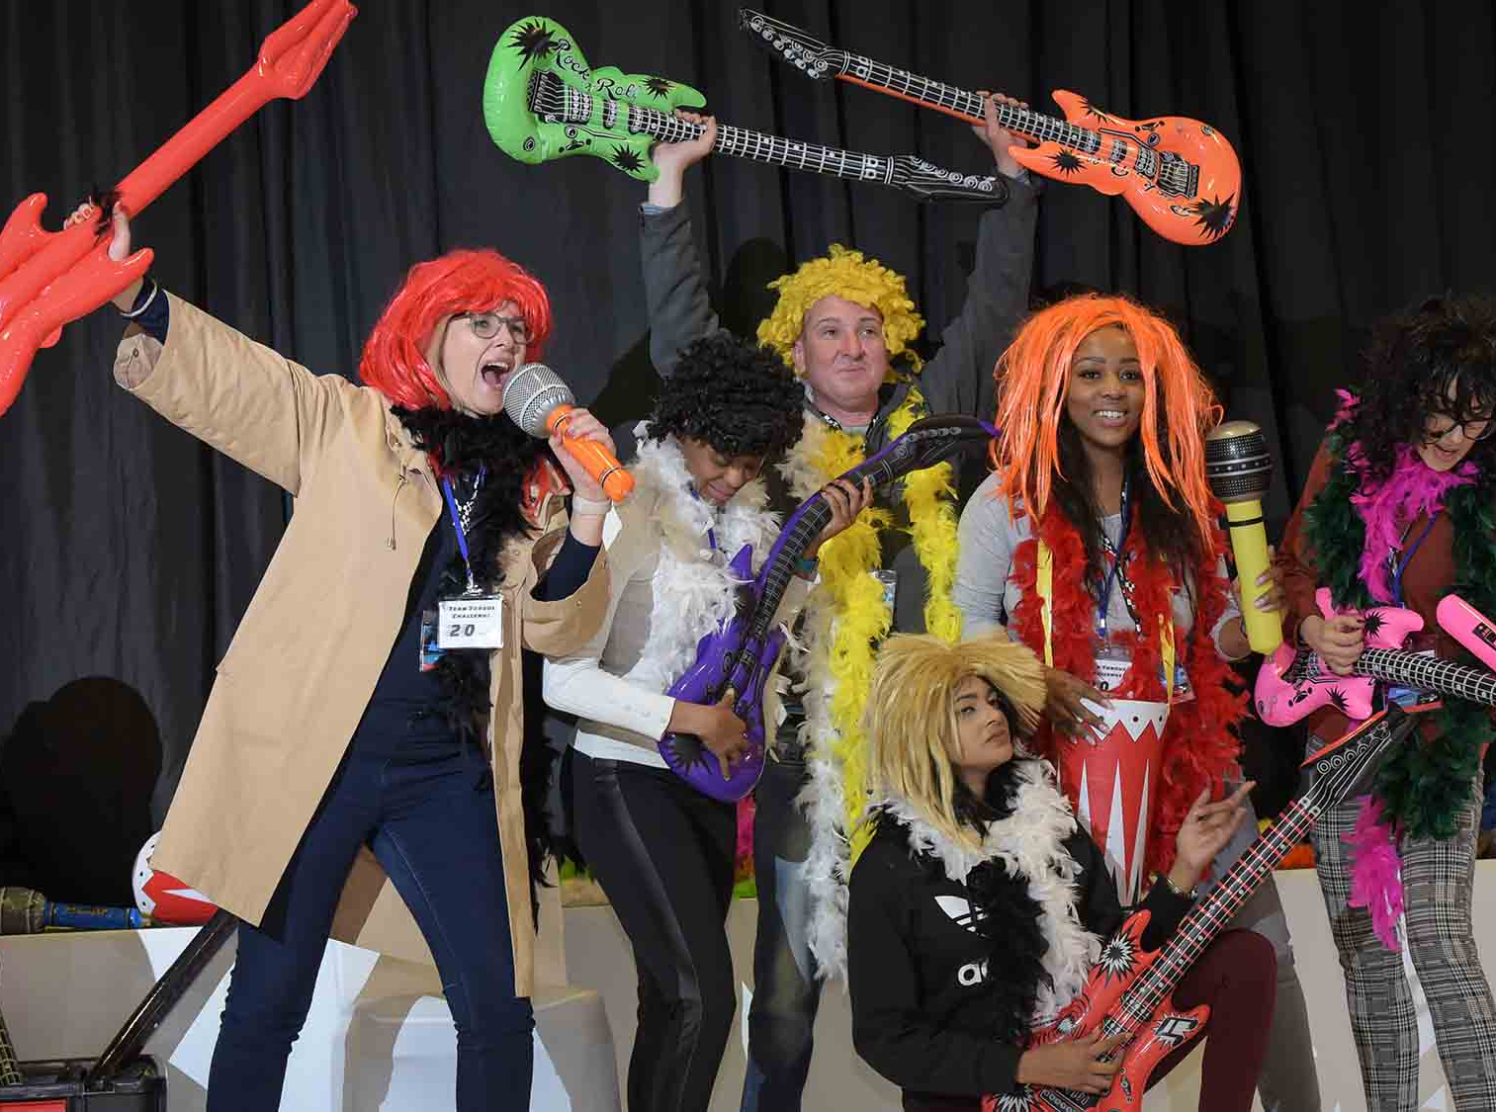
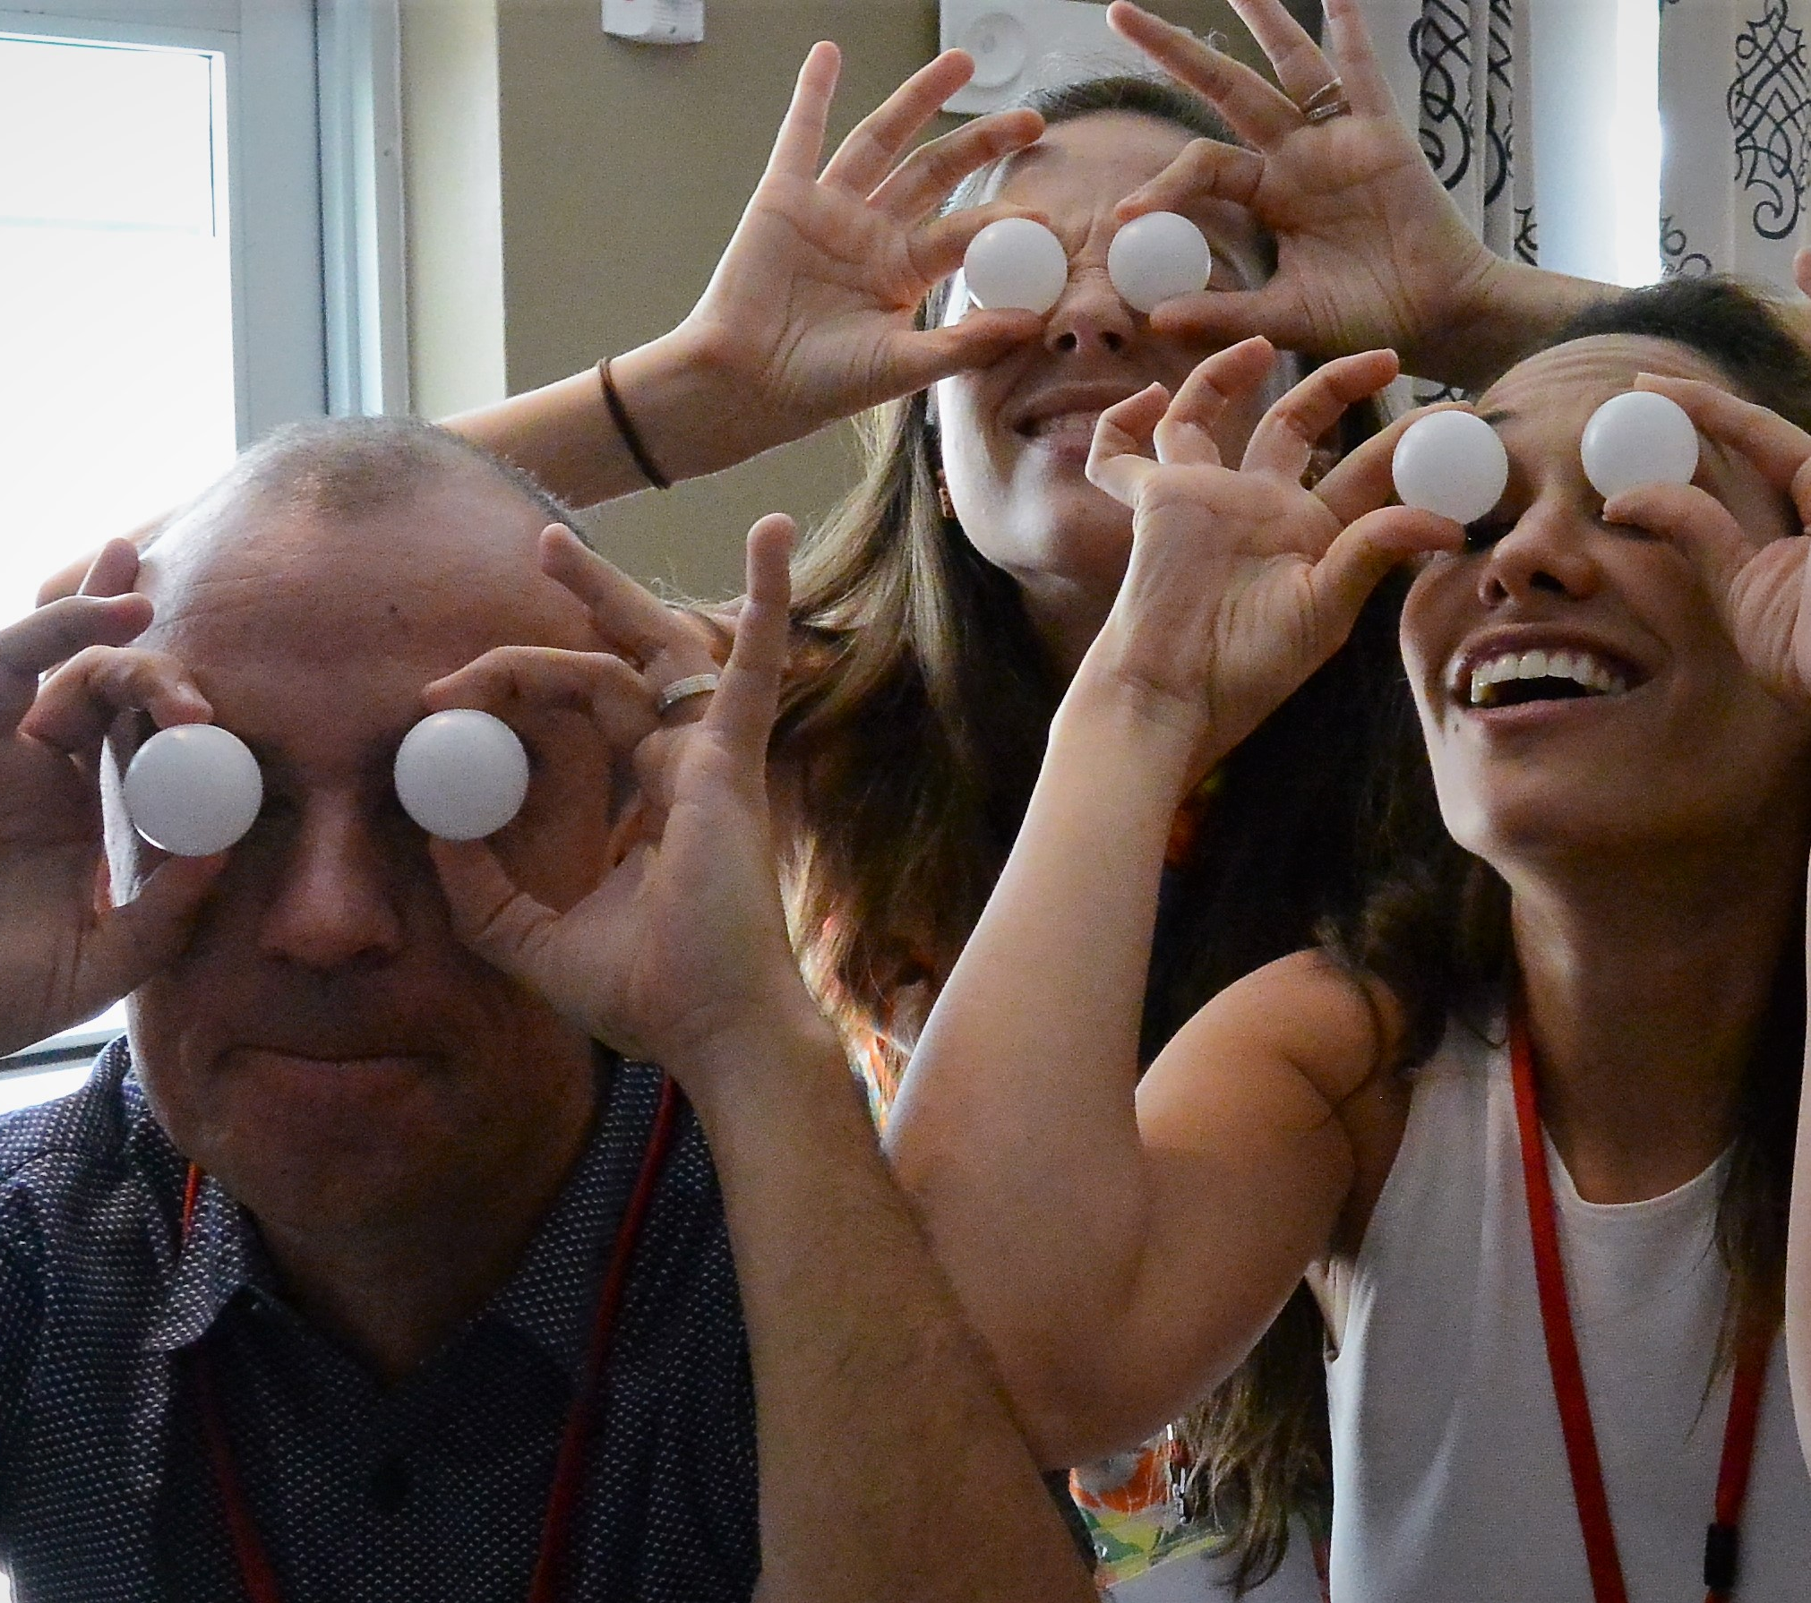
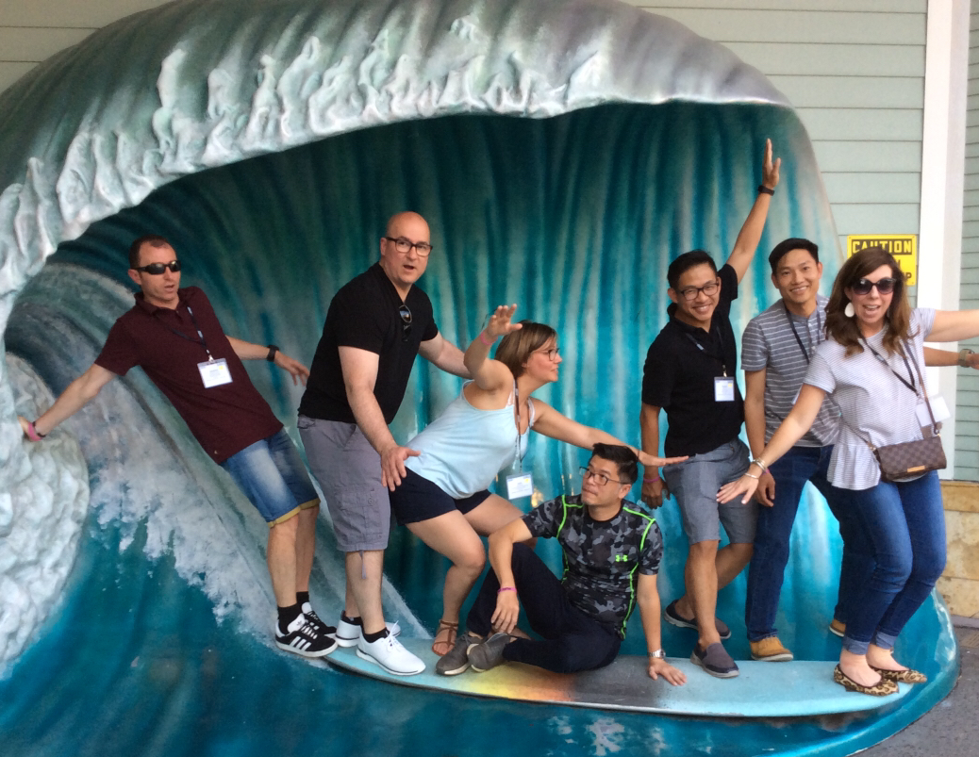
Challenge
60 to
120 min
Players 8 –
Unlimited
Live
Indoor
Outdoor
Introducing the Techno Challenge, an engaging and competitive team event revolutionizing attendee engagement. Using our game app, teams embark on a thrilling showdown through nearly 100 tasks of varying difficulty to create an upbeat and dynamic experience. As teams navigate risks and rewards, the clock ticks and guests step up to confidently tackle challenges.
In this high-energy environment, every direction you look something exciting is happening! You’ll see one corner of the room juggling, another dragon-balling, and another singing a custom team chant! There is never a dull moment when this event is in full motion! The Techno Challenge guarantees laughter, exhilaration, and a strong sense of togetherness as teams bond and individuals discover their strengths and the diverse skills of their group. Trust is built through task completion, fostering a deep appreciation for each team member's abilities.
Intro
90 Minutes
Competition
Awards

