Slide 1
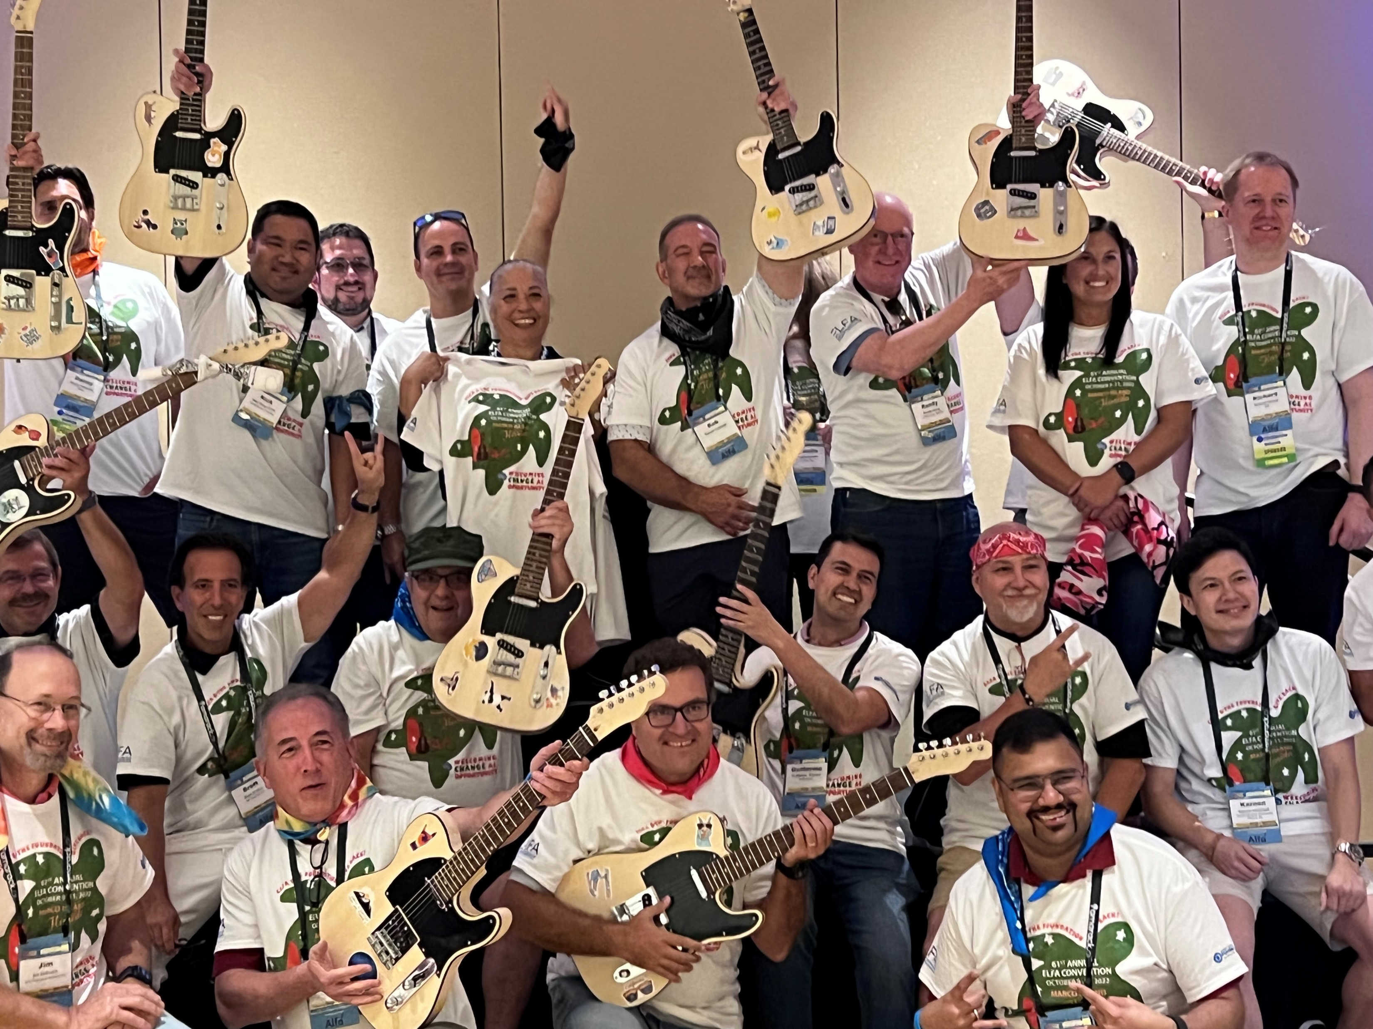
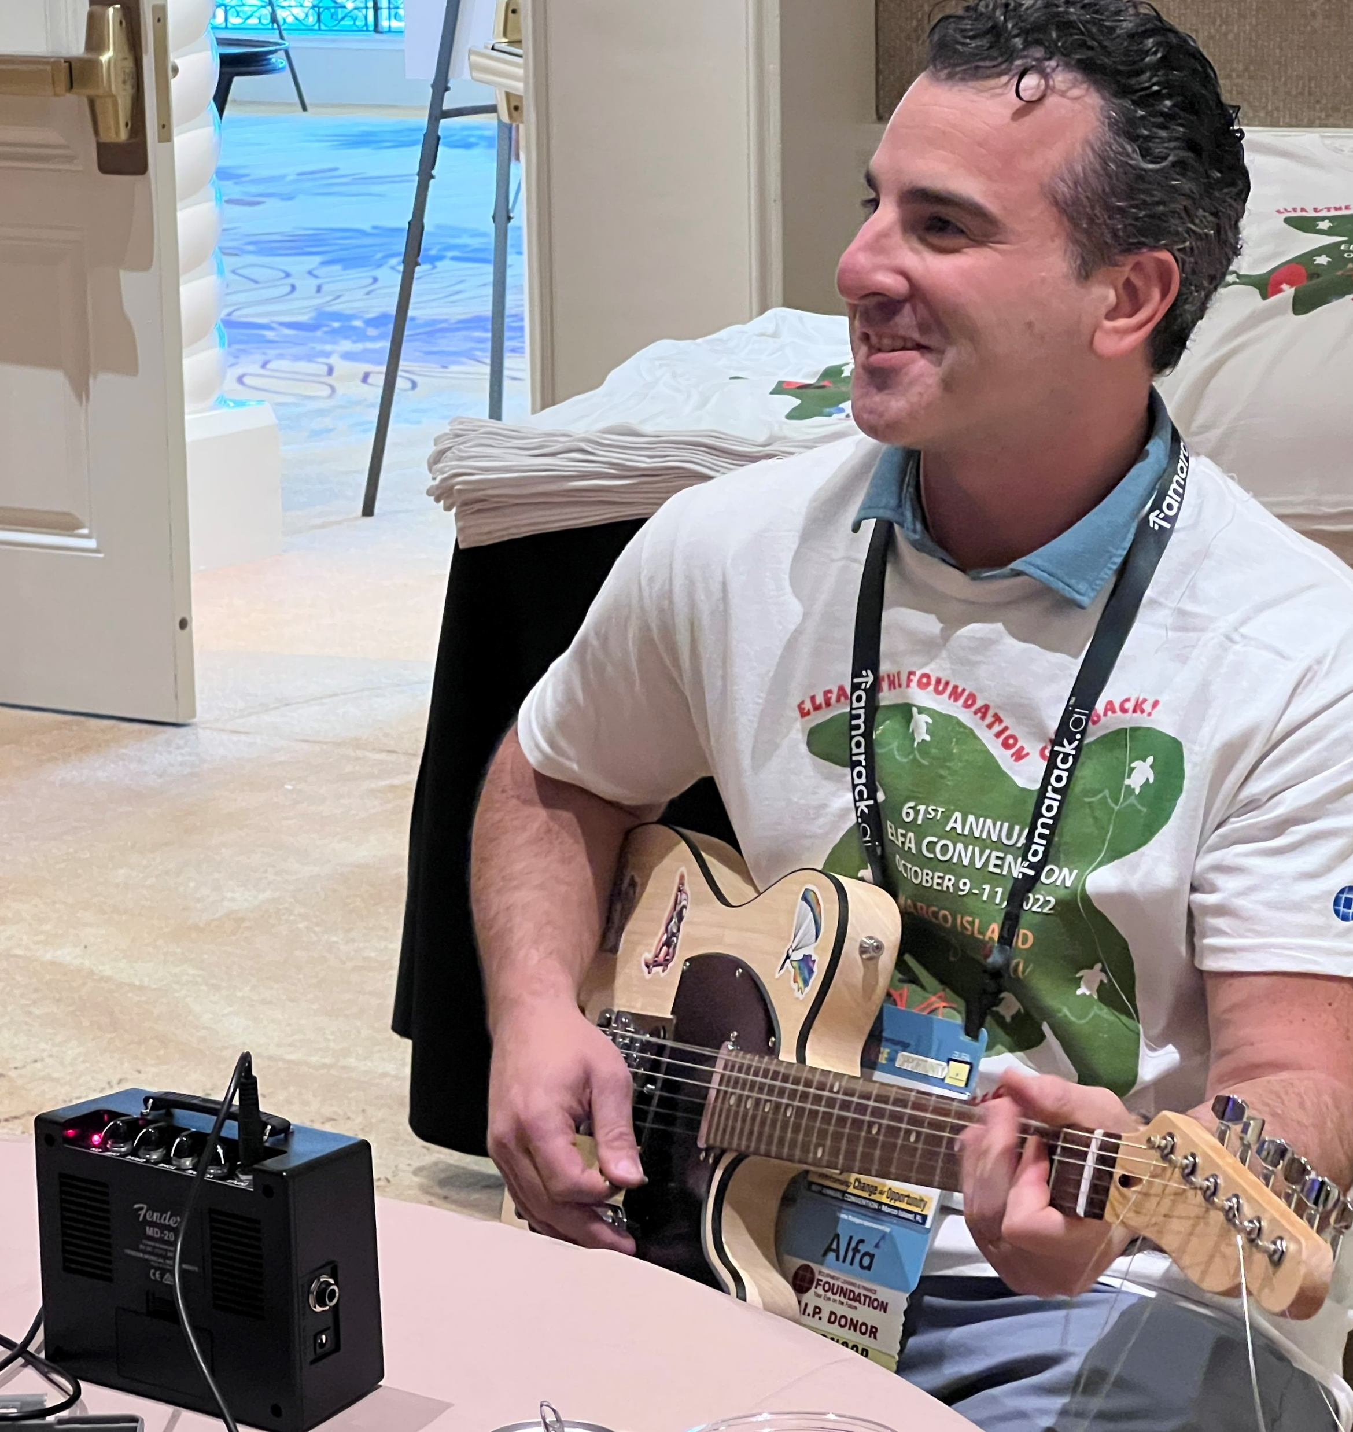
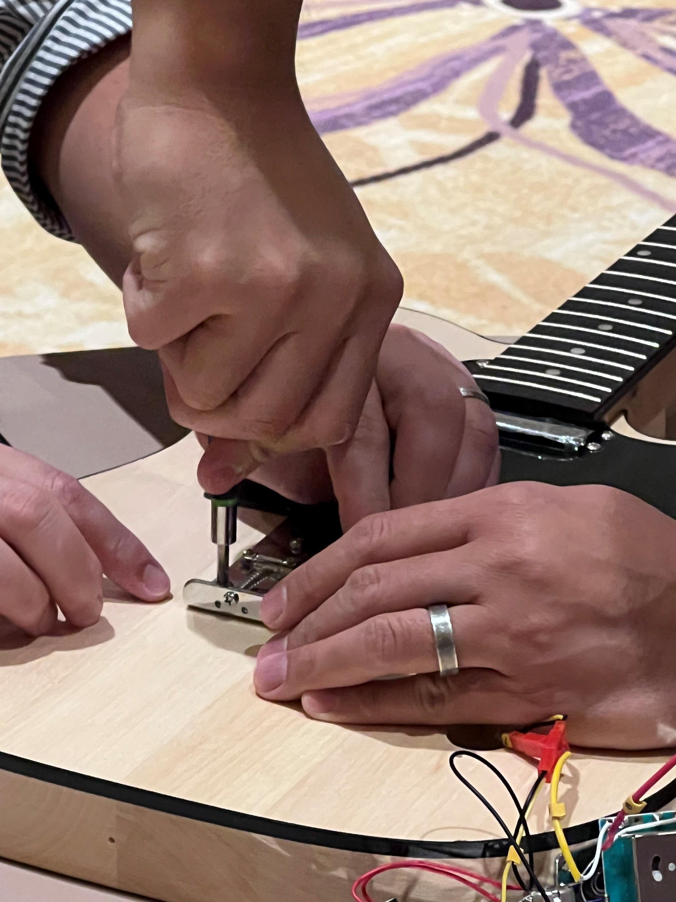
of
ock
Ignite creativity, foster connections, and give the gift of music
60 to
120 min
Players 8 –
Unlimited
Live
Indoor
Outdoor
Intro
The School of Rock Guitar Building Challenge is an engaging and creative teambuilding event that combines music and art. Participants are tasked with building fully functional guitars that will be donated to deserving children, providing them with a pathway to explore their musical talents.
The event fosters child-like qualities such as curiosity, imagination, and problem-solving, while also promoting teamwork and collaboration. With colorful setups, upbeat music, and bonus challenges to earn decorative supplies, this event offers a unique and enjoyable experience that not only strengthens relationships among participants but also leaves a lasting impact on the lives of young musicians.
Icebreaker
90 Minutes
Build &
Challenges
Awards

